Slide 1

BLESSED TO BE A BLESSING
BY DINORAH RIVERA
2018 WOMEN’S MINISTRIES EMPHASIS DAY
GENERAL CONFERENCE
WOMEN’S MINISTRIES DEPARTMENT
Notes:
Sermon: “Blessed to Be a Blessing”

Slide 2
Notes:
The book, The Girl with No Name, tells the fascinating story of Marina Chapman, who faced enormous challenges when she was kidnapped from her home and later abandoned in the jungles of Colombia. At only four or five years of age, Marina lived with—and learned from—capuchin monkeys in the jungle. She learned to eat and act like them. Having no connection with other people, Marina lost the ability to speak as well as her identity as a human being, for she was assuming the family dynamics of the capuchins. Somehow she survived this ordeal.
Five years after being abandoned in the jungle, Marina was “rescued” by hunters who sold her to some unscrupulous individuals in a large city. Used, abused, and impoverished for several more years, Marina was finally and truly rescued by a neighboring family who correctly identified her plight. Sometime later the entire family relocated to England, taking the now adopted Marina with them.
Marina experienced a great blessing when she was rescued by a loving family. Now, instead of learning the ways of small jungle monkeys, Marina could experience, observe, and learn the ways of the truly caring family that had come to her rescue. The blessings which this family brought into Marina’s life eventually equipped her to pass them on to others. Today Marina is the loving wife of a retired scientist, the supportive mother of two adult children, and a doting grandmother to three grandchildren. She used her great blessing to become a blessing to others.
In a sense, Marina’s blessed-to-be-a-blessing story resembles that of many women. Throughout the centuries, nameless women have faced great challenges. Yet those who experienced and identified blessings in their lives, despite their ordeals, emerged from their challenges stronger and with a clearer sense of who they really were.
Of course, the greatest victories are experienced by those who have met Jesus personally and are imitating Him. Since they have gratefully received His blessings into their lives, they now determine how their own blessings can benefit others.

Slide 3
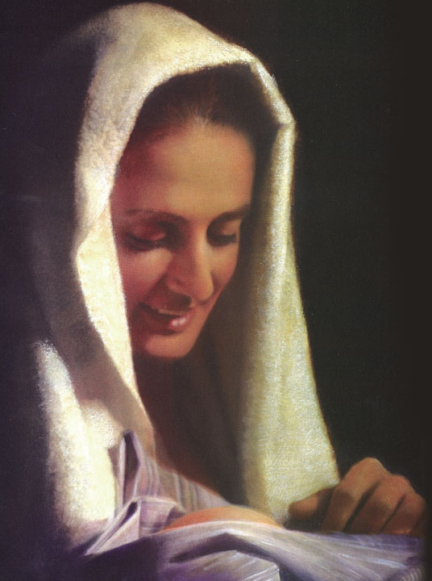
NEW TESTAMENT WOMAN OF BLESSING
According to Luke, an “angel went to her and said, ‘Greetings, you who are highly favored! The Lord is with you.’ Mary was greatly troubled at his words and wondered what kind of greeting this might be.”
(Luke 1:28, 29, NIV)
Notes:
This morning we’re going to look at two women, one from the New Testament and the other from the Old Testament. The lives of these women exemplify the ultimate blessed-to-be-a-blessing experience.
New Testament woman of blessing
The scripture reading for today’s sermon message takes us into the humble abode and heart of a young peasant girl. She had no aspirations to do anything great. In fact, the patriarchal culture in which she was being raised had no great expectations for women—especially for young peasant girls growing up in impoverished circumstances. Yet this young girl, Mary by name, had a deep, trusting, and obedient love for God.
According to Luke, an “angel went to her and said, ‘Greetings, you who are highly favored! The Lord is with you.’ Mary was greatly troubled at his words and wondered what kind of greeting this might be” (Luke 1:28, 29, NIV). What a special moment in young Mary’s life! God was with her and was choosing to bless her in a special way!

Slide 4
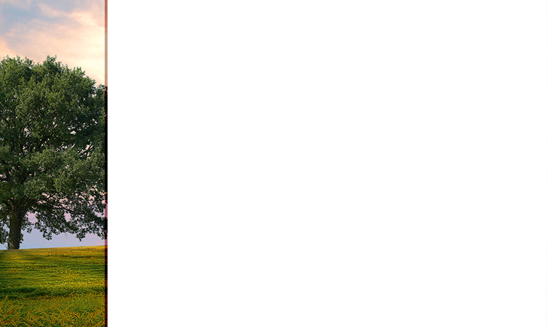
“THE LORD IS WITH YOU; BLESSED ARE YOU AMONG ALL WOMEN”
(Luke 1:28, NKJV, ITALICS SUPPLIED).
Notes:
Let’s notice again the words of the angel. “The Lord is with you; blessed are you among all women” (Luke 1:28, NKJV, italics supplied).
Though astounding to Mary, God Himself had selected her for a special purpose. If not, why would He have sent an angel to tell her of this special blessing? God had chosen her!
Furthermore, we notice that Mary was disturbed by the words of the angel. She was greatly troubled. To me that indicates that she did not expect to be blessed in this manner. She had never suspected that she would be chosen by God—out of all the other young women in Israel—for a most important mission.
Imagine . . . Mary was already engaged to a carpenter by trade. She had probably assumed she would one day be a mother. Yet she had never dreamed she would be the mother of God’s Son!

Slide 5
Mary had to “unlearn” life as she had known it—sort of like Marina Chapman had had to do.
Now Mary had to exercise more faith than ever before so that she could learn what it would mean to be the mother of God on earth.
She knew she would face great difficulties. But did she know if she followed God’s leading, He would use this unexpected blessing in her life to bless countless others?
Notes:
Suddenly—because of this blessing from God—Mary had to “unlearn” life as she had known it—sort of like Marina Chapman had had to do. Now Mary had to exercise more faith than ever before so that she could learn what it would mean to be the mother of God on earth. She knew she would face great difficulties. But did she know if she followed God’s leading, He would use this unexpected blessing in her life to bless countless others?
In any case, God had reserved a unique role for Mary with the ultimate purpose of her becoming a blessing through the blessing He bestowed upon her. Mary was completely submissive to God and His ways.
Would you and I have accepted this blessing from Heaven if we had been in Mary’s shoes? What are we willing to submit to God so that He can use us beyond our most far-reaching thoughts?
Often blessings come with responsibilities and those responsibilities are not always easy to carry. Are you and I willing not only to receive God’s blessings but also to take the risk of carrying them—in His strength—to the point of becoming a blessing to those around us?

Slide 6

MARY’S LEGACY TO US
As we see in the experience of Mary, God will definitely use His blessings in our lives to bless others, even when we can’t clearly see how He is doing so.
Notes:
Mary’s legacy to us
As we see in the experience of Mary, God will definitely use His blessings in our lives to bless others, even when we can’t clearly see how He is doing so. Women—and men—can learn so much from the experience and humble response of Mary to God and His blessings. Mary leaves us a legacy of submission to the will of God—even in the face of great uncertainty.

Slide 7
OLD TESTAMENT WOMAN OF BLESSING
The Shunammite had a spirit of selfless service, as shown through her hospitality to the prophet (2 Kings 4:9, 10).
So here’s a question for each one of us. What act of selfless service—simply because we love God—are we willing to do for Him? These selfless acts may never be listed on the church report list, but they are written on God’s great scroll in heaven.
Notes:
Old Testament woman of blessing
Now let’s look at a woman in the Old Testament who had a blessed-to-be-a-blessing experience. Turn with me to the book of 2 Kings, chapter 4. In verses eight through thirty-seven, we find there a story of another woman. We do not even know her name. Yet God also used her for the purpose of being a blessing to others.
The prophet Elisha referred to this young woman as the Shunammite because she was from the city of Shunem. The Bible does not speak of external beauty, heroic acts, or position. She is identified—as was Mary—as a humble woman who was open to God’s leading in her life. She was also the childless wife of a prosperous farmer.
Let us read the story, starting in verse eight. (USE YOUR BIBLE AND THE TRANSLATION YOU CHOOSE)
What an amazing story! Let’s look at what personal qualities stand out in the character of the Shunammite?
The Shunammite had a spirit of selfless service, as shown through her hospitality to the prophet (verses 9 and 10). This woman wanted to provide a place where the “pastor” could rest when he arrived in her town. She recognized the ministry of Elisha and, without fanfare—and after consulting her husband, offered such a place to Elisha. She did not bring her proposal to the church board so that all would know of her generosity. Her offering of service went unnoticed by man but not by God. So with the consent and help of her husband, she built a private room for Elisha.
So here’s a question for each one of us. What act of selfless service—simply because we love God—are we willing to do for Him? These selfless acts may never be listed on the church report list, but they are written on God’s great scroll in heaven.

Slide 8
THE SHUNAMMITE’S LEGACY TO US
AS WITH MARY, THE EARTHLY MOTHER OF JESUS, THE SHUNAMMITE WOMAN ALSO LEAVES US A LEGACY.
Notes:
AS WITH MARY, THE EARTHLY MOTHER OF JESUS, THE SHUNAMMITE WOMAN ALSO LEAVES US A LEGACY.

Slide 9

1. HOSPITALITY
“Elisha often came to this retreat. God took notice of the woman’s kindness. She had been childless, and now the Lord rewarded her hospitality by the gift of a son.”
(Ellen G. White, Prophets and Kings, p. 237)
Notes:
Hospitality
First, as we have already seen, she leaves us a legacy of service and hospitality. Ellen White comments: “Elisha often came to this retreat. God took notice of the woman’s kindness. She had been childless, and now the Lord rewarded her hospitality by the gift of a son.” (Prophets and Kings, p. 237.3)

Slide 10
2. CONTENTMENT
How many of us have that same spirit? Or we are governed by the desire to have everything that others have—and more? My neighbor has a very expensive car. My car is small and relatively inexpensive. I am content because God has provided for my needs. I can use the blessing of my little car to bless others who need transportation.
Notes:
2. Contentment
Second, she leaves us a legacy of contentment with what she already has. When, by way of gratitude, Elisha offered the woman government intervention, she stated that she was already content with her lot in life.
What would you and I have asked Elisha for, had we had the opportunity? Financial aid? A bigger house or prettier clothes? A high-paying government job or school tuition? But the Shunammite was content in her recognition of what God had provided for her in life.
How many of us have that same spirit? Or we are governed by the desire to have everything that others have—and more? My neighbor has a very expensive car. My car is small and relatively inexpensive. I am content because God has provided for my needs. I can use the blessing of my little car to bless others who need transportation.
Though the size of my house is adequate, my friend recently moved to the city and bought a much larger house with a swimming pool. Yet I cannot be envious because God has provided for my needs. I can use the blessing of my smaller house to bless others who need hospitality and shelter.
Even if my husband has worked for years but isn’t making as much money as workers much younger than he, I do not allow this situation to bring bitterness into my life. God has provided employment for him, and we can use the income we do have as a blessing for our family and our church.

Slide 11
“CONTENTMENT IS NOT HAVING EVERYTHING WE WANT, BUT INSTEAD APPRECIATING EVERYTHING THAT WE HAVE.”
Notes:
Someone once said that “contentment is not having everything we want, but instead appreciating everything that we have.” If we are not happy with the things we already have, we will never be happy with the new things we receive. God cannot bless us with more than we can handle.
For whatever she might have lacked, the Shunammite was rich in gratitude and that “wealth” governed her spirit.

Slide 12
3. PEACE AND TRUST
Not only did she manifest God’s spirit of peace within, but she also offered it to those around her.
Notes:
3. Peace and Trust
Third, the Shunammite leaves us a legacy of peace and trust. Not only did she manifest God’s spirit of peace within, but she also offered it to those around her. Despite the great tragedy in her life and uncertainty surrounding the sudden illness and death of her child, she reassured her husband.
In that moment of quiet anguish and loss, she let her trust in God bring her peace. As a result, God helped her think clearly and take the necessary and confident steps toward getting help.
Do you and I have the same trust and power of God that will bring peace to our hearts as well? Even when sickness and loss knocks at our door? Will we, like this young woman of old, still choose to believe that God is in control?

Slide 13
4. PERSEVERANCE
And as Jesus commended people He healed in New Testament times for their persevering faith, God rewarded the faithful perseverance of the Shunammite.
Notes:
4. Perseverance
Fourth, the Shunammite leaves us a legacy of perseverance. She believed Elisha was a man of God. She trusted that God could work a miracle through the faithful prophet. Faith and hope in God’s power fueled her perseverance. In spirit and proximity, she clung to the prophet Elisha as Jacob had clung to the Angel with Whom he wrestled throughout his darkest night (Genesis 32:22-31). And as Jesus commended people He healed in New Testament times for their persevering faith, God rewarded the faithful perseverance of the Shunammite. Through Elisha He raised her son back to life. The Shunammite knew God loved her.

Slide 14
“We are more than conquerors through him who loved us. For I am convinced that neither death nor life, neither angels nor demons, neither the present nor the future, nor any powers, neither height nor depth, nor anything else in all creation, will be able to separate us from the love of God that is in Christ Jesus our Lord.”
(Romans 8:37-39, NIV)
Notes:
As the apostle Paul wrote centuries later, “We are more than conquerors through him who loved us. For I am convinced that neither death nor life, neither angels nor demons, neither the present nor the future, nor any powers, neither height nor depth, nor anything else in all creation, will be able to separate us from the love of God that is in Christ Jesus our Lord.” (Romans 8:37-39, NIV).
Like the Shunammite, we can have the certainty that nothing that befalls us can separate us from the love of God. God has a purpose for each of our lives. And He pours blessings into our lives. What we do with these blessings and opportunities is our responsibility. One Bible commentary contributor wrote, “Not giving up something we believe in is a sign of determination.” We’ve all been tempted to give up when the going got difficult. Yet each of us must ask God for the determined perseverance of the Shunammite woman. He will answer our prayers!

Slide 15
Right where we are, God chooses us, redeems us, blesses us, and changes us into new creatures in Him. He gives us a new name: daughter of God! Then He equips us—we, who have been so unspeakably blessed—to become a blessing to others. Amazing, incomprehensible grace!
Notes:
Conclusion
As we close, let me remind you of something. As with Marina Chapman being rescued by a loving family . . . as with submissive Mary being chosen to carry in her body the Son of God . . . as with the trusting, determined Shunammite woman who received her son again . . . we too have received blessings from God.
Great blessings!
Amazing blessings!
And now God purposes that we use our blessings from Him to be a blessing to others.
That is what the women in our three stories today have done. Marina continues to bless her own family and inspire others. The death and resurrection power of Mary’s Child, Jesus, continues to save—for eternity—all those who believe on Him. The story of the Shunammite woman is an ongoing testimony of God’s comfort and faithfulness. (Before her death, she even shared her testimony with a king, and God blessed her yet again! See 2 Kings 8:1-6).
Right where we are, God chooses us, redeems us, blesses us, and changes us into new creatures in Him. He gives us a new name: daughter of God! Then He equips us—we, who have been so unspeakably blessed—to become a blessing to others. Amazing, incomprehensible grace!
My friends, I invite you today to accept God’s call on your life. If you have done so already, right now would be the perfect time to renew your commitment to His personal call to you. He will bless your humility, faith, and determination. Furthermore, through each of us, amazing as that seems, God will bless our families, our churches, our communities, and even our nations. His Spirit will be manifest in our lives, and from them will flow abundant blessings of His grace to this dark world.
May God anoint each of us as a chosen vessel to share His love and truth and blessings with everyone around us!
My dear friends, may God bless you!
Let us pray.

