Slide 1
#1 God Loves You
IMPACT IOUC 2025

Slide 3
Religion and love...
“For God so loved the world that He gave His one and only Son, that whoever believes in Him shall not perish but have eternal life.” (John 3:16)
Notes:
Let me welcome you to the first evening of our series of conferences on the theme of the return of Jesus. I thank God for the opportunity to share His Word with you, and especially to speak about the most beautiful promise concerning humanity: Jesus is coming back soon! Before we arrive at this unique, wonderful event, let's take the time to recall the essential lines that allow us to enter into this hope.
If we had to summarize the Bible in one sentence filled with blessings and hope, we would not hesitate to quote the most famous verse: (read the text). The Bible is the only religious book that speaks of God’s love in such a simple and powerful way!
I don’t know about you, but when I read these words or hear someone recite them with passion, I feel that God truly placed hope in His Son. Are you willing tonight to lend an attentive ear to this declaration and perhaps take the path of hope?
(Let us pray together)

Slide 4
Notes:
When you travel and arrive at the airport, whether in Antananarivo, Saint-Denis of Reunion, or Mauritius, you don't want to waste time with formalities. It's the same, of course, in the Seychelles… Especially when they ask for your return date before you have even set foot on local soil. We all want to get through quickly to reach our destination as soon as possible… Like you, I appreciate when an agent waves me over to the counter for border control formalities.

Slide 5
Notes:
Were there any formalities when Jesus first came, and what about His second coming? The Bible proudly and strongly declares that Jesus came down here to save us. Ladies and gentlemen, dear young people who have come this evening, and I thank you in the name of the Lord, I must tell you that we also need to ask when Jesus will return. Both aspects are important, and we cannot appreciate the theme of our conferences if we do not take the time to understand why He came the first time. Understanding the first coming prepares us for the second.

Slide 6
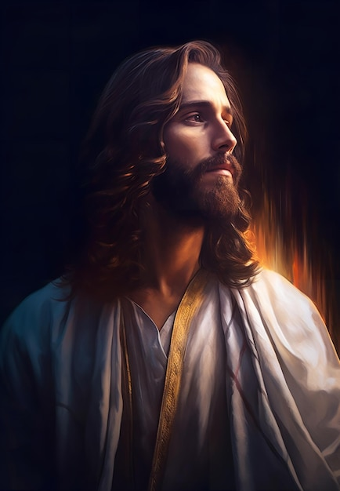
« God did not send His Son into the world to condemn the world, but to save the world through Him. Whoever believes in Him is not condemned, but whoever does not believe stands condemned already because they have not believed in the name of God’s one and only Son”(John 3:17-18)
Notes:
God wants to bring us into His kingdom, but He does not move faster than necessary. He is neither late nor early, but He wants to convince us that what He does, He does well, and He does it for our good. There is no shortcut or bypass to enter God's kingdom. Only one path is possible. (Reading the displayed text). Are you willing to believe in these words, to believe in this message that can radically change your life… Take the time to think about it because it concerns your life!

Slide 7
God Comes to Us
« The one who comes from above is above all; the one who is from the earth belongs to the earth and speaks as one from the earth. The one who comes from heaven is above all. He testifies to what He has seen and heard, but no one accepts His testimony. Whoever has accepted it has certified that God is truthful. For the one whom God has sent speaks the words of God, for God gives the Spirit without measure. The Father loves the Son and has placed everything in His hands. Whoever believes in the Son has eternal life, but whoever rejects the Son will not see life, for God’s wrath remains on them.” (John 3:31-36) »
Notes:
Jesus is presented by biblical writers as an integral part of divinity. Ladies and gentlemen, I can understand that you may have different ideas about Jesus, but by drawing from the biblical narrative, we must accept that all our ideas combined will not outweigh the truth revealed by God Himself. Listen to what John says about Jesus: (reading). God personally came to save us, to tell us that true life is possible through Jesus. Accepting Jesus, believing that He is the true envoy of God for salvation, allows for a new beginning and also offers hope.

Slide 8
Understanding Love
Notes:
Whether in English, Creole, Malagasy, French, or Mahorais, talking about love always warms the heart. We cannot imagine our world going 24 hours without expressions of love.
The Bible also speaks of love. But this word can take on different meanings depending on how we use it.
It is common to talk about love. Almost everyone thinks they can and know how to talk about it, right? In some languages, particularly French, the verb "to love" is present in all contexts. In our beautiful language, we love our relatives, our pets, eating cherries or mangoes, hiking, or surfing the Internet…
How can we speak of love? How do we express love from the moment a person meets Jesus Christ?

Slide 9
- Agapaô refers to deliberate, responsible, and chosen love. It is love that comes from a clear mind, capable of discernment and filled with good sense.
- Erao is passionate, intense love, strongly sensual, and even consuming. This dimension can range from patriotism to eroticism and sexual love.
- Storgeô (only found as *astorgos*) refers to natural love, familial love—essentially, love inherent to human nature.
- Phileô represents attachment and affection in an emotional sense. It signifies a personal affection, often a passion for something, such as love for friends.
Notes:
The noun commonly used by John to evoke love is *agapè*, a term well known to Christ's disciples, especially after two millennia of Christianity. The verb related to it comes from the same root *agapaô* and means not only "to love" but also "to esteem," "to cherish," "to favor," "to honor," "to respect," "to accept," "to value," "to be devoted to," etc. In Greek, *agapaô* is in tension (competing) with three other verbs that express relational dimensions. Let’s explore this briefly:

Slide 10
When the Bible Speaks About Love...
God's love for Christ ;
. God's love for humanity;
Man's love for God;
Man's love for his fellow beings.
Notes:
The term "love" certainly requires a definition; however, the issue is not so much in explaining it but in applying it. Speaking of love in the Bible places man in a relational dimension. Thus, we can observe four areas where love applies:

Slide 11
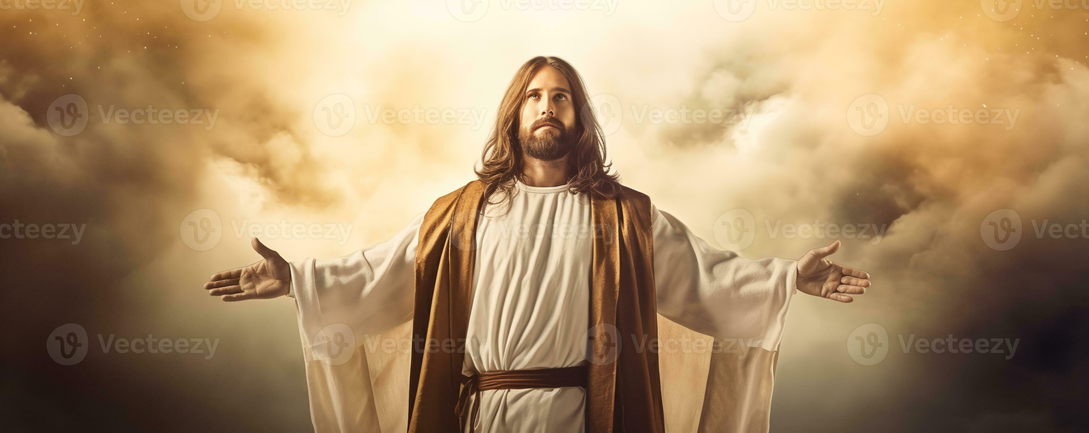
Notes:
Love is undoubtedly the criterion for evaluating our relationship with others—first with God, then with our neighbors. Love is a profound transformative power that enables us to develop cordial relationships around us. Such an experience involves solid and honorable relationships with one’s spouse, children, parents, neighbors, colleagues, or members of the same church...
It is very likely that the biblical man understood that every fulfilling and constructive relationship with one's neighbor finds its true purpose when it is measured by the faith and love of God.

Slide 12
Love for God
« Hear, O Israel: The Lord our God, the Lord is one. Love the Lord your God with all your heart and with all your soul and with all your strength. (Deuteronomy 6:4-5)
Notes:
But the Good News for us is this: It is God's love that teaches us to love! (Read Deut. 6:4-5)
This is the first way to produce the spiritual fruit named love. The Christian experience becomes valid and meaningful from the moment it resembles a response of man's love in the face of God's love. The *Shema* Israel (*Shema* in Hebrew means "listen") is the foundation of the covenant people's creed. It is interesting to note that Israel's creed begins with a relational dimension. Accepting God as the only God, the only Lord, the only Master of the universe is the first step toward recognizing the other, confirming the transformation that takes place when the believer allows themselves to be guided by the Spirit. Should we summarize moral norms by bringing them back to their strictest meaning—that is, love? Yes, I say love, not obedience, the first prejudice often induced by the notion of law. The reflection on moral law brings us to a significant conclusion: the law speaks of love more than of obedience.

Slide 13
Notes:
The spiritual experience proposed by the Bible is built on the acceptance of one God, thus initiating the first step on the path of faithful love. The analogy with the marital bond is very strong, as it is about telling the divine Other that He is the only one in our heart, just as we ideally and sincerely declare that our spouse is the only loved being in intimacy and respect. It is not easy to devote oneself to a unique relationship, especially when competition is possible. Because there are difficulties, the commandment of love (paradoxical, isn’t it?) says that we must love with all our heart, with all our strength, and with all our mind.

Slide 14
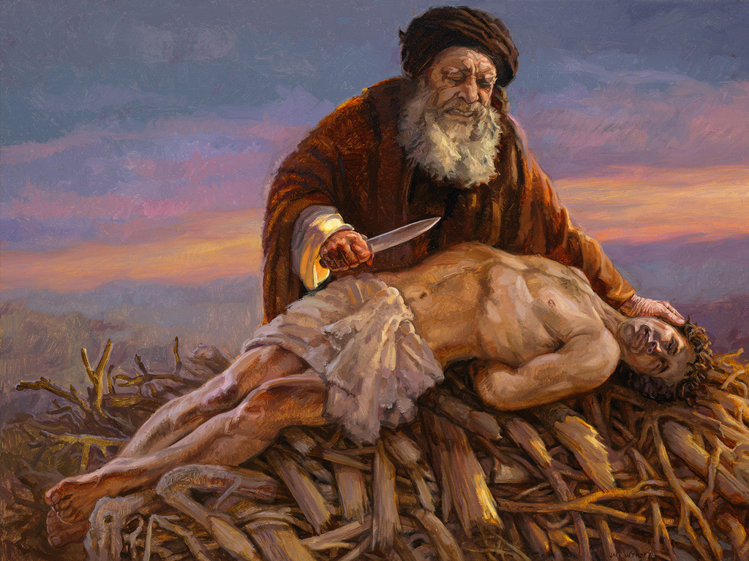
Notes:
Our love for God does not rest simply on the notion of faith. It also requires courage and a persevering will to accept divine love: courage in the face of doubts, questions, and even His silences. A persevering will is essential because love becomes possible when one is willing to express it... consistently. It is not always easy to love and believe that one is loved by others, especially when life's challenges hit us, and we feel alone, even doubting the attention that God might give to our situation.

Slide 15
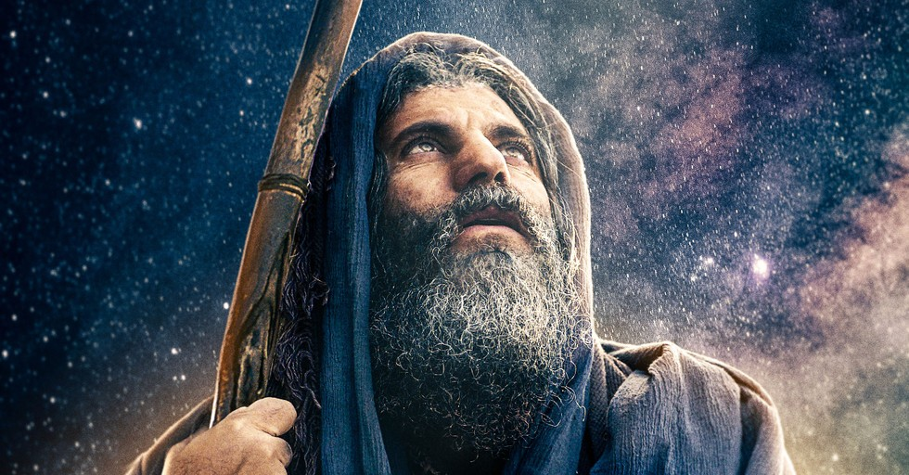
Notes:
The believer discovers that the covenant God offers is one of love, protection, and security. Humanity is not called to serve God merely as witnesses of truth but as members of His family. Entering the covenant means entering love, a trusting love. One enters the covenant with the opportunity to love God (according to one’s abilities, of course) and the privilege of learning to love as God loves humanity. Love for God represents the first part of the fruit of the Spirit, at least in its vertical dimension. It is necessary to speak of verticality since we will now look at love in its horizontal aspect.

Slide 16
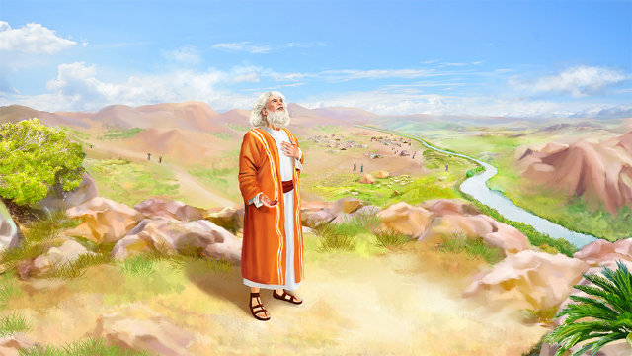
Notes:
This love for God becomes possible because God loved us first. Without God's love, we would never know what it means to "love"! Moreover, this love does not simply provide us with a sense of satisfaction from being loved. God's love becomes our strength and courage in the face of the challenges inherent to the human condition.
"Without God's love, we would not know how to love. Because He has placed His love in our hearts, He has the power to transform it into the ability into the capacity to love." (1 John 4:19)

Slide 17
Can We Respond to God's Love?
Notes:
There is no hope without God's love for us as humans. To believe that Jesus is coming back is to believe that God loves us and wants to see us in His kingdom.
How will you respond to God's invitation tonight? Will you go home in the same state of mind you came with? Let me suggest the following: simply make the commitment to think about the opportunity Jesus is offering you tonight to come to Him and have eternal life. It is a gift only accessible through faith.
Jesus wants to speak to you. In His time, there were also hesitant people, or others who had so many theories or so much knowledge that they couldn’t discern the truth He embodied. Do not dismiss any idea before understanding that God loves you.

Slide 18
«And the Father who sent me has himself testified about me. You have never heard his voice, nor seen his form, and his word does not dwell in you, because you do not believe in the one he sent. You study the Scriptures diligently because you think that in them you have eternal life. These are the very Scriptures that testify about me, yet you refuse to come to me to have life!" (John 5:37-39) »
Notes:
You probably have questions about God’s love for you. Some people do not wonder if God loves them or if they too can love God; they simply believe that God exists and that he is far from us. Others think that it is enough to believe in God, respect him, and pray every day without asking too many questions, because too much analysis paralyzes... There is probably someone here who has already wondered if God really loves them, especially when they found themselves in difficult, unpleasant, almost unbearable situations.
The Bible helps us understand that God's love is unconditional and should not be tied to difficulties or evil. Tomorrow evening, we will talk about the origin of evil on our planet, and we will gain a clearer understanding of the connection between love and troubles. As for our topic tonight, I simply want to draw your attention to the expression of God's love for you and me, and this love was manifested in Jesus.

Slide 19
"Bless the Lord at all times; His praise will always be on my lips. My soul will boast in the Lord; let the afflicted hear and rejoice. Glorify the Lord with me; let us exalt His name together!" (Psalm 34:2-4)
Notes:
How then can we express our gratitude even when things go wrong on our planet? Listen or read with me some of the declarations from biblical figures about showing gratitude to God despite problems:

Slide 20
God is our refuge and strength, an ever-present help in trouble. Therefore, we will not fear, though the earth gives way and the mountains fall into the heart of the sea, though its waters roar and foam and the mountains quake with their surging." (Psalm 46:2-4)
Notes:
What do we notice, dear friends? What do we understand from the language used by the psalmists? I see that the testimony given here is done with full awareness of the present difficulties on the planet. In other words, even if life on earth faces numerous challenges, faith is possible; personal and spiritual growth with God is possible.
Know that faith is not the denial of reality but its transcendence. Faith does not lead us to ignore obstacles, problems, illness, failures, or other discouraging situations. Faith becomes trust and can also be called "love." That is the true secret of faith: to love!

Slide 21
Love for One's Neighbor
« You shall love your neighbor as yourself. I am the Lord. (Leviticus 19:18). »
Notes:
By learning to love God, humanity learns to love its neighbor! (Read Lev. 19:18). The spiritual experience inevitably involves love for one’s neighbor. The Bible is clear about our relationships with others. Jesus emphasizes this theme because the application of the gospel message finds its full meaning there. The subject interests us because loving one's neighbor must not be a beautiful theory. It concerns us since Jesus gave guidance on relational matters and communicated His vision of love for one’s neighbor through the parable of the Good Samaritan, which has become proverbial in collective memory (Luke 10:25-37).

Slide 22
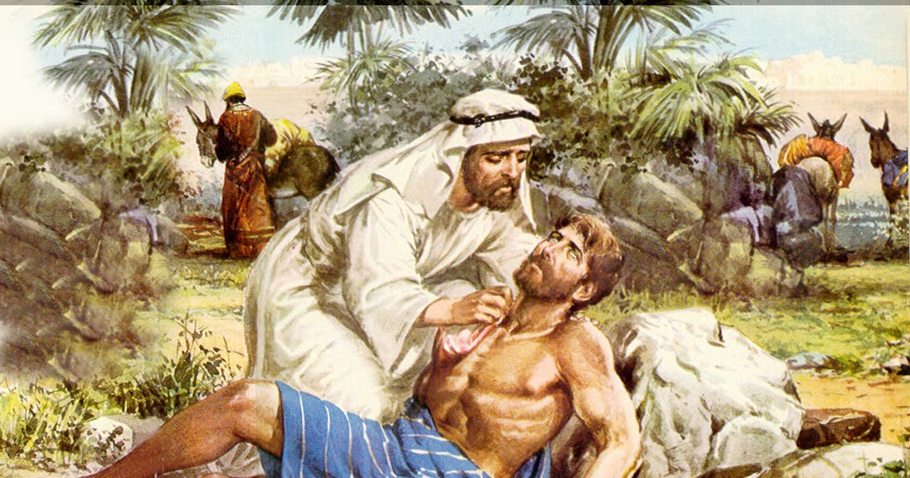
Notes:
This story is one of the most beautiful lessons on loving others, no matter who they are! A neighbor has no face, name, culture, or even address. To love one’s neighbor, it is not necessary to ask for their papers, socio-professional category, or even their religion if they have one. If we only love those from our cultural, economic, or familial circle, it’s interesting, but we are off-center from the love of a neighbor. If we understand well what Jesus teaches, the neighbor comes from nowhere and goes where destiny leads. The neighbor is a friend of God, one of the least of Christ's brothers. Jesus also illustrates this in another parable—the "Parable of the Sheep and the Goats."
The Lord wants to lead us there. He proposes a pedagogy of love that shows no preference, a love for one’s neighbor expressed to every man, woman, young person, or child whom life places in our path. By exercising love for our neighbor, we learn to love the Lord Himself.
Matthew 25.34-40.

Slide 23
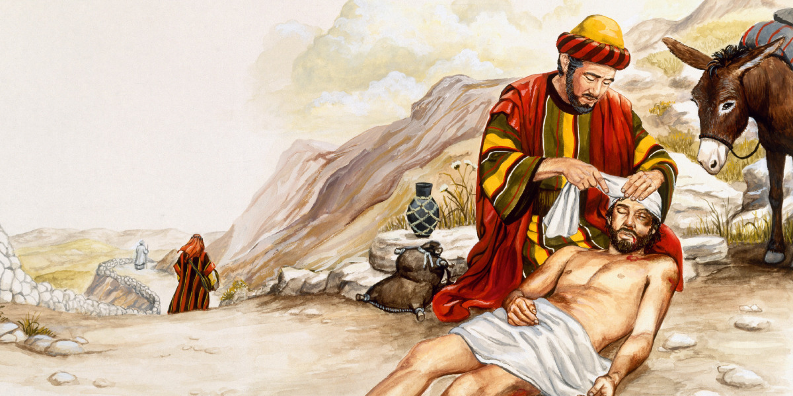
Notes:
Such love is only possible if we have self-esteem. Self-esteem is not pride or arrogance as long as it does not turn into egocentrism. Love for oneself becomes the measure of our love for others. We cannot love our neighbor if we have a poor opinion of ourselves, if we spend our time believing that we are incapable, worthless, or insignificant, and so on. The Christian, whom Jesus commands to love their neighbor, must not forget that they are redeemed by God, adopted as a child of the Heavenly Father, and are on a path of hope.
The neighbor is the one who receives our friendship and help whenever the opportunity arises, whenever it is beneficial for them, even if it is not rewarding for us. This is not about a kindness or generosity that is publicized or praised. It is rather about the ability to help others, whoever they may be, without ulterior motives or unfavorable prejudice. The neighbor, often a stranger to our daily lives, is the friend we have not yet had the time to know or appreciate. Moreover, the fruit of the Spirit becomes the visible sign of our ability to reach out to others… that is, to our fellow human beings.

Slide 24
Love your neighbor as yourself is learning to love God Who became man, that is, our neighbor. Loving your neighbor is seeking the presence of God in humanity. But God Wants to teach us so that we may under.

Slide 25
Love for Enemies…
« But I tell you, love your enemies and pray for those who persecute you." (Matthew 5:44)
Notes:
Difficult does not mean impossible! (Read the verse…). Isn’t it too much to ask of people? I have often heard that Jesus "sets the bar a little high," as we commonly say. But the fact remains that He said it.
Jesus implies that every person needs support and that interdependence is the best chance for social man, but with Jesus, we discover that the man of faith is equally concerned. Jesus knows it’s a real challenge to manage emotions, especially since human relationships are never static.
Returning to Christ’s exhortation, let’s address the connection implied by hatred, which is more burdensome. Jesus calls upon the hardest and darkest part of our hearts because he undoubtedly wants to see us exercise an intelligent and constructive faith, not a sectarian faith locked in religious self-centeredness, with pious wishes and a faith full of appearances. He pushes us to go beyond ourselves, encouraging us to reflect as deeply as possible on love, even where, with people who might seem agreeable, no one would expect it.

Slide 26
« "You have heard that it was said, 'Love your neighbor and hate your enemy.' But I tell you, love your enemies and bless those who curse you, do good to those who hate you, and pray for those who mistreat and persecute you, that you may be children of your Father in heaven. He causes his sun to rise on the evil and the good, and sends rain on the righteous and the unrighteous. If you love those who love you, what reward will you get? Are not even the tax collectors doing that? And if you greet only your brothers, what are you doing more than others? Do not even pagans do that? Be perfect, therefore, as your heavenly Father is perfect." (Matthew 5:43-48) »
Notes:
He leads us onto the ground of our adversaries, our enemies, those who are aggressive towards us, those who do not like us and make it clear, those who exclude us because they feel threatened by our person or personality. Jesus gives an expansive commentary on the law, which he transforms into an ideal: (read the biblical text)

Slide 27
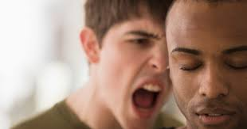
Notes:
Jesus refers here to a command given by God in the Old Testament. The enemy can be someone we have chosen to designate as such or someone who positions themselves as such. It is important, however, not to confuse difference with enmity. In a debate, for instance, someone may disagree with us on a number of ideas, on a method of work, or on an approach to common or unusual problems, but that does not make that person an enemy.
Living out this aspect of love is never easy, let’s admit it. It becomes complicated and strange when people let their emotions cloud their reason. We do not want to oppose reason to emotions here, but simply state that the emotional element often prevents us from reasoning clearly. We are so different from one another, due to our cultural, social backgrounds, our education or upbringing, but nothing prevents us from sharing moments of fellowship, sporting activities, and other leisure pursuits. Differences in opinion, work methods, or even responsibilities within the same organization, or even within the same church, should never create relational or emotional barriers.

Slide 28
Notes:
The believer is encouraged to show fraternal love towards those who disagree with them despite differences in ideas, working methods, decisions, or actions. To love in this context, one must live without any complexes, without pride or arrogance. It means learning to give character and quality to the verb "to love"!
The Lord asks us to love our enemies just as He asks us to love our neighbor. In short, He asks us to love everyone—to hold no hatred for anyone, to live without negative emotions, bitterness, or a vengeful spirit. He does not ask us to expose ourselves unnecessarily or live naively in the face of evil, pettiness, or aggression. He asks all who decide to be His disciples to conjugate the verb "to love" without bias, prejudice, segregation, barriers, or hierarchically categorizing people. He asks us to love friends and enemies alike because that is how we bear fruit for His glory.

Slide 29
Notes:
Let’s not forget that the Holy Spirit is preparing us to share eternity with those we meet on earth. We do not know who we will see on the new earth. Therefore, it is necessary to learn in this present life to love our fellow beings—friends or enemies—because salvation is offered to all humanity. We should not think that only our friends will be in God’s kingdom. We do not know how our enemies and persecutors will respond to God’s invitation. We do not know who will be saved, who will eventually accept Jesus as Savior and Lord.
Furthermore, by loving those who hate us, we bear witness to the power of love in the face of hatred and malice. Many people have experienced a life change because they could not resist the love shown by those they once persecuted. God’s grace is a “saving power” (Titus 2:11), and we must never doubt God’s work in the human heart. If Jesus asks us to love those we believe are rooted in evil, it is because He died for them as well. To them, too, the Lord extends a hand, and it is very likely that Christians are the most visible sign of God’s presence and action on their behalf. If God has opened the way to heaven for us, we must remember that He does so for every human being in whom He has placed the capacity to believe in Him.

Slide 30
« And you who were once alienated and enemies in your mind by wicked works, yet now He has reconciled you by His death in His physical body, to present you holy, blameless, and above reproach in His sight, if indeed you continue in the faith, grounded and steadfast, and are not moved away from the hope of the gospel which you heard, which was preached to every creature under heaven... (Colossians 1:21-23) »
Notes:
The apostle Paul understood this well. He states it when speaking to the Christians in Colossae: (read the text on the screen).

Slide 31
If You Love Me…
« If you love me, keep my commandments.” (John 14:15) ».
Notes:
Love needs rules, and remember this idea: it is not enough to break the thermometer to make the fever disappear!
Jesus says to His disciples: (read the displayed verse). And He is not only speaking about the new commandment that many Christians refer to. It is certain that He places Himself in the moral perspective opened by the Ten Commandments or the Ten Words (Exodus 20:1-17), as the unique character of these commandments shows the special bond God wanted to develop with His people.
The Christian who loves God is called to keep His commandments, and it is not something difficult that the Lord proposes. Love is verified in the quality the Christian is willing to give to the commitment that binds them to God. The two axes recalled by Jesus concern God and one’s neighbor. He even went further by including the enemy. However, in the Decalogue, God gives exclusive orientation to the covenant with His people, showing that He desires a serious, faithful, constant, and respectful relationship with the honor and dignity of all involved.

Slide 32
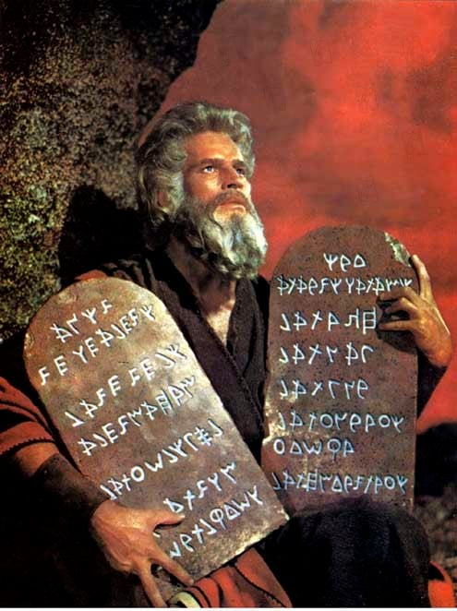
The Ten Words Reveal These Requirements:
- One God;
- One worship;
- One unique Name;
- One unique day;
- Respect for parents;
- Respect for life;
- Respect for sexuality;
- Respect for others’ property;
- Respect for honor;
- Respect for emotional and material boundaries.

Slide 33
Notes:
If love is the fulfillment of the moral law, then the law is important. If the law expresses divine grace, it has its place in the covenant between God and man. Covenant implies what is distinct, visible, autonomous, separated, and valued. Grace does not diminish the importance of the commandments. Grace saves, certainly, but it also sets in motion and produces testimony of divine love. This fidelity is based on ethics, and the moral law remains as a mirror to help us correct the way we walk in faith and hope.
What disappears with Christ's coming is that which has no direct consequence on our present life in relation to God and to others. What becomes obsolete is what no longer concerns our need for justification or atonement, both theoretically and practically, as outlined in the Old Testament. On the other hand, what must be considered is everything that gives a new identity and structures the believer’s life in the world. What is no longer necessary as a principle or structuring element in the covenant is abolished by the person and mission of Jesus.

Slide 34
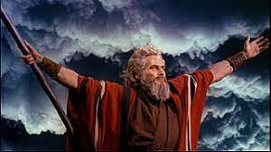
Notes:
Paul explains that the law has a pedagogical dimension when it helps organize the moral life of God's people. Among the Greeks and Romans, the "pedagogue" (often a slave) was responsible for educating and caring for the young boy until he reached adulthood. Does this mean the pedagogue is no longer important? Thus, the law and grace hold significance and interest for believers because both express the divine character. The law demonstrates God's justice, while grace reflects His love. The biblical perspective reconciles these two entities by teaching that God is both a God of love and a God of justice. In Christ, we observe that God’s love takes precedence for our benefit, but it does not eliminate His justice towards sin. Speaking of God's grace while upholding the duty to observe the commandments is like talking about the freedom to drive while adhering to traffic laws.
(Galatians 3:23).

Slide 35
Notes:
The surest and most visible indicator of our love for the Lord is found in observing His commandments. The law itself does not degrade humanity; it aims to help define the parameters of our understanding of others—both with God and our fellow beings. The law is structuring when it does not prevent the believer from encountering God's grace, which rehabilitates the sinner, lifts them up, and restores them in the rights of redemption.
It is not enough to break the mirror to say there is nothing to change about our physical appearance… Refusing to accept the truth about oneself is likely the shortest path to failure. It is a conscious refusal to progress and take on certain responsibilities. The law helps us adjust how we advance under the guidance of the Spirit.

Slide 36
Conclusion…
Notes:
This is where Jesus wants to lead you tonight: to believe that the Bible tells the truth and that He alone can lead you to God and, above all, offer you eternal life. Of course, such a thing does not happen automatically. Neither with a snap of the fingers nor with a smile or a sigh.
Would you like to make room for God's love in your life? Would you simply reflect on it if you are not ready to answer the question right away? Furthermore, if you have so far only accepted God's love for you, would you seriously and thoughtfully consider the possibility for you, too, to love God—and, by extension, also think of your neighbor?
The theme of our conferences directs attention to the return of Jesus. I invite you to think about it, but I especially want to encourage you to live right now in God’s love for you and in the expression of your love for God as you wait for Jesus’ return.

