Slide 1
#2 Storm in Paradise...

Slide 2
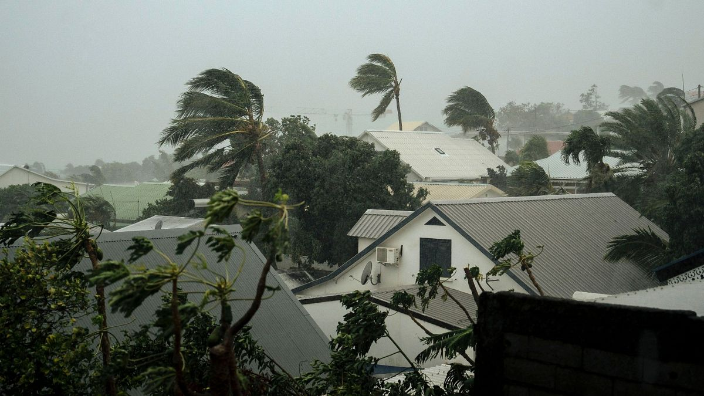
Notes:
In the French overseas territories, there are cyclone alert codes. For example, on the island of Réunion, the classifications are as follows:
Cyclone Pre-Alert: The population is advised to stay vigilant as a potential threat is present on the island and may persist over the coming days.
Cyclone Yellow Pre-Alert.
Cyclone Orange Alert.
Cyclone Red Alert.
Cyclone Purple Alert.
When there is a “purple” alert, the danger level is very high, and no movement is allowed within the territory.

Slide 3
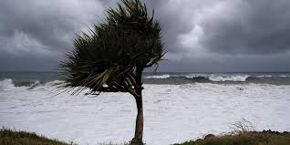
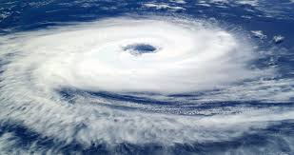
Notes:
In the Garden of Eden, there is an alert: “You may eat from any tree in the garden, but from the tree of the knowledge of good and evil, you shall not eat. For the day you eat from it, you will surely die.” (Genesis 2:16) This tree is not a temptation set by God, especially since in verse 9, it is said that “God caused every tree that is pleasing to the sight and good for food to grow from the ground.”
No one likes disorder, especially when it brings shame and dishonor.
In every country, someone has wondered about the origin of evil. In every culture, there are traditions, and thus in the Indian Ocean countries as well, stories and legends are plentiful. However, in the context of our conferences, let us see what the Bible tells us about the origin of evil. (But before we do, let me pray…)

Slide 4
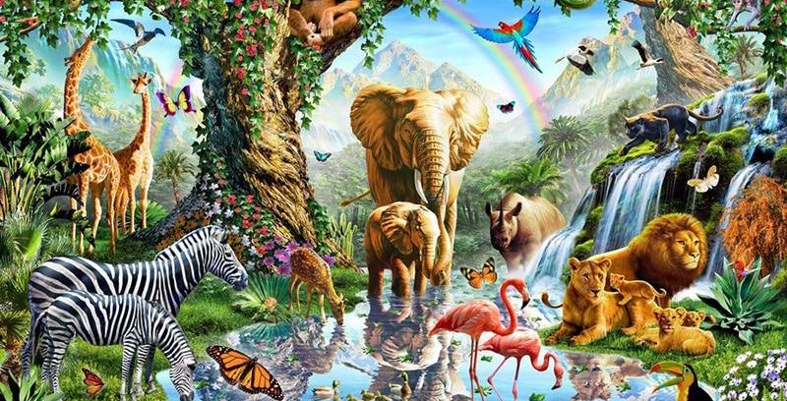
Notes:
The first words that man hears about himself come from God, and it is a word of blessing and responsibility: “God said to them, ‘Be fruitful and multiply, fill the earth and subdue it; have dominion over the fish of the sea, the birds of the air, and over every living thing that moves on the earth.’” (Genesis 1:28)
A little further on, Genesis 2:25 provides a detail about the physical state of the first representatives of humanity: they were “naked” – arumim – and they felt no shame!
“And they were both naked, the man and his wife, and were not ashamed.” (literal translation). Immediately following is Genesis 3:1, which highlights the “nakedness” or “craftiness” – arum – of the serpent!

Slide 5
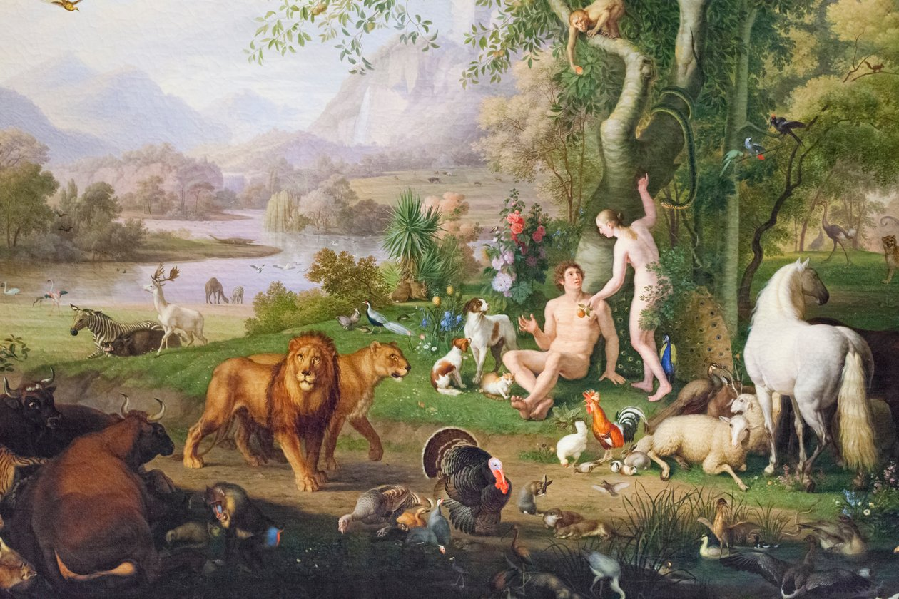
Notes:
“And the serpent was more crafty than any beast of the field which the Lord God had made.” Note the connection between the “naked” man, without shame or embarrassment, and the “naked” serpent, without any moral or ethical connotation. It simply states that its nakedness is peculiar among all the animals of the field. Most translations interpret the serpent’s nakedness as “craftiness.” It also feels no shame in being what it is, whether through cunning, malice, guile, hypocrisy, or deceit... Is this a hint or a warning to the reader? The continuation of the story provides the answer…
The text structure suggests that humans and animals lived in a happy balance, without fear or shame, in peaceful coexistence, with creation functioning in optimal conditions. The problem would arise later with the interpretation of God’s word, which would disrupt this situation.

Slide 6
Notes:
This first command explicitly instructs man to have dominion over animals, including the serpent. The narrative is structured to show, on one hand, the transition from one word to another, and on the other hand, the shift from one situation to another. Additionally, the human couple receives specific guidance on their diet and that of the animals (Genesis 1:29-30 and 2:16-17). The rule concerning the tree of the knowledge of good and evil carries a punishment—death—but this punishment should be seen more as a logical consequence than as a divine desire to bring about human death. God does not set traps for man, nor does He push him toward sin or death. In fact, any attentive observer would wonder why God would create something He would later want to see turn into chaos, suffering, and death, especially as He is the Creator, the God of life...

Slide 7
Storm Warning
A word for intimacy
(« For this reason, a man shall leave his father and mother and be joined to his wife, and they shall become one flesh." (Genesis 2:24). »
Notes:
Another word outlines the future of humanity. It involves a different kind of detachment (Genesis 2:24), this time from father and mother, to bond with the wife. The true meaning of this bond is the union of two individuals into “one flesh.” The future is only possible when there is this detachment, this emancipation. To fully live the marital bond, one must know how to detach. This command is pronounced with a dual purpose: man and woman are called to form a solid union, and from this union, they will produce a single flesh, identifiable in their offspring.
Such a command has a prophetic resonance because it shapes the emotional future of humanity. The parental couple is the first threat to a man who wants to cling to his wife. Thus, man must decide to leave his father and mother to unite with his wife. Here too, man is called to prudence and respect, which requires him to clearly define the boundaries of his intimacy. Detachment does not mean eliminating all relationship with parents, but rather developing a structured relationship.
In this context, many issues arise within the family environment, because relationships with parents are not always managed with clarity and objectivity. It is true that we are rarely objective when it comes to our parents, but if the Bible advocates such a process, it is not to induce relational problems within families, but rather to avoid them. This is a precautionary principle. Detaching from parents does not mean removing them from our hearts, not loving them, or failing to care for them. Detachment means that the newlyweds are now adults and must take responsibility for life and its many challenges.
Considering what is stated in 3:15, we discover that another prophetic word is pronounced over humanity: a word of grace, of return, a word of restoration, even of vengeance. The text says: “And I will put enmity between you and the woman, and between your seed and her seed; He shall bruise your head, and you shall bruise His heel.” This word already announces that the woman’s offspring will be involved in the divine plan and, consequently, will be caught in the conflict between good and evil. This word is rooted in human time and space, where one must expect both happy and unhappy moments.

Slide 8
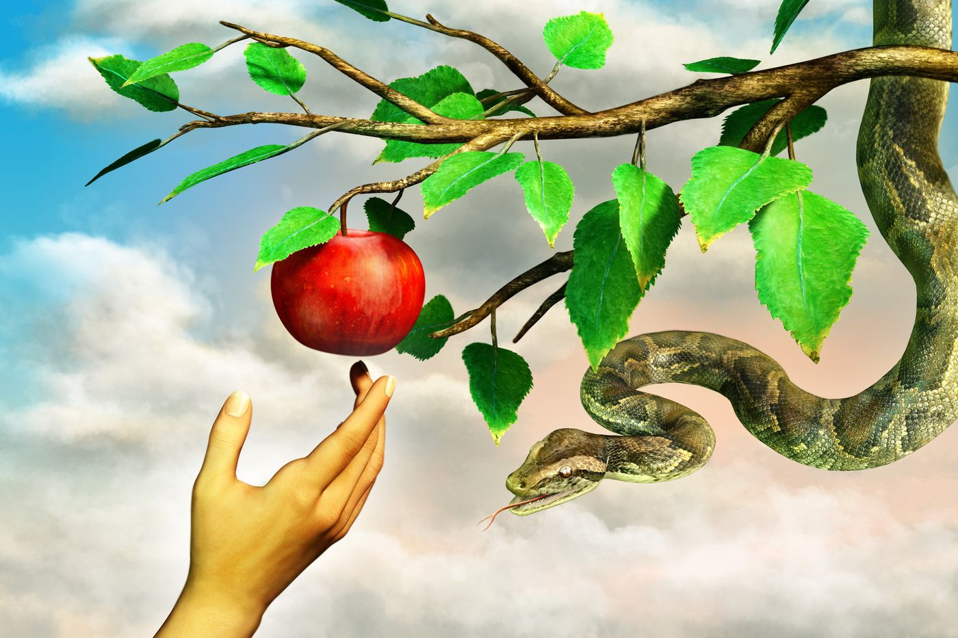
Storm Warning
An antagonistic word
«And I will put enmity between you and the woman, and between your seed and her seed; He shall bruise your head, and you shall bruise His heel. »
Notes:
Considering what is stated in 3:15, we discover that another prophetic word is pronounced over humanity: a word of grace, of return, a word of restoration, even of vengeance: “And I will put enmity between you and the woman, and between your seed and her seed; He shall bruise your head, and you shall bruise His heel.” This word already announces that the woman’s offspring will be involved in the divine plan and, consequently, will be caught in the conflict between good and evil. This word is rooted in human time and space, where one must expect both happy and unhappy moments.
Sin, which emerges outside of the divine plan, has an influence on man created in God’s image, preventing him from fully bearing the responsibilities entrusted to him, which inherently brings about problems, lack, and suffering. Man’s status and prerogatives are alienated, but the prophetic word opens up a right to hope. As soon as hope is mentioned, God takes man under His wing; He does not abandon His original plan, reminding us that love precedes evil, has nothing to do with it, and can overcome it. God commits to restoring His image, thus restoring humanity, and His intervention at the end of the Book of Job shows that He cares about creation, a symbol of His power, and that He doesn’t need to justify the existence of evil.
The account of original sin states that to cover the couple’s distressing and alienating nakedness, God used skins (3:21). It is not specified what animal is involved, especially since the term “animal” is not mentioned in this verse. However, by deduction, we understand that the term “skin” cannot refer to plants… and that likely an animal was sacrificed to obtain its skin. Yahweh-Elohim is a teacher, even in these dramatic moments, where suffering has already entered the world because of sin. We see that sin immediately causes innocent beings to suffer, while the Bible never claims that animals have sinned… Could this not be the first expiatory or even propitiatory action, through innocent blood? It is sin, not God, that brings suffering and imbalance; sin inherently carries its own responsibility as it is intrinsically the cause of rupture, and thus of injustice and misfortune. Because of this, sinful man will learn or understand that it is someone else, an innocent, who will perform the work of redemption for him. And this act, we can say in the light of the Gospels, is initiated by God. He took responsibility for it by sending His Son to die for the guilty.

Slide 9
Storm Warning
The serpent’s deceptive proposal alienates God’s work by leading humanity to damage its special relationship with the Creator.
A deceitful word
The true fall here lies in the fact that they become naked like the serpent, meaning they find themselves at the same level as the animal that moves on the ground, which they were supposed to subdue and have dominion over.
Notes:
And here comes another word external to man, this time from the serpent. The woman does not seem surprised, shaken, or frightened by this insidious word that sows doubt: “Did God really say, ‘You must not eat from any tree in the garden’?” (Genesis 3:1). But the narrative reveals that the woman is aware and has not lost sight of the divine command regarding the forbidden fruit, a word that is unambiguous. She appears not to forget the precautionary principle tied to this command, guarding against any external aggression toward the couple. She even corrects the serpent, who took a shortcut in his attempt at seduction: “We may eat the fruit of the trees in the garden, but about the fruit of the tree in the middle of the garden, God said, ‘You shall not eat it, nor shall you touch it, lest you die.’” (Genesis 3:2-3). However, she does not realize that someone is subtly altering the divine command... Evil is there, insidious, seductive. It is carried by the serpent in a word that will change things, demonstrating the subtlety of the first temptation: “You will not surely die; for God knows that in the day you eat of it, your eyes will be opened, and you will be like gods, knowing good and evil.” (Genesis 3:4-5).
Evil and misfortune likely stem from this, from the freedom creatures take to alter the intention of the divine word. By suggesting that humans consume the forbidden fruit, the serpent effectively leads them into an “unnatural” perspective. Adam, "man" drawn from adamah, "the earth," was created with human status, belonging to creation and distinct from divinity. Aspiring to be “like gods” is to desire, even covet, a change in status, function, and environment. The serpent’s deceptive proposal is an alienation of God’s work, for it leads humanity to damage its unique relationship with the Creator. They enter into the knowledge of good and evil, but in doing so, they open the door to many challenges in their existence.
As soon as they decide to break free from the prohibition, humans experience a kind of expansion of intelligence and awareness. Evil sometimes appears as a victory or accomplishment, making humans feel they have crossed a significant threshold. But what happens at that precise moment to Adam and Eve? The man and the woman consume the forbidden fruit, and they both “knew that they were naked.” This sudden awareness is not a discovery in itself but rather a new understanding of their own identity. They rediscover themselves with a gaze filled with fear and shame: they no longer recognize themselves, they have lost certain reference points, which once distinguished them from the rest of creation.
The narrative suggests that this choice generates an imbalance. The awareness of their shameful nakedness coincides with their change in status. The real fall here is that they become naked like the serpent, meaning they find themselves at the same level as the animal that moves on the earth and which they were meant to dominate and subdue. Their reckless ambition brings only shame and discomfort into their environment—the very place that was supposed to be their home, their refuge, the shelter of their relationship and happiness. Sin immediately brings disorder, decline, and disappointment into the lives of the first humans, just as they thought they were reaching the heights of power and glory.
Just as the Book of Job begins with a scene that addresses human faith and obedience, so does Genesis chapter 3 imply that, from the very origins of his history, man has faced this challenge: to trust God’s word, a word that is sometimes preventive, sometimes judicial. Such a word allows man to find a kind of balance against the assaults of the tempter. It seems, in the story of the fall, that the first sin results from a misinterpretation and a gradual neglect of the divine word. However, man will never be abandoned to himself, for he will continue to hear it echo, sometimes as a word of covenant, sometimes as a word of hope. From this observation, we are drawn to the fact that sin enters human existence as something pleasant, almost an accomplishment, but deep down, it is a real poison, a true threat to relational, emotional, and moral balance.
The serpent—a mere animal—takes the initiative to seduce the woman. By doing so, he overturns the inherent order of the divine project. In Genesis 1:28, humans are commanded to govern the animals. In chapter 2, we see this function in action when Adam names the animals. Most scholars emphasize that the narrator does not present the serpent as an external figure, with man as its innocent and tragic victim. The serpent is not portrayed as a rival or an autonomous competing force; it remains within the created order. As noted earlier, it is the Book of Revelation (chapter 12) that reveals its true identity and intentions.

Slide 10
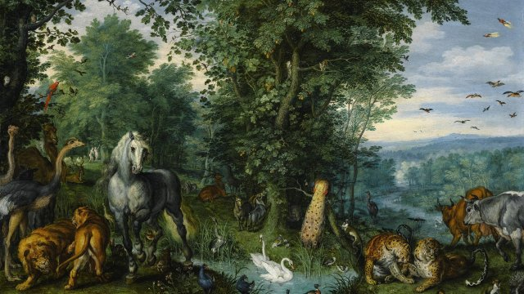
Imbalance in Creation
Notes:
The Book of Job raises the question of suffering in the human condition. The early chapters highlight the unjust nature of Job's sufferings, as Satan is given the freedom to strike him in his possessions and his flesh. However, the Bible, from Genesis chapter 3, addresses the beginning of mankind’s troubles on earth. The story of the original fall reveals a series of ruptures that are synonymous with or lead to suffering. Whenever there is separation, there is either autonomy or solitude.

Slide 11
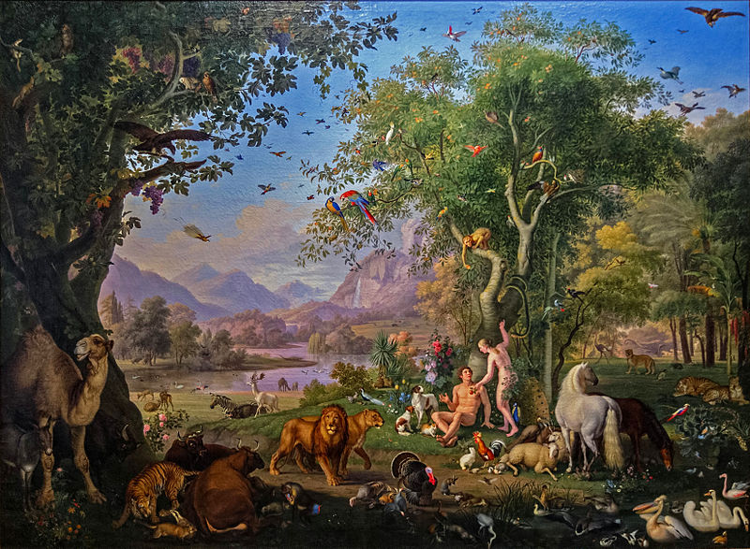
Separation from God
The divine question, “Where are you?” certainly highlights the relational fracture now established between man and his Creator, but it can also resonate as a word of hope. Sin damages man’s intimate bond with God, but by asking “Where are you?” God implies that not everything is lost.
Notes:
The account of the original sin continues, stating that man and woman were afraid to face their Creator: “They hid from the presence of the Lord God among the trees of the garden” (v.8). The author skillfully and subtly describes the events. When God calls the man first, it aligns with the creation of man because, according to chapter 2, man was created first. The first call to life, which is a call out of nothingness, corresponds to the first call out of the relational void created by sin.
Already, God intervenes to seek man out. The divine question, “Where are you?” certainly highlights the relational fracture now established between man and his Creator, but it can also resonate as a word of hope. Sin damages man’s intimate bond with God, but by asking “Where are you?” God implies that not everything is lost. This bond is rooted in the divine word that defined the manner in which man was created and later transformed into a word of blessing. Even though sin drives man to flee and hide, it does not stop God from seeking him.
This first rupture with the Creator is the result of neglecting the word of warning against man's temptation to rise above his status. When God tells man not to eat from the tree of the knowledge of good and evil, He invites him to remain within what is given: to be a creature of God, to stay as man and woman, living out the plan communicated to them through blessing (Genesis 1:28). By straying from the path of life that was set before them, the human couple introduced an endless series of threats and problems into their existence.

Slide 12
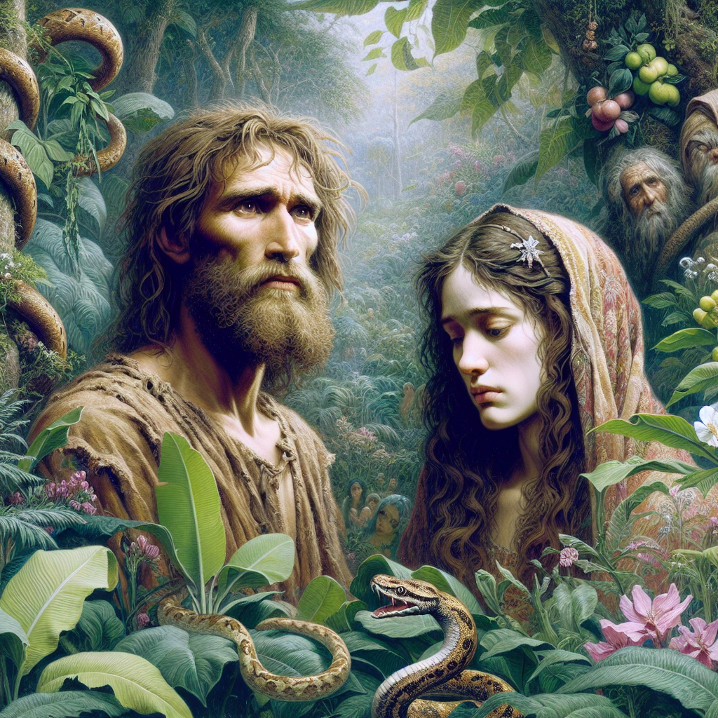
Identity Rupture
Notes:
An immediate effect of their choice is that man and woman are now ashamed of their nakedness, something that didn’t bother them before they chose to eat the forbidden fruit. “I was afraid because I was naked”: the fear likely comes from an awareness of an identity rupture. What was natural to his nature suddenly becomes a source of fear and terror. Man is now uncomfortable with what makes him human, created in God’s image: his sexuality! The differentiation of sexes takes on a negative connotation; it becomes pejorative. Humans would later transform it into prejudice, and even pervert it. Inequality and injustice will flow from it, as will suffering…
Since this negative and pessimistic awareness, how many evils have been caused within the human family! So much suffering, and our century is even more threatened by excesses and trivializations around this issue. This rupture will wreak havoc throughout human history! Human behavior will often become erratic and unstable due to this alienation from the sexual question, resulting in numerous ruptures and misunderstandings, especially as human beings come to be seen as consumable, interchangeable objects. Here too, many evils arise in human life.

Slide 13
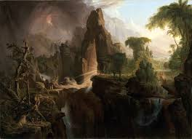
Ecological Rupture
Notes:
The choice to go against the divine recommendation leads man to his first ecological rupture. The garden-home becomes the garden-hideaway, the garden-hiding place. Genesis 2:8 states that the Lord God planted a garden in Eden for man to live in. Disorder begins when the place of delight becomes the place man wants to flee. Because of sin born from desire, the place of life becomes a synonym for confusion. The story tells us that the tree of the knowledge of good and evil was in the middle of the garden and that after eating the forbidden fruit, the man and woman hid “from the presence of the Lord God among the trees of the garden.” There is an ironic tone in the story, suggesting that the reference points have been reversed…
Because of sin, the environment becomes distressing, even suspicious. It takes on the aspect of a dramatic place, a place of tension and flight, even resignation, as man and woman were tasked with tending and caring for their environment. Due to man’s sin, the earth is cursed, and it is not surprising to see nature disturbed.
Even today, man suffers within his environment, which he has inherited since the beginning. He realizes that he has not managed natural resources properly, and there are alarming signs regarding climate phenomena. Our planet suffers, and we face challenges like global warming, alarming water shortages in some regions, and the depletion of minerals and non-renewable energy sources. Entire populations suffer due to unchecked deforestation, where economic gain takes precedence over the survival of hundreds of inhabitants. Suffering arises from ocean pollution by careless oil tankers. The earth’s environment becomes frightening due to atypical diseases: avian flu, bovine spongiform encephalopathy (mad cow disease), or chikungunya, also known as the “bent man” disease, caused by venomous mosquitoes, dengue fever, and since 2019, the Covid-19 pandemic, caused by the coronavirus. The environment no longer seems reassuring to man, as both land and sea become sources of fear due to earthquakes, landslides, tsunamis…

Slide 14
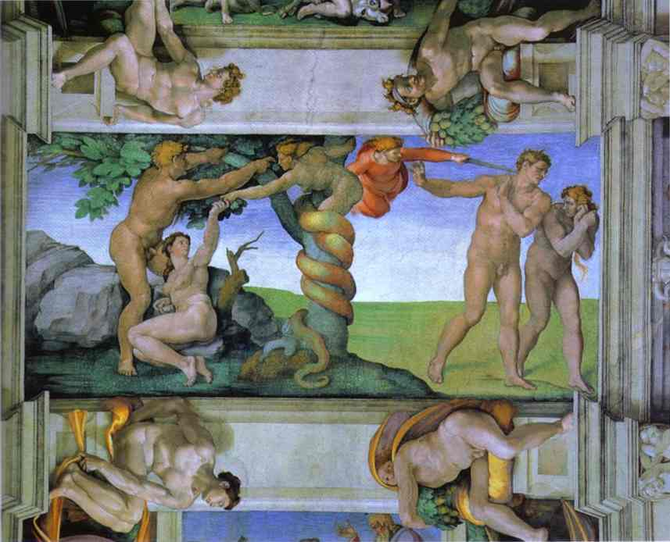
Rupture of an Ideal
Notes:
Before sin is an action, it is presented here as an attitude, a state of mind. It lies more in the motivation than in the action itself. When God asks man if he committed the forbidden act—eating from the tree of the knowledge of good and evil—he expresses the fourth rupture presented in the text: “The woman whom you gave to be with me, she gave me from the tree, and I ate” (v. 12).
Let’s be clear: it is sin, motivated by desire, that leads man to turn his back on the woman he once saw with the eyes of love. The man who was amazed in Genesis 2:23 now experiences his first rupture with his counterpart, his helper, the one who is his equal in sexual differentiation. The romantic expression, “bone of my bones, flesh of my flesh,” fades and is replaced by an excuse, even an accusation: “It was the woman whom you gave to be with me; she gave me from the tree, and I ate.” Here we witness a case of tension within the couple, of abandonment, dissociation, and destabilization. Notice how this dissociation sounds like a reproach directed at God. Already, the other becomes the source of all our woes, our deviations, our failures. So easy, so fragile… Only God can still intervene to restore strength, courage, and especially a spirit of solidarity within the couple.
Sin separates the original couple: here are two beings torn between the fact and the description of their situation. What should normally be united, “clinging,” is now disunited, disrupted, diverted. The unity of the couple is affected. There is thus an inversion of values that causes the rupture of the ideal God intended. The way man exercises his freedom can lead to a weakening of the male-female relationship, introducing the risk of frustration, separation, and distortion of these same relationships, hence alienation. Sin transforms the loving man into an adversary for the one whose role was to bring him joy, his wonder at the realization that she is of the same nature as him. Even though they are of the same nature, she is different—a difference that enriches man because he depends on otherness to flourish, to provide a future for his species, even for his history and identity.
This future of the species will not be without difficulty. It is God himself who, in a judgmental tone, announces to the woman a condition of suffering: “I will greatly increase your pain in childbearing; in pain you shall bring forth children. Your desire shall be for your husband, and he shall rule over you” (v.16). Such a declaration seems hard to hear, but it is likely linked to the woman’s mistake. She failed to uphold the divine word, a word that originally established the rules of life and harmony between the two sexes. God had granted equality in procreation and in the male-female relationship. However, sin disrupts this relationship. The act of disobedience has the effect of upsetting the imagodeic balance intended by the Creator between man and woman. From now on, there will be suffering and unfulfilled desires: is this the dawn of death, the death of healthy relations between man and woman, the death of the couple as the representative of the human species?
Some have taken advantage of this divine declaration to give it a normative value. The announcement made to the woman has been exploited to subordinate women, trapping them in dominant-submissive relationships. Too often, she has been relegated to the role of mother, worker, and exploited, if not dominated, spouse, especially in sexual terms. Let us simply remind here that this declaration is a consequence of sin and not the new norm of conjugal life.
So much harm, so many misfortunes, and thus so much suffering from this first fatal choice, and so many relational damages caused thereafter! The entire history of humanity has been affected, and believers have not been spared. It shows once again that sin brings collateral damage, and man lives in fragile relationships. He must continually exercise caution, compassion, forgiveness, kindness, and love to harmonize the marital bond.

Slide 15
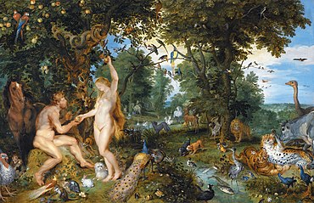
Sin Pollutes Creation
Notes:
Sin entered through the first human couple, and the entire human family has been affected. In Romans 5:12 and following, the Apostle Paul explains that through Adam, sin entered the world, into human existence, and through sin, death. This draws our attention to the fact that there is, in the realism of the biblical discourse, an explanation for suffering, evil, and death.
Reflecting on this first sin, we understand that it came through an attempt (or a temptation) to become like God. At its core, it is a distortion of the human created in the image of God. Imagining God through man, through what man could become, is a real temptation of excess, of the unspeakable. This is a form of idolatry, which is incompatible with God's plan for man, His creature. (Refer to the 2nd of the Ten Commandments).
The story of the fall is told without modesty, and the author seems to suggest that man has gone from the level of dominance to being dominated by evil. This evil enters into man’s history, making the Genesis account stand in opposition to myths by attributing historicity to evil. The entire biblical worldview will be shaped by this distinctiveness. Nowhere else, as in the Bible, is evil denounced with such relentless fury, unyielding implacability, and outraged horror: it is the moral disorder that nothing justifies; evil, called sin, becomes the enemy and the work of the enemy. Myths, and the philosophies they spawn, necessarily suppress the sense of the intolerable nature of evil, whether committed or suffered. The Bible, however, can accuse and awaken this sentiment, because it knows that evil was not there in the beginning and is not part of God’s project or will.

Slide 16
Sin Pollutes Creation
Notes:
The Bible seeks to hold man accountable. Evil is not presented as a fatality or a contingency but rather as the result of an action freely chosen by the first human. The narrative of the first sin should not be seen as naive, as neither the immediate nor the broader context favors such an interpretation. Reason and moral conscience did not awaken only when man ate the fruit: both are necessary for an act to be truly human, hence the notion of responsibility tied to free will.
In short, man violates the prohibition as soon as he feels trapped by a moral law. He deliberately seeks to break free from the Creator, wanting probably to enter into the unspeakable, the indescribable. To become “like God”—isn’t that the only forbidden dream in his relationship with the divinity? Sin does not liberate man; on the contrary, it imprisons him, disturbing his dependent relationship with the Creator. How could one not expect that such a rupture would bring about a series of unfortunate consequences for man? It is highly likely that this is also where every form of existential anxiety originated, as soon as there is doubt about God’s goodness for not preventing man from stepping over the boundary of prohibition.

Slide 17
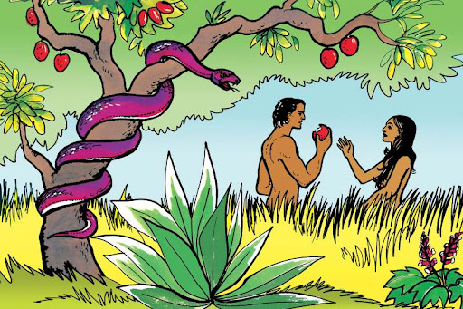
Notes:
Evil does not come from God; it is, in itself, the symbol of all disobedience, all rebellion against God. From this disobedience, creatures experience terrible, painful, and deadly consequences. Even today, we are invited to understand that we live with a certain relational and emotional fragility, and when we transgress a number of basic rules or moral laws, we risk facing a series of sufferings.
Moreover, we must acknowledge that some misfortunes come from the cruel and petty choices of unscrupulous individuals who will stop at nothing to satisfy their thirst for power and wealth. We certainly know such people, both in our immediate surroundings and in the circles of governmental or economic power. How many lives are sacrificed, supposedly on the altar of "state reason" or "national security"? How many families are impoverished (sometimes even an entire village) once certain big corporations realize that labor is cheaper in developing countries than in their own? Because of greed and poorly managed impulses, innocent lives have been brutally taken by sexual predators, the depraved, and the debauched. What about those who test their products on entire populations? Or those who constantly live in lies, violence, and duplicity? "Because of you, the ground is cursed..." Sin wreaks havoc. It is a lasting pandemic, transmitted from generation to generation and from country to country.

Slide 18
In Conclusion…
Sin does not come from God, but from the transgression of God’s law.
Evil begets evil, resulting in misfortunes and suffering.
Jesus came to tell us that sin is not inevitable.
True hope is indeed found in Jesus.
Open your heart to God’s grace.
Notes:
To conclude, let us clearly state that sin does not come from God but from the transgression of God’s law. Just as no government can be blamed for causing accidents simply because there is a traffic code imposed on all drivers, God cannot be accused of tempting man simply by establishing a law.
Evil begets evil, resulting in misfortunes and suffering. This situation is sometimes of our own making when we do wrong or hurt someone. We also suffer when others wrong us, act negligently, thoughtlessly, cruelly, or insensitively. Evil and suffering are within reach of mankind, but nothing compels us to grasp them.
Jesus came to tell us that sin is not inevitable. Humanity can understand and receive the Good News of God’s intervention through the second Adam, that is, Jesus Christ. Through him, God wanted—and still wants today—to tell all the descendants of Adam that despite all the inherent problems of their human condition, a new life is possible. True hope is indeed found in Jesus.
This evening, ladies and gentlemen, young men and young women, I invite you to carefully consider the question of evil.
Final point: if you hear the question, “Where are you in your life choices?” open your heart to God’s grace, to His love. If you want to enter into hope, you must let go of all misguided reasoning on the question of evil.
I wish you a good evening, and I pray that the Lord abundantly blesses you.

Slide 19
Impact iouc 2025

