Slide 1
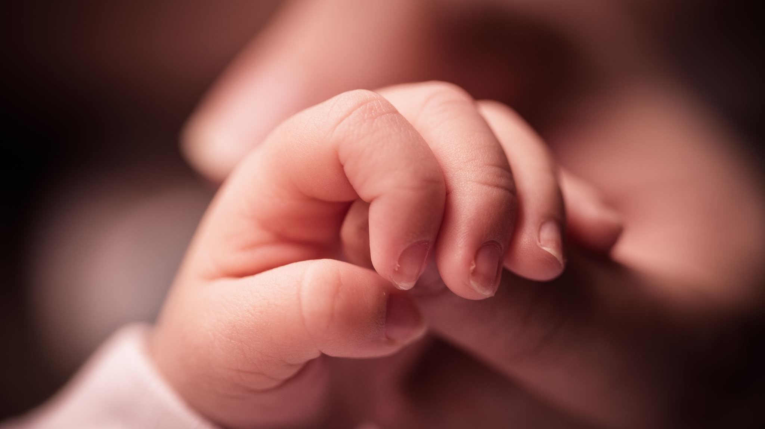
A Birth Announcement…
IMPACT 2025 - # 3
#1

Slide 2
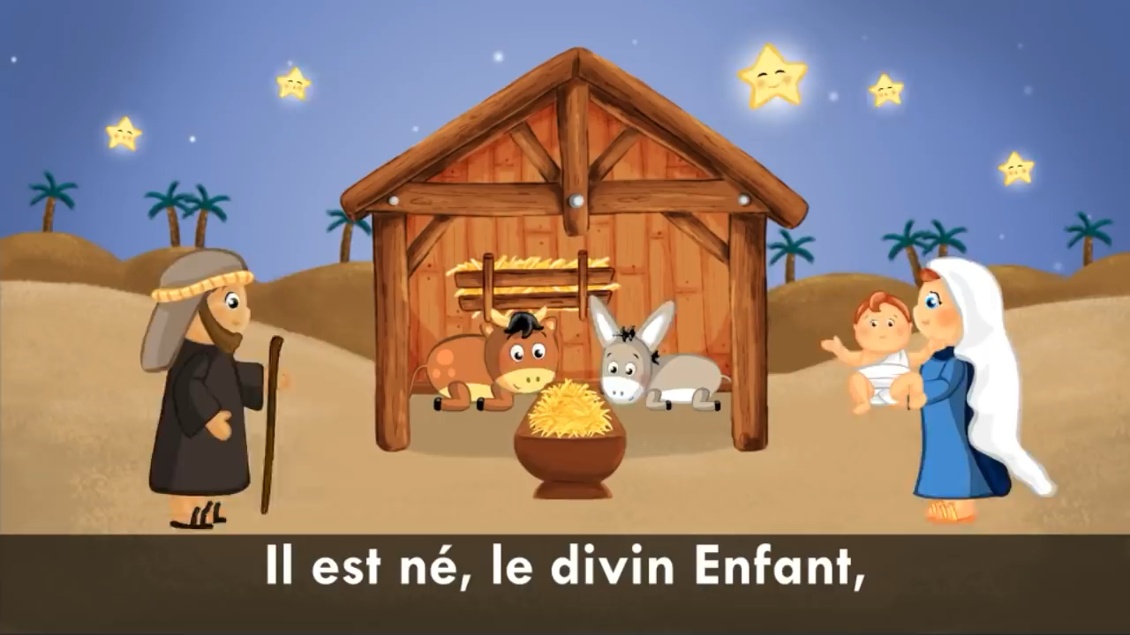
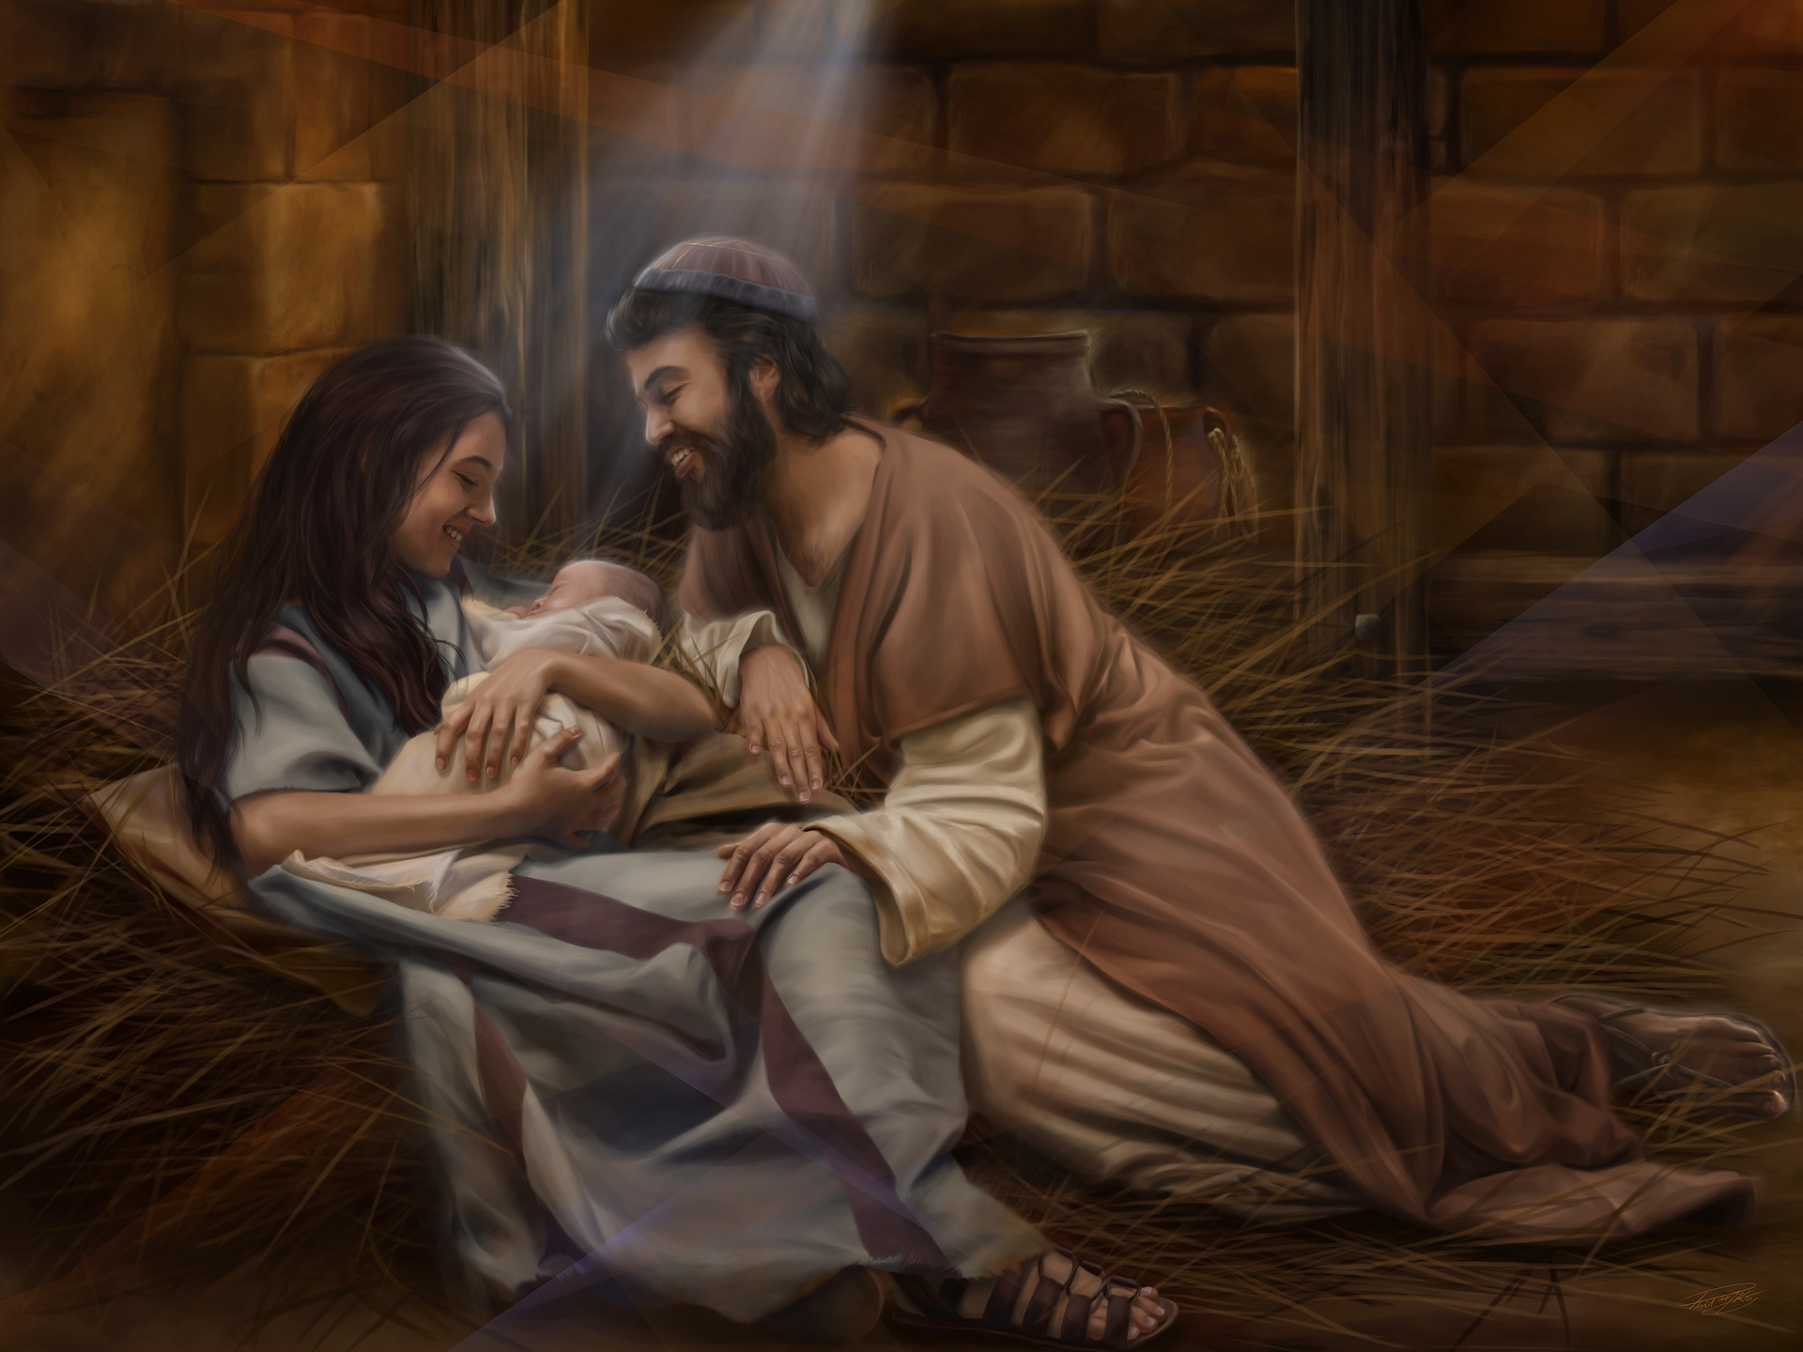
Il est né
Notes:
(You may consider playing a Christmas clip or the classic carol "Il est né le divin enfant" or "Jingle Bells" as an introduction if you find it appropriate…)

Slide 3
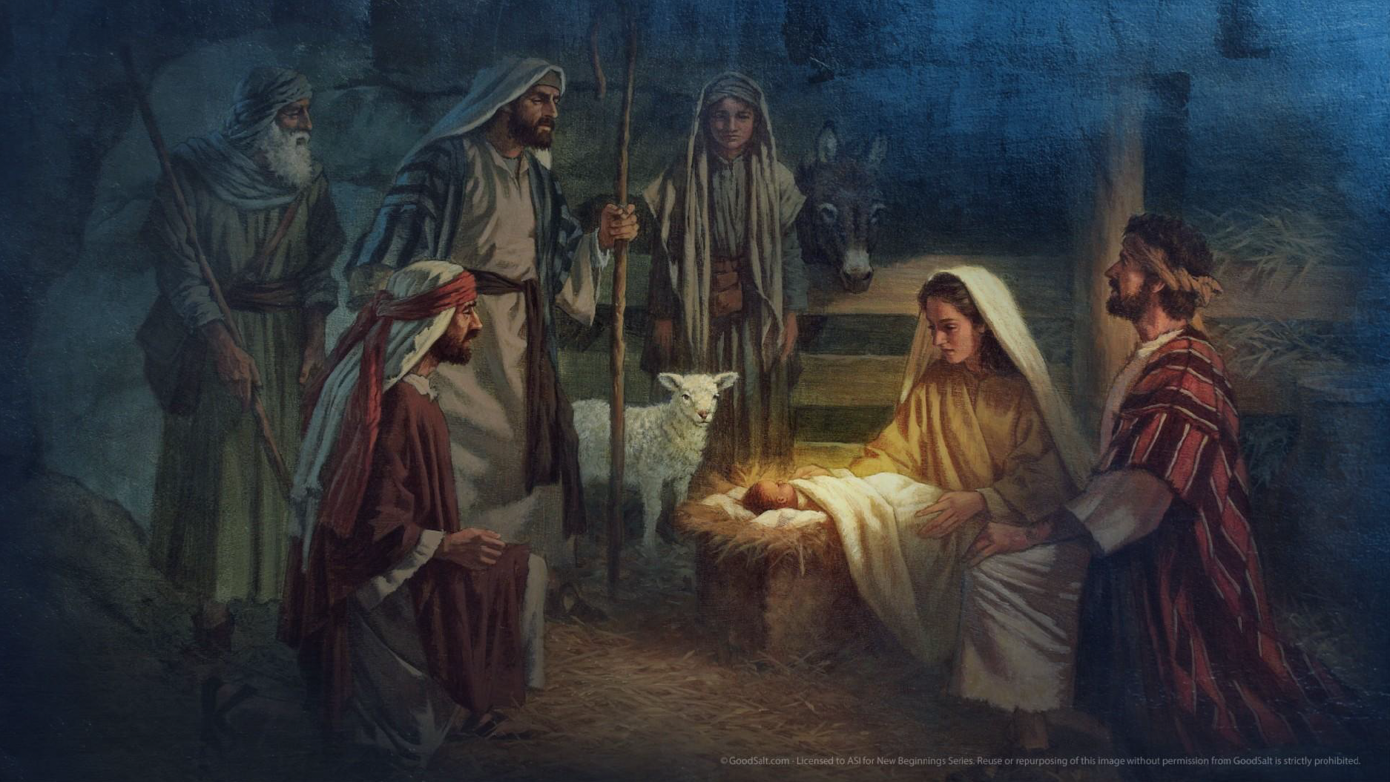
Notes:
You’ve probably heard the refrain of this well-known carol, which first appeared in 1818 during the Christmas celebrations. Whether or not you celebrate Christmas, take a moment to hear the announcement of the birth of the divine child, regardless of the exact date. Doesn’t it seem like this celebration has become a social event, celebrated not just by Christians, but also by non-Christians, Hindus, Muslims, atheists, agnostics, Freemasons, existentialists, and others?

Slide 4


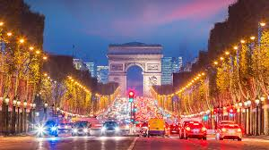
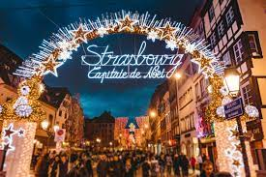

Notes:
In France

Slide 5
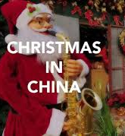
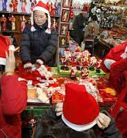
Notes:
in China

Slide 6

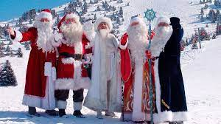
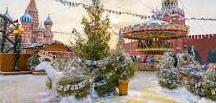
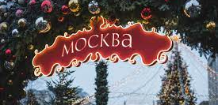
Notes:
In Russia

Slide 7

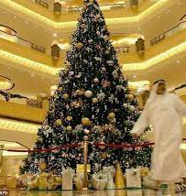
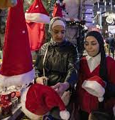
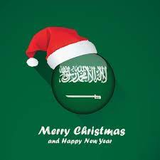
Notes:
In Saudi Arabia

Slide 8
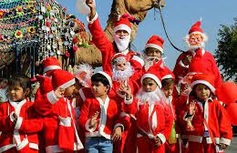

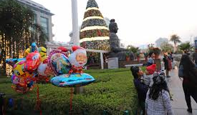
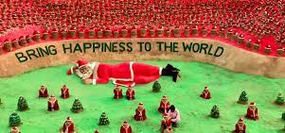
Notes:
in India

Slide 9
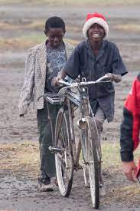
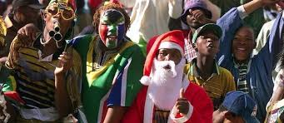
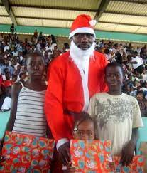
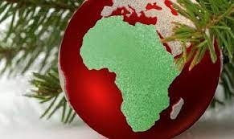
Notes:
In Africa

Slide 10
Notes:
You may enjoy seeing nativity scenes displayed in memory of the night of Jesus’ birth. We still see them in front of or inside churches, outside certain shops, and even—oh, the height of secular tolerance—in some town halls. For many, the cherished image is that of baby Jesus lying on fresh straw, visited by the wise men and shepherds in the stable where Mary gave birth and where Joseph took on his new responsibilities.
And then, there’s Santa Claus in his red-and-white outfit with his sack of presents… For most children around the world, he is the most eagerly awaited figure on the evening of December 24, even though this date is not necessarily the actual birthdate of baby Jesus.
In the history of Christianity, the date of the winter solstice was overlaid with the intent to celebrate. But let’s not dwell on this secondary issue and instead focus on the essential: Jesus, the beloved Son of God, was born among men, and this event changed the course of history for our planet.

Slide 11
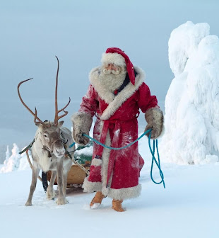
Notes:
Santa Claus, the hero! Society has celebrated “Father Christmas” so much that it has lost sight of the true message to remember. People tend to forget the real hero of this unique story, who came into our history to bring us the most precious gift of all: eternal life!

Slide 12

A birth foretold by the prophets
Notes:
From the Garden of Eden, the first messianic prophecy echoed throughout the earth. Following the conflict between the serpent and the woman, and between their offspring (Genesis 3:15), God made it clear that salvation would come from the woman’s offspring—a descendant who would crush the head of the tempter serpent, later identified as the devil and Satan in the book of Revelation (12:9).

Slide 13
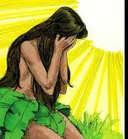

"I will put enmity between you and the woman, and between your offspring and hers; he will crush your head, and you will strike his heel." (Genesis 3:15)
Notes:
From the Garden of Eden, the first messianic prophecy echoed throughout the earth. Following the conflict between the serpent and the woman, and between their offspring (Genesis 3:15), God made it clear that salvation would come from the woman’s offspring—a descendant who would crush the head of the tempter serpent, later identified as the devil and Satan in the book of Revelation (12:9).

Slide 14
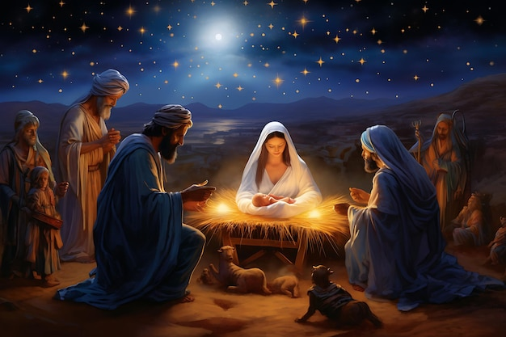
"Behold, the virgin shall conceive and bear a son, and shall call his name Emmanuel." (Isaiah 7:14)
Notes:
Many prophets foretold the coming of Jesus. As early as eight centuries before His birth, Isaiah proclaimed: "Behold, the virgin shall conceive and bear a son, and shall call his name Emmanuel." (Isaiah 7:14).
The name Emmanuel, from the Hebrew Immanu-El, meaning “God with us”, already pointed to the profound meaning of Jesus’ presence among humanity.

Slide 15

"4 Surely he took up our pain and bore our suffering,
yet we considered him punished by God, stricken by him, and afflicted.
5 But he was pierced for our transgressions, he was crushed for our iniquities;
the punishment that brought us peace was on him, and by his wounds we are healed.
6 We all, like sheep, have gone astray, each of us has turned to our own way;
and the Lord has laid on him the iniquity of us all.
7 He was oppressed and afflicted, yet he did not open his mouth;
he was led like a lamb to the slaughter, and as a sheep before its shearers is silent,
so he did not open his mouth.
8 By oppression and judgment he was taken away.
Yet who of his generation protested?
For he was cut off from the land of the living;
for the transgression of my people he was punished."
Notes:
The same Isaiah later reveals how the figure of the Suffering Messiah is embodied in the person of Jesus, the Only Son sent by the Father. When we read chapter 53 of this great prophet from the Old Testament, we see how the teachings surrounding the rituals of the Israelite sanctuary were preparing the people to behold the Lamb of God who would be slain. Our attention is drawn to the following expressions (emphasis added):

Slide 16
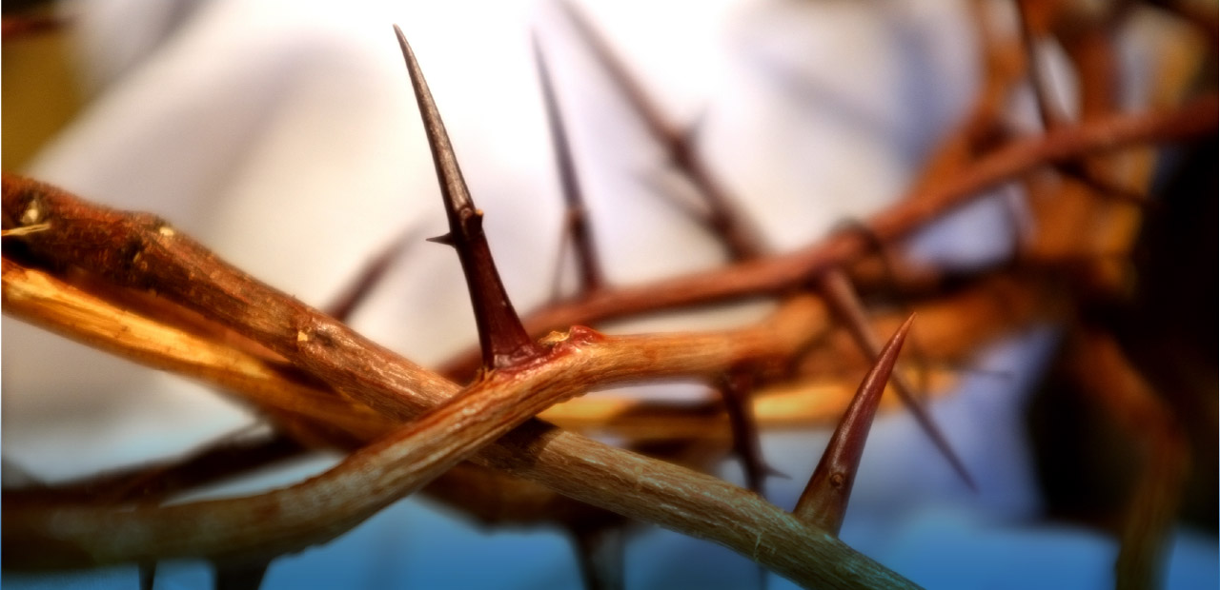
"9 He was assigned a grave with the wicked, and with the rich in his death,
though he had done no violence, nor was any deceit in his mouth.
10 Yet it was the Lord’s will to crush him and cause him to suffer,
and though the Lord makes his life an offering for sin,
he will see his offspring and prolong his days,
and the will of the Lord will prosper in his hand.
11 After he has suffered, he will see the light of life and be satisfied;
by his knowledge my righteous servant will justify many,
and he will bear their iniquities.
12 Therefore I will give him a portion among the great,
and he will divide the spoils with the strong,
because he poured out his life unto death,
and was numbered with the transgressors.
For he bore the sin of many, and made intercession for the transgressors."

Slide 17
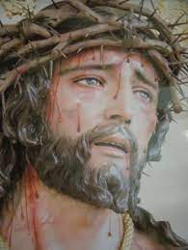
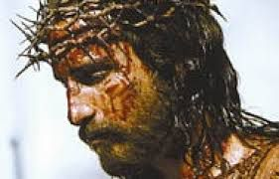
Notes:
This entire passage is worth underlining or highlighting, as you will agree, but here we emphasize the messianic concept of the person of Jesus. His coming among humanity is Good News for the world: He takes our place on the altar of divine justice and secures our forgiveness (atonement) through His sacrifice.
The sacrificial act of Jesus is certainly dramatic, with the tragic dimension of suffering on the cross, but beyond that, Isaiah reveals that humanity can find peace, that our burdens are lifted, and that our guilt is carried by the suffering servant of the Lord.
Each of us is personally impacted by this prophetic and profoundly messianic announcement. Salvation is offered to us freely, but it came at an extraordinary, dramatic cost to divinity…

Slide 18
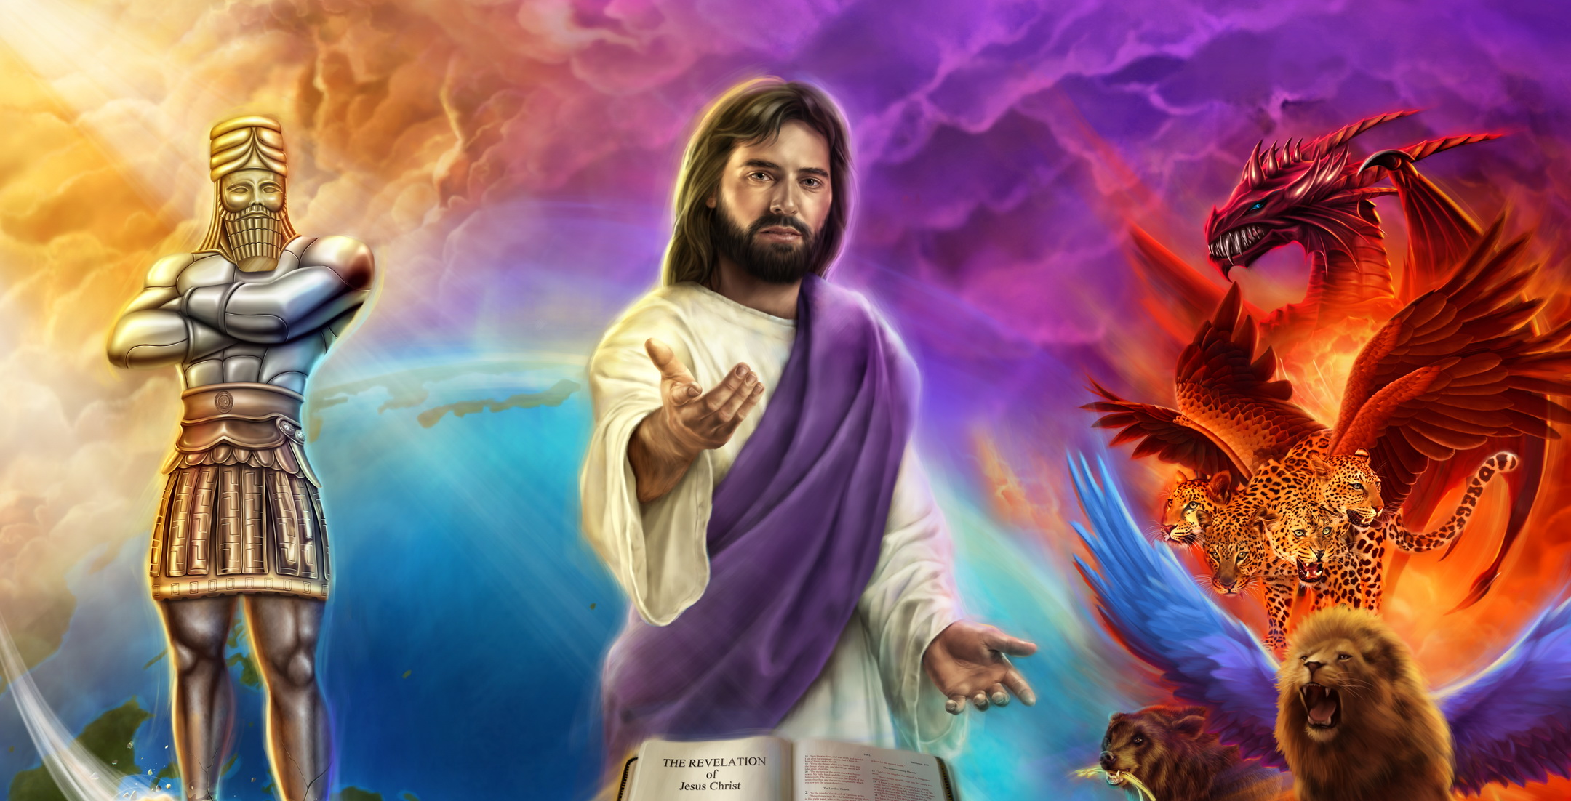
Notes:
The Prophet Daniel Also Receives a Vision of Jesus’ Coming, In chapter 7 of the book bearing his name, Daniel sees in a vision “someone like a son of man, coming with the clouds of heaven. He approached the Ancient of Days and was led into his presence. He was given authority, glory, and sovereign power; all peoples, nations, and men of every language worshiped him. His dominion is an everlasting dominion that will not pass away, and his kingdom is one that will never be destroyed.” (Daniel 7:13-14).
At the end of chapter 9, following a prayer that remains one of the most memorable in the Bible, the prophet Daniel receives confirmation of the Messiah’s coming (Daniel 9:21-26). In chapter 10:18-21, he contemplates a Christ-like figure, and it is here that the revelation takes its full meaning, with Christ at its very center.

Slide 19
The Announcement to Mary
Notes:
Imagine the scene! This story might be easier for young girls to visualize (Luke 1:26-38).
Here is Mary, a young virgin, for whom the sexual chaos of our century was utterly inconceivable. She receives an extraordinary visit, yet she does not seem surprised. I imagine her as a fearless girl with a strong relational potential. She is sociable and speaks in a very direct manner. Some might say she seems too approachable because she talks freely with strangers.

Slide 20
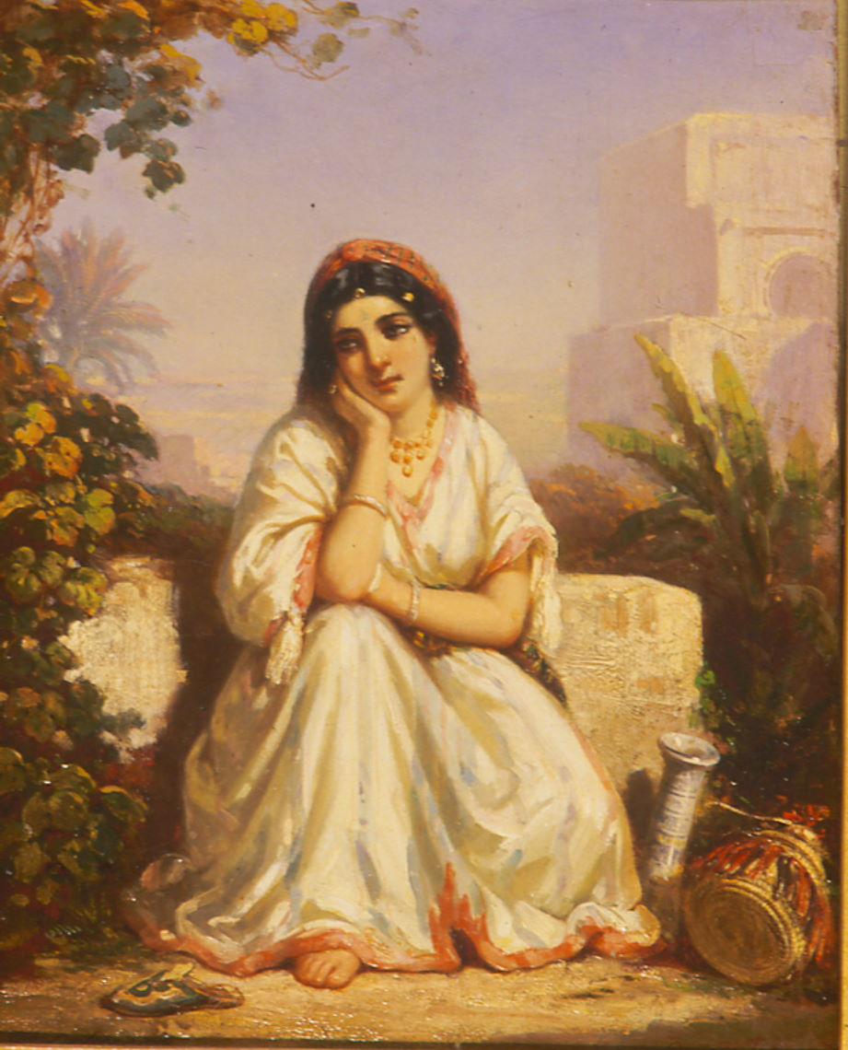
-“Greetings, Mary!”
-“Greetings! What do you want with me?”
-“Do not be afraid. I am not asking anything personal of you, but listen to what lies ahead. I want to tell you how truly favored you are and to share some wonderful news: The Lord is WITH you!”
“With me? What do you mean?”

Slide 21
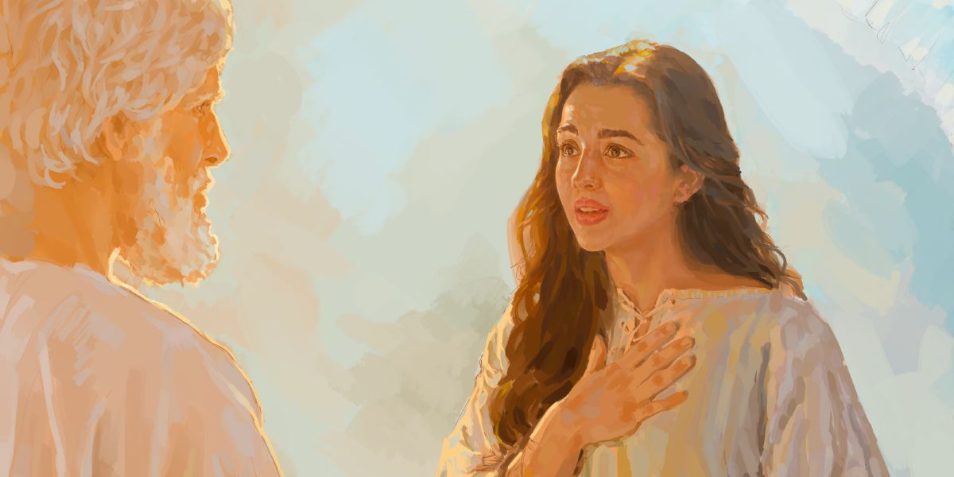
"I am the Lord’s servant; may it be done to me according to your word!"
Notes:
And that is where this unique story unfolds. A virgin girl would give birth to a child from heaven, conceived by the Holy Spirit Himself, changing the face of the world for eternity.
After the exceptional conversation with the angel Gabriel, Mary makes this solemn declaration: (click)

Slide 22
Notes:
Furthermore, Jesus Himself gave no indication, recommendation, or directive that His mother should have a prominent role or special status within the community of disciples. The last event where Jesus made a strong statement concerning her was during the crucifixion, entrusting her to the beloved disciple, John, who later took Mary into his home.
Mary is simply the mother of Jesus, who performed the incredible service of being the mother-bearer of the Son of God, raising Him until He was old enough to “be about [His] Father’s business.” The Bible does not elevate this servant of the Lord to the status of Queen of Heaven or Regent of the Church.
Everyone should respect her experience and honor her submission to God’s will. It is a beautiful lesson for women. However, her role is limited to this call to carry the Son of God.

Slide 23
28 The angel went to her and said, “Greetings, you who are highly favored! The Lord is with you.”
29 Mary was greatly troubled at his words and wondered what kind of greeting this might be.
30 But the angel said to her, “Do not be afraid, Mary; you have found favor with God.
31 You will conceive and give birth to a son, and you are to call him Jesus.
32 He will be great and will be called the Son of the Most High. The Lord God will give him the throne of his father David." (Luke 1)
Notes:
The question for you is about your openness and availability to the Lord. Do you think you have time for God and His plan for your life? The first thing to decide is your commitment. If you have already accepted Jesus as the Savior and Lord of your life, you can glorify God. If not, let Him convince you that His love for you is real and that, like Mary, you have found favor in His eyes.

Slide 24
"I am the Lord’s servant!"
Mary is not called the “mother of God.”
Mary is not the mother of a new god.
Mary herself did not come from a sanctified mother.
Mary committed herself to participate in the Incarnation.
Mary submitted to divine will.
Notes:
Mary was not called to be the mother of God (click), because God has neither father nor mother, having no beginning.
(click) Nor was she called to be the mother of a new god. A woman cannot of her own conceive a god, as is often seen in myths, mythologies, or non-biblical religions. Without intending to offend anyone, let me say that this young girl found favor, but nothing in Scripture says she was pure in her flesh, calling for a rejection of the theory of the Immaculate Conception. You may have grown up with such religious teachings, but read the Bible and heed its direct and simple teaching on this matter. (click)
The Bible attests that Mary contributed to the Incarnation. Put simply yet profoundly: Mary submitted to divine authority.

Slide 25
Notes:
Furthermore, Jesus Himself gave no indication, recommendation, or instruction that His mother should hold a specific role or special importance within the community of disciples. The last significant moment where Jesus spoke about her was during the crucifixion, entrusting her to the beloved disciple, John, who later took Mary into his home.
Mary is simply the mother of Jesus, who rendered the great service of being the bearer of the Son of God, raising Him until He was old enough to “be about [His] Father’s business.” The Bible does not exalt this servant of the Lord as the Queen of Heaven or the Regent of the Church. Everyone should respect her experience and honor her submission to God’s will. This is a beautiful lesson for women, but her role is limited to this calling to bear the Son of God.

Slide 26
34 “How will this be,” Mary asked the angel, “since I am a virgin?”
35 The angel answered, “The Holy Spirit will come on you, and the power of the Most High will overshadow you. So the holy one to be born will be called the Son of God.
36 Even Elizabeth your relative is going to have a child in her old age, and she who was said to be unable to conceive is in her sixth month.
37 For no word from God will ever fail.”
Notes:
Mary fully collaborated with the Holy Spirit. For those who might have doubts, this is not just any spirit. It is not, as some think, the Spirit of Jesus. It is the Third Person of the Trinity who Himself presided over the ovulation and conception of this child who is God-made-man. This is a unique event that changed the course of human history.
Mary made herself available to God, and the Incarnation took on its full meaning. Thus, God entered into our human condition and experienced the natural course of humanity—from fetus to death—and through this journey, with the resurrection, He embodied the hope of humanity. Mary walked the path of faith and humbly followed the Lord’s will!

Slide 27
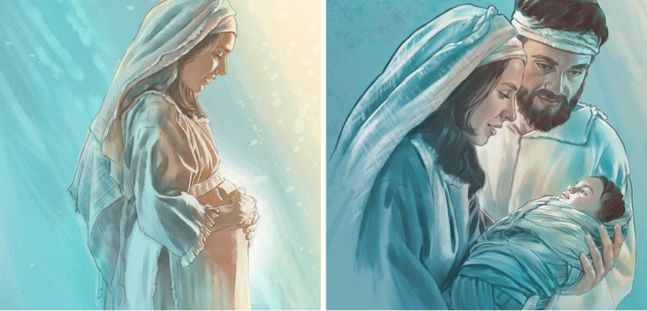
The Birth in Bethlehem
Notes:
The birth announcement had already been prepared centuries before the Incarnation. The prophet Micah, one of the twelve "minor" prophets, proclaimed: (click)

Slide 28
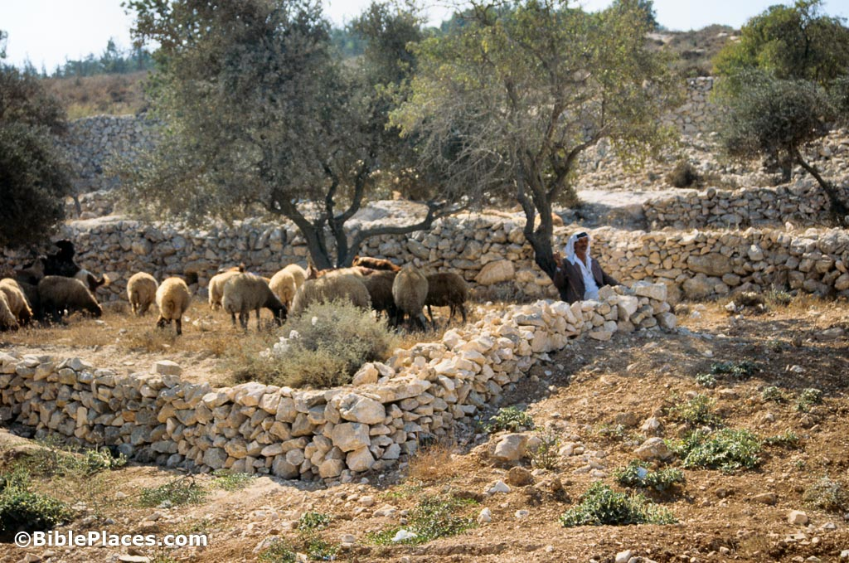
"But you, Bethlehem Ephrathah, though you are small among the clans of Judah,out of you will come for me one who will be ruler over Israel." (Micah 5:2)
Notes:
Later—more than seven hundred years after this prophecy—the evangelist Matthew affirmed that, according to the prophecy, a child was to be born in Bethlehem.
Madam, I am certain that if you wanted your future child to be born in Cilaos, Réunion Island, or Stanley, Plaines Wilhems, Mauritius, you would take the time to move before the end of your pregnancy to be ready for the birth in the location of your choice. Now imagine telling your family that your great-great-great-great-grandson or granddaughter will be the president of Madagascar and will be born in Sambaina, in the Antsirabe region. You could say it, or even write it in your will, but what guarantee do you have that this place will still exist in three centuries? Yet the prophetic voice, resounding with divine will, foretold the birth of the Messiah in a specific place and time.

Slide 29
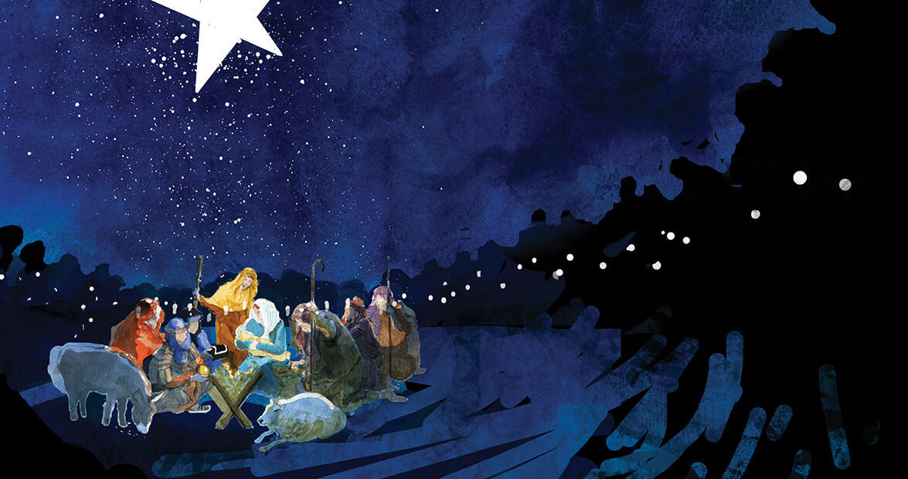
Notes:
Isn’t it amazing, ladies and gentlemen, dear readers of the Bible, to see how this holy child was to be born—not just anywhere, by chance, through the encounters of families—but in a precise manner and in a specific location? Only a powerful God can accomplish such extraordinary things.
When the child was born in Bethlehem, the town was not in uproar, but God sent a birth announcement to shepherds tending their flocks on the hills (Luke 2). They came to see the child and witnessed firsthand what the angels had announced to them on the hillside.

Slide 30
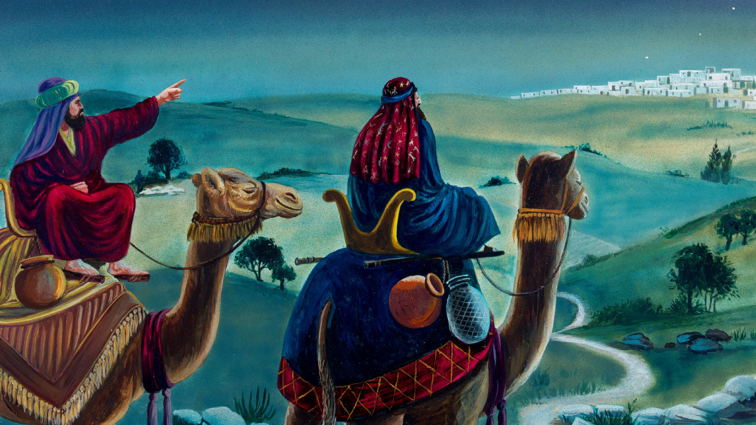
Notes:
Later, wise men came, guided by a star (Matthew 2). The prophetic birth announcement confirmed the predictions in the book of Daniel (Daniel 9:21-26). Mary treasured all the words spoken by the angel, the shepherds, and the wise men who visited (Luke 2:19). For her, it was more than a birth announcement: she was participating in the greatest birth on this planet, that of the Son of the Most High!

Slide 31
Son of God or God?
"1 In the beginning was the Word, and the Word was with God, and the Word was God.
2 He was with God in the beginning.
3 Through him all things were made; without him nothing was made that has been made.
4 In him was life, and that life was the light of all mankind.
5 The light shines in the darkness, and the darkness has not overcome it.
_{(...)}
14 The Word became flesh and made his dwelling among us. We have seen his glory, the glory of the one and only Son, who came from the Father, full of grace and truth.
15 (John testified concerning him. He cried out, saying, ‘This is the one I spoke about when I said, “He who comes after me has surpassed me because he was before me.”’)" (John 1)
Notes:
God took the care to announce the coming of His Son through the prophets, highlighting the unique and wondrous nature of this divine entry into our world.

Slide 32
John 14
"9 Jesus answered: 'Don’t you know me, Philip, even after I have been among you such a long time? Anyone who has seen me has seen the Father. How can you say, "Show us the Father"?
10 Don’t you believe that I am in the Father, and that the Father is in me? The words I say to you I do not speak on my own authority. Rather, it is the Father, living in me, who is doing his work.
11 Believe me when I say that I am in the Father and the Father is in me; or at least believe on the evidence of the works themselves.'”
Colossians 1
"15 The Son is the image of the invisible God, the firstborn over all creation.
16 For in him all things were created: things in heaven and on earth, visible and invisible, whether thrones or powers or rulers or authorities; all things have been created through him and for him.
17 He is before all things, and in him all things hold together."
Notes:
The theological point emphasized here is the total, intrinsic, non-negotiable divinity of Jesus. His incarnation truly reflects the divine presence among men. By saying “reflect,” I refer to what, in human terms, is accessible to our eyes.
When Philip later asks Jesus to show them the Father, His answer, surprising as it may have been to His immediate audience, clearly explains the meaning of the Incarnation.

Slide 33
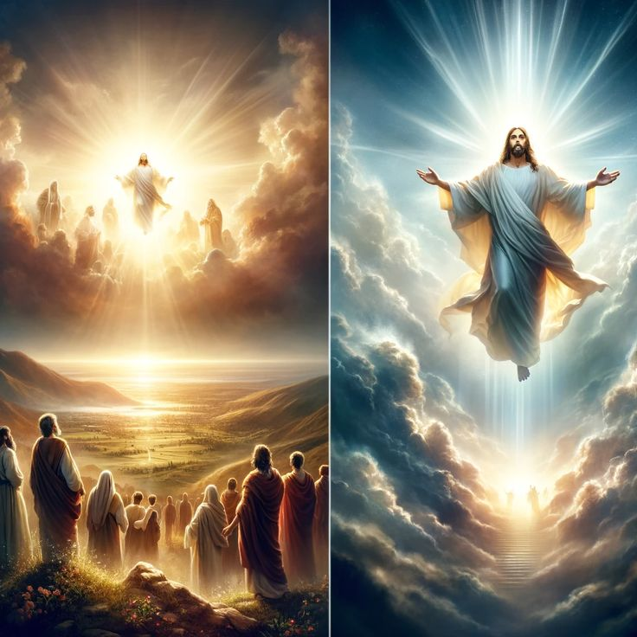
The Prophet Daniel Sees the Vision of Jesus' Coming
The prophet Daniel saw "someone like a son of man coming with the clouds of heaven. He approached the Ancient of Days and was led into his presence. He was given authority, glory, and sovereign power; all peoples, nations, and men of every language worshiped him. His dominion is an everlasting dominion that will not pass away, and his kingdom is one that will never be destroyed." (Daniel 7:13-14)
Notes:
Daniel also received, in a vision, an announcement of Jesus’ coming. In chapter 7 of the book bearing his name, Daniel witnessed the Son of Man approaching the Ancient of Days, receiving dominion, glory, and a kingdom that will never end. Later, in chapter 9, after a memorable prayer, Daniel received confirmation of the coming of the Messiah (Daniel 9:21-26). In chapter 10:18-21, he saw a Christ-like figure, which brings the revelation to its full meaning, with Christ at its very center.

Slide 34
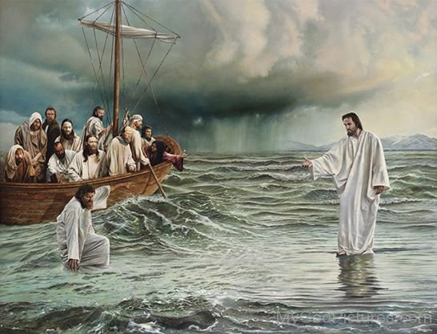
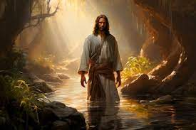
Notes:
Jesus Assumed the Incarnation
This implied full awareness of His divine nature, His equality with the Father, and His humanity. A simple formula might describe it as 100% God and 100% man, though this remains a profound mystery for humans. We shouldn’t calculate percentages but rather recognize Him as the Only Son of the Most High, who accepted to also be the Son of Man. After all, isn’t a child 100% their father’s and 100% their mother’s?

Slide 35
"6 Who, being in very nature God, did not consider equality with God something to be used to his own advantage; 7 rather, he made himself nothing by taking the very nature of a servant, being made in human likeness." (Philippians 2:6-7)
Notes:
When Paul urged Christians to have the same mindset as Jesus Christ, he was not asking them to become Christ or to think of themselves as Him. Instead, he encouraged them to reflect on Christ’s profound humility and awareness of His mission. Paul emphasizes that Jesus, though equal with God, humbled Himself and took on the form of a servant.
Jesus: Son of God and Fully Divine
Jesus is the eternal Son, equal to God. He and the Father are One, as affirmed in multiple passages, forming the cornerstone of the Christian faith. Jesus is God made man, not a man who became divine.

Slide 36
"6 Then I saw a Lamb, looking as if it had been slain, standing at the center of the throne, encircled by the four living creatures and the elders.
8 And when he had taken it, the four living creatures and the twenty-four elders fell down before the Lamb. Each one had a harp and they were holding golden bowls full of incense, which are the prayers of God’s people.
9 And they sang a new song, saying:
‘You are worthy to take the scroll and to open its seals, because you were slain, and with your blood you purchased for God persons from every tribe and language and people and nation.
10 You have made them to be a kingdom and priests to serve our God, and they will reign on the earth.’" (Revelation 5:6, 8-10)
Notes:
Paul confirmed the apostolic faith, teaching that Jesus is "the image of the invisible God" (Colossians 1:15) and that "God was reconciling the world to himself in Christ." (2 Corinthians 5:19). Unlike humans, who are made in the image of God, Jesus is the image of God, fully reflecting divine essence. He, equal to God, chose to be born as a baby, crying in His mother’s arms, in solidarity with humanity to bring perfect salvation.
The final book of the Bible shows the Lamb at the heart of divinity, at the center of God’s throne:

Slide 37
"11 Then I looked and heard the voice of many angels, numbering thousands upon thousands, and ten thousand times ten thousand.
12 In a loud voice they were saying:
‘Worthy is the Lamb, who was slain, to receive power and wealth and wisdom and strength and honor and glory and praise!’
13 Then I heard every creature in heaven and on earth and under the earth and on the sea, and all that is in them, saying:
‘To him who sits on the throne and to the Lamb be praise and honor and glory and power, for ever and ever!’" (Revelation 5:11-13)
Notes:
(Apocalypse 5.6, 9-13

Slide 38
Jesus Came to Give You Life
Notes:
A life without Jesus is a life without hope. The Garden of Eden—the famous paradise—became inaccessible because of the sin of the first man (Genesis 3). It was a forbidden door because evil is incompatible with God’s plan for His creation. The Tree of Life could not coexist with disobedience.
It seemed all was lost, but the God who created through His Word spoke a Word of salvation. This Word, fully embodied in the beloved Son, resonated powerfully on the cross at Golgotha about two thousand years ago. That infamous, unjust, scandalous cross became the profound symbol of God’s love. It represents both God’s justice and the justification and hope offered to all humanity.

Slide 39
The Most Extraordinary Event
For humanity in search of its roots, the most extraordinary event is the coming of Jesus Christ to earth. Humanity was not present at creation, but the Bible clearly states that it is because men saw, heard, and touched the Son of Man that they announced Him. Revelation helps us understand that the Gospel was not formed through myths, fables, or legends, but through a shared journey, a concrete experience with the Son of God. It is a Gospel accessible to all, not only because of the cross, but also because of the Incarnation.

Slide 40
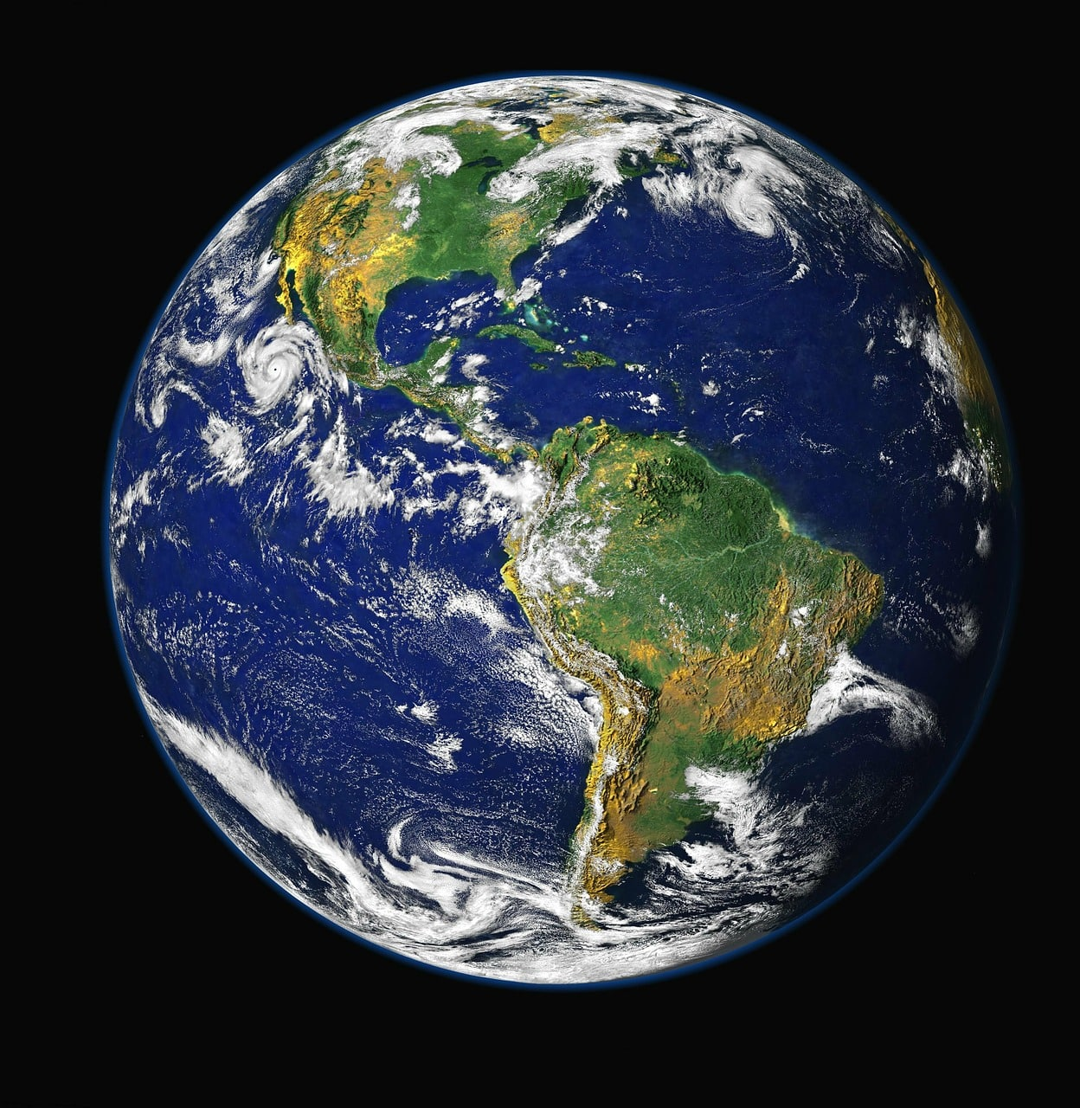
The Good News of salvation was incarnated in the person of Jesus Christ. Without the cross, where Jesus shed His blood and bore the disgrace that sinful humanity deserved, there would be no hope for the human race. Without the Incarnation and its marvelous message of love, humanity would be condemned to wander aimlessly across the universe, on this blue planet, with a history devoid of purpose or meaning—merely the result of chance and coincidence, culminating in eventual annihilation.
Without the Incarnation, humanity would continue to live under the influence of politics, trends, societal changes, and passing fashions. Without the Incarnation, humanity would have fleeting joys with no future, anxieties with no hope of healing, and divisions with no chance of reconciliation. Without the Incarnation, humanity would have missed out on the greatest gift: adoption as sons and daughters of God.

Slide 41
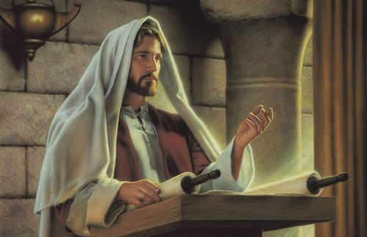
Notes:
Jesus Christ allows humanity to move from randomness into a divine plan—a perspective imbued with the presence and grace of God. It is a setting where our relative values encounter the Absolute of God, a meeting under the banner of love that saves, restores, and unites.
God’s love does not seek to impose itself. Each individual has the right to refuse or even reject it. God would not be a God of love if He were unwilling to accept the consequences of the freedom He granted to His creation. Unfortunately, sin demonstrates that humanity, mishandling its freedom, can lead to separation from God.
God presented Himself to us in an accessible way through Jesus. At the cross, Jesus took our place, substituting Himself for the sinner condemned by divine law, to give all people, across all times and cultures, a reason to hope and the possibility of receiving divine forgiveness. God, the One offended, forgives. Humanity, the offender, can reestablish a relationship with the Creator because forgiveness opens the doors of God’s kingdom. Through forgiveness, those who place their faith in Christ’s merits can be reconciled to life itself.

Slide 42
God’s love is not only discovered in His Word, which comes to us. It is also seen in the testimony of believers whose lives have been transformed—men and women, entire families—who have found conviction in the coming of Jesus to this world, giving meaning and substance to the story of this planet.
The message of the Gospels invites us to walk the path of life, truth, and eternity. This path has a name: Jesus.
Notes:
God’s love is not only discovered in His Word, which comes to us. It is also seen in the testimony of believers whose lives have been transformed—men and women, entire families—who have found conviction in the coming of Jesus to this world, giving meaning and substance to the story of this planet.
The message of the Gospels invites us to walk the path of life, truth, and eternity. This path has a name: Jesus.

Slide 43
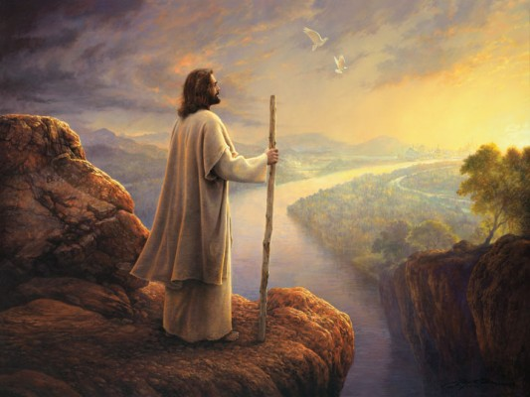
To Conclude
(5) From the cradle to the cross,
God reveals a profound mystery.
From the cradle to the cross,
He loves us endlessly.
(6) May He return at the end of time
To lead us to the joy of the Father.
May He return at the end of time
And reign eternally.
Notes:
The last two stanzas of this Christmas carol convey this: (read displayed text)
Everything has been said about the birth of this child, the Son of the Most High, who became the Son of Man for the salvation of humanity. Jesus was born of an ordinary woman, humbly devoted to the Lord. The Incarnation was a sovereign decision of God. Jesus was born among men not only to save humanity but also to redeem the human race. He came to save the family of Adam, the one who was initially tasked with creating a family for God.
And now, He invites you to be part of this great family. Jesus was born, and He is the Savior and Lord of all who trust Him for eternity.

Slide 44
Notes:
Let me ask you a very personal question right now—or rather, consider it a special invitation for you this year, 2025. May I share it with you humbly but with great friendship?
Would you consider tonight the idea that the little child you may have seen in a nativity scene is no longer just baby Jesus? He is the Savior and Lord—for everyone, for you, for your loved ones, and for me as well.
(Prayer, if you wish)
Jesus came in the powerful name of an Almighty God of love. Think about this as you return home tonight.
I wish you a pleasant evening and a blessed journey with Jesus!

Slide 45
A Birth Announcement

