Slide 1
Jesus teaches us victory over sin. Tempted without sinning: is it possible?
Notes:
Good evening, ladies and gentlemen. I don't know if you have made much effort to arrive tonight, but I am glad to see you again for our 4th conference. I waited all day for this topic because it is of utmost importance. We need to know, according to the Bible, whether we are destined to do wrong or if Jesus truly opens the doors of hope for us. First, I'd like to share a short story with you. Do you enjoy stories? Listen to this...

Slide 2
Notes:
A scorpion asked a frog to carry him on her back across the river.
“No way!” she said. “You would use the opportunity to sting me, and I know your sting is deadly.”
“Think about it,” said the scorpion, “I cannot swim. If I stung you, I would drown. It’s logical, isn’t it?”
“Logical,” said the frog, who finally agreed to take him.
But as they reached the middle of the river, the scorpion stung the frog. And as her strength faded, she murmured:
“That’s stupid! We are both going to die... Why did you do that?”
And the scorpion, sighing, replied:
“What can I say... it’s stronger than me, it’s in my nature!”
Understand the lesson well: not everything that seems logical carries truth… I think that sometimes we easily get caught up in interesting reasoning that doesn’t benefit us. An invisible, colorless, and odorless poison is more dangerous than a known poison that is visible or has a recognizable smell. What about sin, this poison that is sometimes visible but often subtle? (Let’s pray before moving forward.)

Slide 3
Have you ever been faced with the obligation to commit a sin ?
Notes:
A scorpion asked a frog to carry him on her back across the river.
“No way!” she said. “You would use the opportunity to sting me, and I know your sting is deadly.”
“Think about it,” said the scorpion, “I cannot swim. If I stung you, I would drown. It’s logical, isn’t it?”
“Logical,” said the frog, who finally agreed to take him.
But as they reached the middle of the river, the scorpion stung the frog. And as her strength faded, she murmured:
“That’s stupid! We are both going to die... Why did you do that?”
And the scorpion, sighing, replied:
“What can I say... it’s stronger than me, it’s in my nature!”
Understand the lesson well: not everything that seems logical carries truth… I think that sometimes we easily get caught up in interesting reasoning that doesn’t benefit us. An invisible, colorless, and odorless poison is more dangerous than a known poison that is visible or has a recognizable smell. What about sin, this poison that is sometimes visible but often subtle? (Let’s pray before moving forward.)

Slide 4
Let’s learn from Jesus…

Slide 5
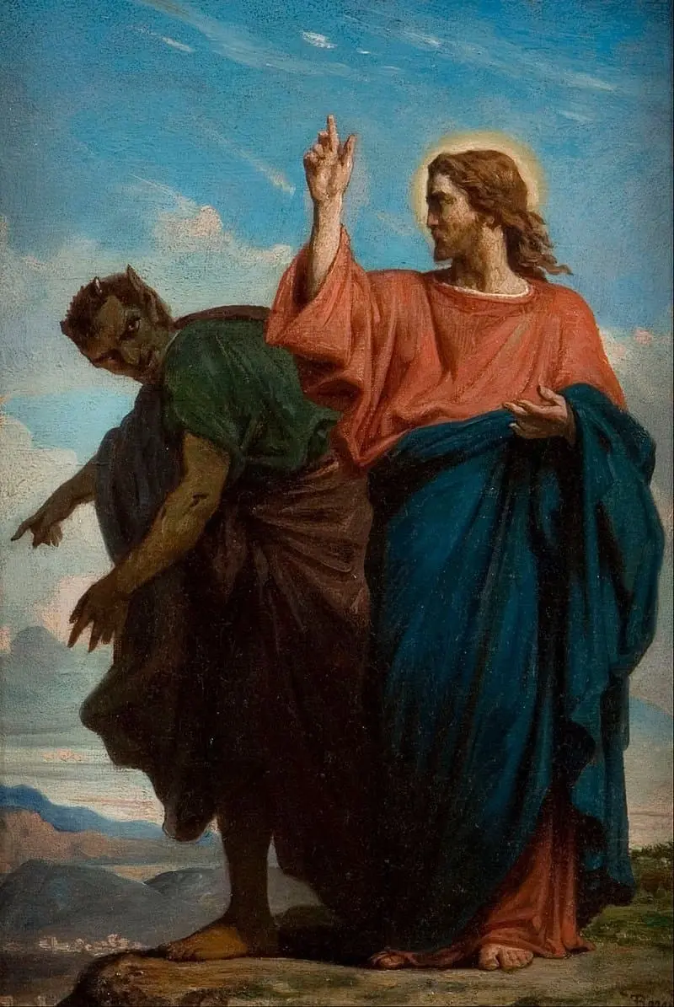
First Temptation:
Desire
« If you are the Son of God, command these stones to become bread! ! » (v.3)
« Jesus answered, ‘Man shall not live on bread alone, but on every word that comes from the mouth of God. » (v.4)
Notes:
"Jesus is hungry. He has fasted for forty days, and things are not looking good. It is often said that a hungry stomach has no ears, and here, the Messiah is facing this existential reality called hunger.
The devil, who does not want to miss any opportunity to divert the Son of God from his mission, comes with a first temptation, one that touches on desire, hunger, appetite—essentially, the basic human needs."

Slide 6
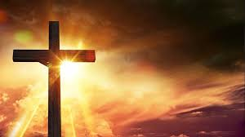
Lust
Possession
Selfishness
Jealousy
Notes:
"‘If you are the Son of God, command these stones to become bread!’ (v.3)
The issue is not really about Jesus’s ability to turn stones into bread. Imagine the number of sandwiches that could appear in that desert and rocky place. The real issue is yielding to the egoistic provocation: ‘If you are the Son of God!’ The devil knows who Jesus is. He knows it so well that he comes with all his cunning, malice, and wickedness to counter the divine plan of saving humanity from sin and its consequences. The devil acts cunningly, using the guise of confirming the connection between the Son and the Heavenly Father to set his trap for Jesus: to demonstrate his status! Jesus is confronted with the opportunity to prove that he truly is the Son of God. It’s tricky, but it’s tempting.
Indeed, he could prove in a fraction of a second that he IS the Son of God, that he has the power to turn a stone into bread for immediate consumption. But Jesus shows that God is wise and does not need to prove to Satan that he is the Son of God. God doesn’t play the magician; he does not put on a show for applause, praise, or approval. God is God without us. Satan knows this very well, but he is seductive and mean. Jesus responds and confirms that he is truly the Son of God, without needing to change stones into food.
There are at least 4 aspects in this first temptation: lust, possession, selfishness, and jealousy... The devil wants to take everything and pretends to give… but he acts through cunning, seduction, or violence. Don’t let yourself be deceived."

Slide 7
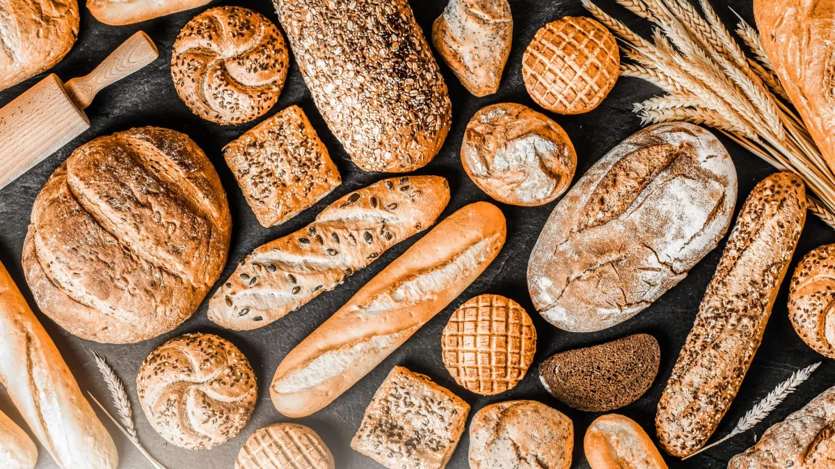
« If you are the Son of God, command these stones to become bread!’ » (v.3)
« Man shall not live on bread alone, but on every word that comes from the mouth of God. » (v.4)
Notes:
"‘Man shall not live on bread alone, but on every word that comes from the mouth of God.’ (v.4)
Can we distinguish between temptations related to consumption, satisfying all desires and cravings? Let us also remember that Jesus taught his disciples to make their needs known to the Heavenly Father—needs, not desires."

Slide 8
Second Temptation: Pride
« 5 The devil took him to the holy city, set him on the pinnacle of the temple,
6 and said: ‘If you are the Son of God, throw yourself down; for it is written: He will command his angels concerning you, and they will lift you up in their hands, so that you will not strike your foot against a stone.
7 Jesus replied, ‘It is also written: You shall not test the Lord your God. »
»
Notes:
"Jesus knows who he is and what he is capable of doing. When we read the different gospels, we observe that Jesus never sought to impress his disciples by doing ‘extraordinary’ things, not to mention ‘magical’ or ‘astonishing’ acts, to confirm his messianic role and especially his divinity. Indeed, he will walk on water, multiply loaves and fish, but these occasions will neither be to put himself forward nor to yield to a temptation or diabolical flattery.
The temptation here is pride. Flattering someone’s ego can fill them so much with themselves that they forget to reason. And it is certain that if our pride leads us to put ourselves first, we will have no trouble falling into sin, as our thoughts will be filled with our own ideas and not with the Word of God."

Slide 9
« 5 The devil took him to the holy city, set him on the pinnacle of the temple,
6 and said: ‘If you are the Son of God, throw yourself down; for it is written: He will command his angels concerning you, and they will lift you up in their hands, so that you will not strike your foot against a stone.
7 Jesus replied, ‘It is also written: You shall not test the Lord your God. »
»
Notes:
"Jesus will once again respond by relying on the biblical Word. This seems natural, you might say, as Jesus is countering the devil’s attack.
What a lesson for all who want to walk with Jesus! Learning to resist materialistic temptations by seeking support from the teachings of the Word of God is a valuable aid. It means that the believer learns to refer to the Word of God and the shield of faith to ‘extinguish all the flaming arrows of the evil one,’ as Paul says in Ephesians (6:16)."

Slide 10
Second Temptation: Pride
« 5 The devil took him to the holy city, set him on the pinnacle of the temple,
6 and said: ‘If you are the Son of God, throw yourself down; for it is written: He will command his angels concerning you, and they will lift you up in their hands, so that you will not strike your foot against a stone.
7 Jesus replied, ‘It is also written: You shall not test the Lord your God. »
»
Notes:
"The trap for us humans would be to rely on our own conscience, thinking that we are capable of deciding what is right and what is wrong. Sometimes we reason in a way that seems logical to us but ultimately misleads us, causing us to confuse good with evil and gradually silence our conscience. We might even decide that the question shouldn’t arise anymore, as long as it doesn’t harm anyone.
When Jesus tells Satan not to tempt the Lord, he asks him not to provoke Him, which means the provocateur dares to place himself at the level of the Lord or seeks to take authority over Him. When we make our conscience say things that are no longer in agreement with the Word of God, we indeed express freedom of conscience, but in reality, we place our conscience above the Word of God.
To find our way out, Jesus suggests letting the Word of God enlighten and nourish our conscience."

Slide 11
Pretentiousness
Rivalry
Contempt
Hypocrisy
Notes:
"This second temptation hides other challenges, at least four, and if we are not careful, we will easily fall into the traps of pretentiousness (click), rivalry (click), contempt (click), and hypocrisy (click). I’ll let you think about this for a moment, and you can ask Jesus now to help you overcome these temptations, just as he overcame them. Decide in your soul and conscience if you want to walk this path of victory… yes, victory, but only in Jesus!"

Slide 12
Third Temptation: Worship
« 8 The devil took him again to a very high mountain and showed him all the kingdoms of the world and their glory,
9 and he said: ‘I will give you all these things if you bow down and worship me.
10 Jesus replied, ‘Away from me, Satan! For it is written: Worship the Lord your God and serve Him only. »
Notes:
"The devil does not give in to the Word of God. If he dared to attack the Lord, question His justice and His love, he does everything to denigrate and cast doubt on the Word of God itself and undermine the importance of the teachings of God's messengers. He now leads Christ into the realm of material possession.
The idea that well-being is built around the verb ‘to have’ is truly diabolical. Having been contradicted on the issues of consumption and possession, here he comes again with a higher level of temptation. He has nothing to lose but everything to gain because, since time immemorial, he has sought a status equal to that of the Lord Himself (Isaiah 14:13-14; Ezekiel 28:15).
In his arrogance and pride, with arrogance masked behind false generosity, he wants Jesus to worship him in exchange for the kingdoms of this earth."

Slide 13
Self-Worship
Exclusivity
Domination
Manipulation
Notes:
"A bow in exchange for authority over all the kingdoms of the earth!
Tempting, isn’t it? Especially from a ‘theological’ point of view, as Jesus supposedly came to save the world...
But this is where we could be mistaken. Jesus did not come to personally save humans from the devil but from the condemnation brought by sin: eternal death! The devil has no right over a single human being; he himself is already condemned to eternal death, and he knows it (Revelation 20:10).
He also knows that every attentive reader of the Bible will discover the truth about his future. So, he tempts, seduces, and diverts humans from the truth embodied by Jesus. He does not want your life to be influenced by Jesus or by the Holy Spirit. As a result, he sends ten thousand distractions to the planet, and the disconnection with Jesus becomes quickly possible, unless we remain alert and pray, as Jesus himself taught us to do (Matthew 6:9-13)."

Slide 14
Saying that we are imperfect, weak, and limited does not mean that we cannot resist sin at all.

Slide 15
Define « Sin »
Sin is transgression of the law (1John 3:4)
Doing evil instead of good(James 4:17).
There is no small or Great sin(James 2:10)
The Universality of sin (Psalm 14:3; 53:2; 143:2; Pr 20:9; Rm 3:23; 5:12)
Notes:
"Sin truly affects our existence. To define it even more precisely, sin is the love of self more than the love of God. Sin is what separates us from God, equivalent to moral autonomy, a distancing.
Jesus made it clear when he said that sin first resides in the heart of man before becoming visible in his words and actions: ‘But the things that come out of a person’s mouth come from the heart, and these defile them. For out of the heart come evil thoughts—murder, adultery, sexual immorality, theft, false testimony, slander.’ (Matthew 15:18-19)
When the heart allows itself to be filled with a love, a passion so strong that it competes with the love for God, sin takes root. From that point, the heart becomes the command center that produces actions incompatible with the divine will."

Slide 16
Sin is transgression of the law (1John 3:4)
Doing evil instead of good(James 4:17).
There is no small or Great sin(James 2:10)
The Universality of sin (Psalm 14:3; 53:2; 143:2; Pr 20:9; Rm 3:23; 5:12)
Notes:
Sin has exerted a negative influence on the environment, and because of human mentality, it sells well (and can even be exchanged for free), especially when its packaging is reassuring and attractive.
We therefore need to understand that God wants to save us from it, but above all, He wants to make us victorious.

Slide 17
Sin, a constant threat
Notes:
"God invites man to carefully consider the problem of sin. He wants to show him its terrible consequences, its cruelty, and its horrific nature.
He wants to tell man that sin is a true enemy and a permanent threat to the peaceful relationship between God and His creature, but also between humans themselves. That is why God asked Cain not to let himself be dominated by sin, which has all the characteristics of a predator (Genesis 4)."
Sin is defined in the Bible as the transgression of divine law. It becomes thes discordant element of creation. Here is a list of the major terms used in the context of sin :

Slide 18
Various aspects of sin...
Old Testament:
-Het or hatta, "missing the mark," implying the idea of transgressing God's law (Exodus 9:27; Leviticus 5:5; Psalm 51:4)
- Avon, "iniquity," "rebellion," "twisting," "stain," implying wickedness (Genesis 15:16; Isaiah 43:24)
- Pesha, "transgression," "intentional and conscious sin" (Isaiah 1:2; Amos 4:4)
- Resha, "wandering," "guilt," conveying wickedness (Genesis 18:23; Exodus 23:1)
Notes:
Let’s take a few minutes to define sin...

Slide 19
Various aspects of sin...
New Testament:
-Hamartia, "missing the mark," conveying the idea of sin, hostility towards God (John 19:11; 1 John 1:8; Romans 5:12)
- Parabasis, "the act of overstepping," "transgression" (Romans 5:14)
- Parakoe, "difficulty in hearing," "disobedience," indicating spiritual deafness and unfaithfulness (Romans 5:19; Hebrews 2:2)
- Paraptoma, "fall," "deviation" (Matthew 6:14; Romans 4:25; 5:15)
- Anomia, "lawlessness," "iniquity" (Matthew 7:23; Hebrews 1:9; 1 John 3:4)
- Agnoema, "ignorance," "fault" (Hebrews 9:7)
- Hettêma, "failure," "defeat," "diminishment" (Romans 11:12)
Notes:
The terminology used by the Bible shows, in essence, that sin distances us from God; it is divisive, violent, mean, wicked, and fatal to humanity. Before being an action, sin is a thought, an intention, a focus on oneself rather than on the divine will. The world is dominated by it, but Jesus Christ has conquered both the world and sin.
There are many dangerous places in the world, on every continent. It is said that in recent years, the growing tension between the two shores of the Taiwan Strait (facing China) worries international observers. In 2021, the Economist magazine even called Taiwan ‘the most dangerous place in the world.’ But what about sin? Know that there is no place on our planet where sin cannot threaten you.

Slide 20
God wants to help us change our mindset, to move away from a fatalistic, pessimistic spirit and understand that if we sin, it is often because we ourselves choose to sin. God acts as a preventive measure, like a good father or a good teacher, an instructor who wants to see us succeed
Notes:
(Read the slide first and then the following text...)
How then can we guard ourselves against sin? If neither you nor I are scorpions who think they cannot do anything but sting, this means that by nature we are not obligated to sin. Saying that we are imperfect, weak, and limited does not mean that we cannot resist sin at all.
God wants to help us change our mindset, to move away from a fatalistic or pessimistic outlook and understand that when we sin, it is often because we choose to sin. God acts preventively, like a good father or a good teacher who wants to see us succeed.
In His wisdom, God offers Israel a pedagogy of forgiveness that lays the foundation for the Gospel of salvation. It is in this perspective that He asked the people of Israel to build a sanctuary (Exodus 25:8). This place would have not only theological but also eschatological significance. The pedagogy mentioned finds its true meaning in His beloved Son, the Lamb who takes away the sin of the world (John 1:29). Only a pure God can purify humanity!

Slide 21
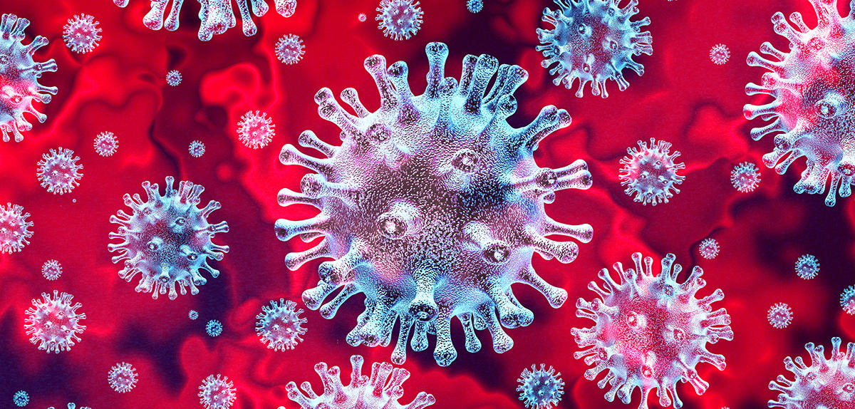
Victory is possible
Notes:
When the Covid-19 pandemic emerged, the whole world was afraid. In many places, healthcare professionals had to accept vaccination to work, and in other circumstances, a vaccination certificate was required for international travel. Taking PCR tests also became a necessary formality for accessing certain services, and you probably remember when wearing a mask was mandatory.
When the pandemic of sin entered the world, what solution was proposed?
In addressing the story of the original sin (Genesis 3), humanity succumbs to the temptation of becoming like God. Thus, sin is a distortion of humanity created in the image of God. Imagining God through what man could become is a real temptation of excess. All of this constitutes a form of idolatry. Sin could be defined as self-worship…

Slide 22
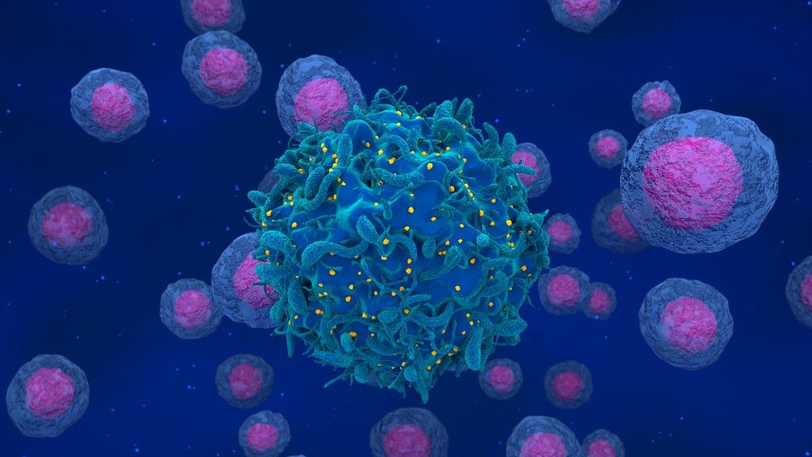
Notes:
Evil is not revealed as an inevitability but rather as the result of an action freely chosen by the first human couple. Sin does not liberate humanity; on the contrary, it confines and alienates our relationship of dependence on the Creator. If sin were an inevitability, there would be no point in relying on Christ to achieve victory.
Some believers think that sin is inevitable, that we cannot do anything about it. They suggest establishing a kind of ‘cohabitation contract’ with sin, as if it were impossible to resist it. This is a diabolical trap, as the enemy wants to trap us in bad habits by making us believe that our nature is permanently corrupted and that we are powerless against this reality. Jesus came to say the opposite!

Slide 23
"1 Corinthians 10:
12 So, if you think you are standing firm, be careful that you don’t fall!
13 No temptation has overtaken you except what is common to mankind. And God is faithful; he will not let you be tempted beyond what you can bear. But when you are tempted, he will also provide a way out so that you can endure it.
If you choose to accommodate sin, you will have no difficulty doing so because sin is ‘pleasant to the eyes and good for food.’ Resisting would instead lead us to depend on the Lord and, most importantly, on the Holy Spirit, who can convince us not to yield to temptation. Jesus taught his disciples to ask the Father not to lead them into temptation but to deliver them from evil (Matthew 6:9-13).
.
Notes:
Therefore, we can rely on Jesus to help us resist and achieve victory over sin. The Bible encourages us to stand firm and not be discouraged. Listen to or read what Paul says to the Corinthians: ‘If you think you are standing firm, be careful that you don’t fall! No temptation has overtaken you except what is common to mankind. And God is faithful; he will not let you be tempted beyond what you can bear. But when you are tempted, he will also provide a way out so that you can endure it.’ (1 Corinthians 10:12-13)"

Slide 24
«That is why He is able to save completely those who come to God through Him, because He always lives to intercede for them.” (Hebrews 7:25). »
… If we claim to be without sin, we deceive ourselves, and the truth is not in us. If we confess our sins, He is faithful and just and will forgive us our sins and purify us from all unrighteousness. If we claim we have not sinned, we make Him out to be a liar, and His word is not in us.” (1 John 1:8-10))
Notes:
Do you want to entrust your life to Jesus tonight, here and now? It is likely that someone here is struggling with a sin, or someone else is tormented by ambiguous behavior, unsure if it is right or wrong... You need clarity and victory. So, I repeat, let Jesus win victories in your life. The epistle to the Hebrews says: ‘Therefore, he is able to save completely those who come to God through him, because he always lives to intercede for them.’ (Hebrews 7:25)
Thus, we are invited to be honest with ourselves and humble before God, to confess our faults to Him and receive His forgiveness and support to resist.

Slide 25
Notes:
Jesus is truly the only one who can understand, support, forgive, and heal us from sin and its consequences. He wants to teach us through the Holy Spirit, who leads us to awareness of what is wrong and, if we desire, to victory.

Slide 26
Jésus veut nous sortir du péché et de son emprise sur l’esprit humain. Il veut nous guérir des conséquences du péché, d’un péché personnel ou du péché de quelqu’un d’autre qui a impacté votre parcours de vie.
Notes:
In conclusion, ladies and gentlemen, understand the following:
Jesus was tempted in various ways. What lessons can you draw from this?
Jesus resisted temptation. What can we learn from his testimony?
I don’t want to ask you tonight what you would have done in Jesus’ place. I couldn’t tell you with certainty what I would have done either... but I have understood a number of things. Allow me to share them with you: (read the ...)"

Slide 27
Notes:
"Do you need the special help of the Holy Spirit to get out of a situation incompatible with the divine will? If there is a situation or behavior that you recognize as ‘sin,’ do not be discouraged, because Jesus can help you achieve victory. Sometimes, victories are immediate; other times, they are progressive. But do not delay—tell Jesus your needs.
Let’s walk with Him and allow Him to help us gain clarity about our own situation and accept His help, through the action of the Holy Spirit in our hearts. (Brief prayer)
May God bless you abundantly and help you achieve victories!"

Slide 28
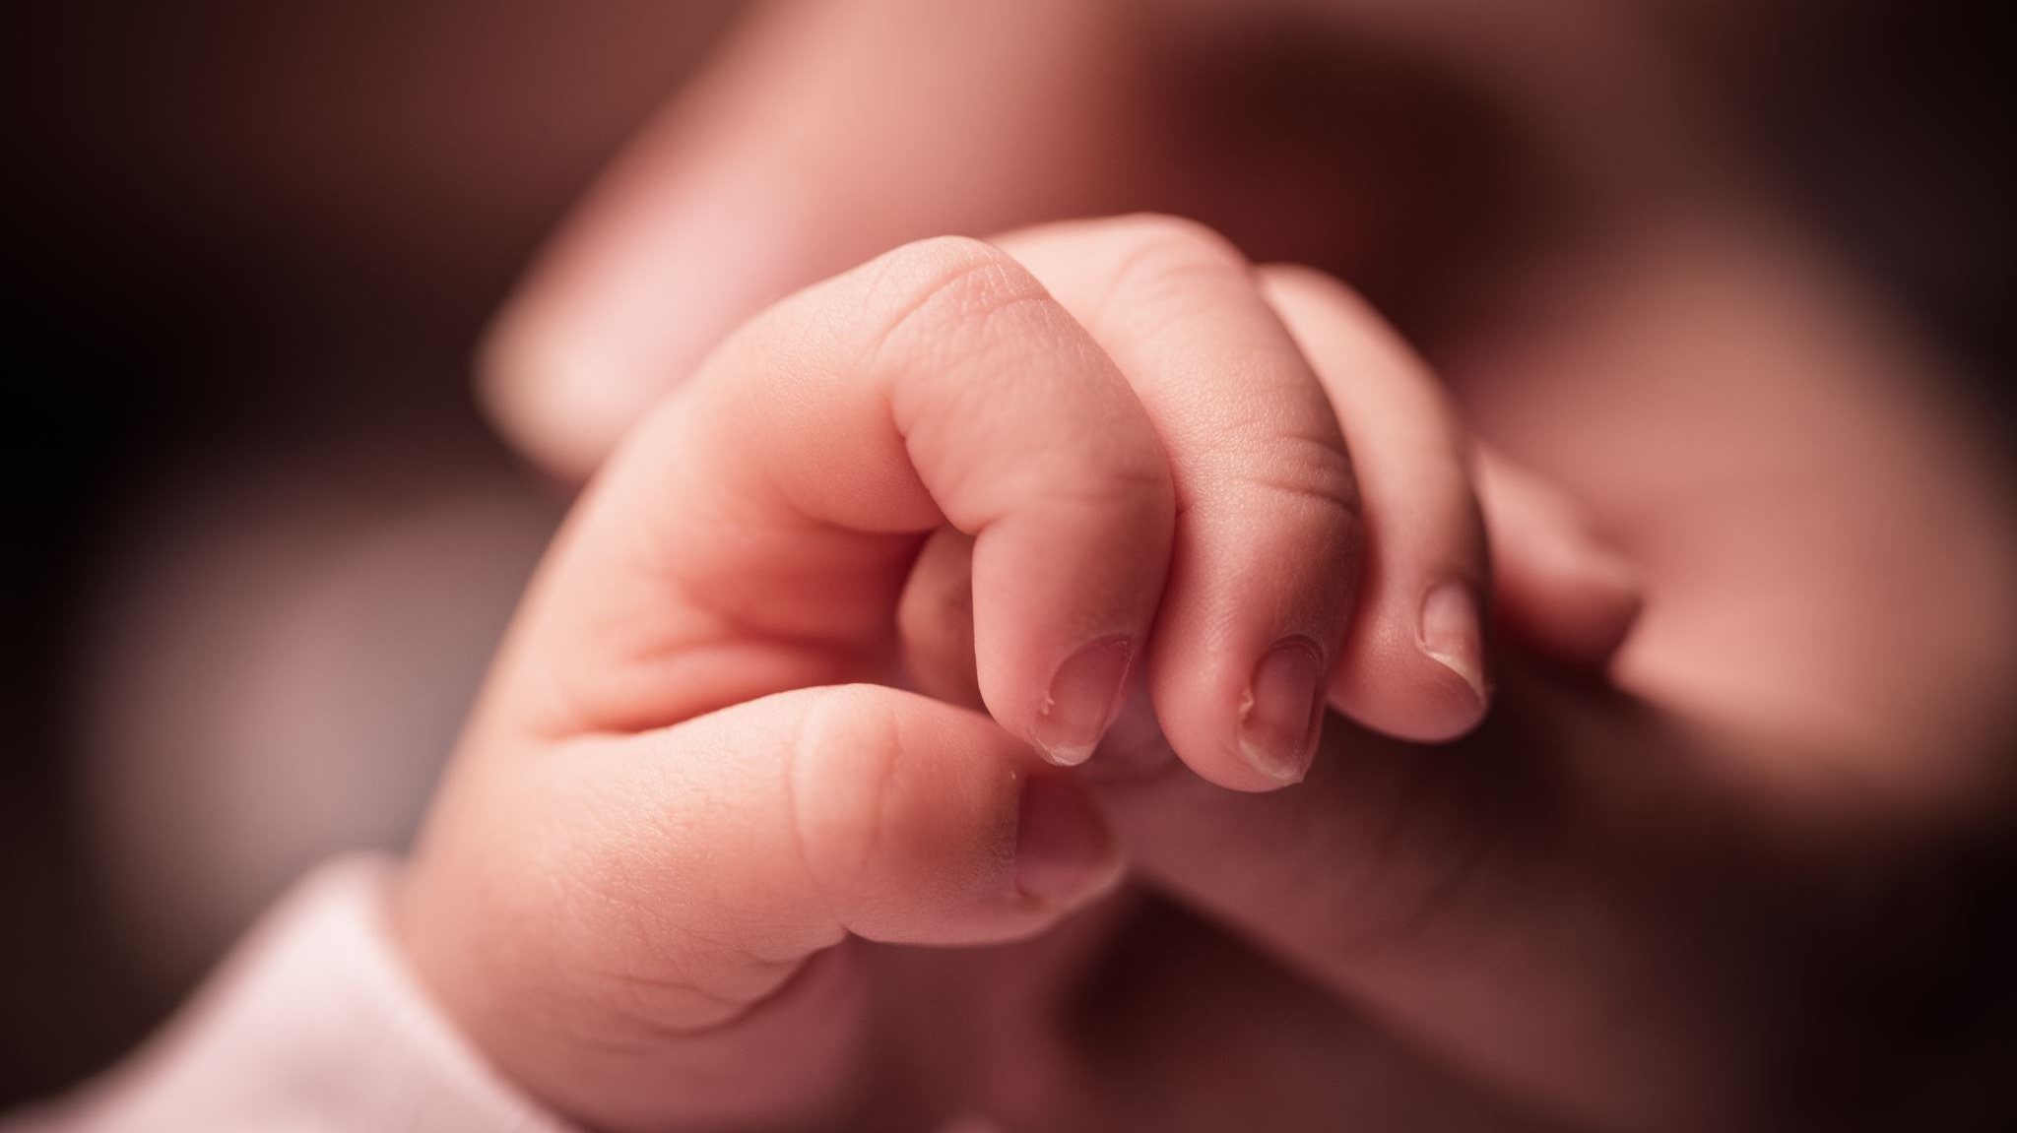
IMPACT 2025

Slide 29
Genesis 2
“Then the Lord God planted a garden in Eden, in the east, and there He placed the man He had formed. The Lord God caused to grow from the ground every tree that is pleasing in appearance and good for food, as well as the tree of life in the middle of the garden, and the tree of the knowledge of good and evil.

Slide 30
The Lord God took the man and placed him in the garden of Eden to work it and take care of it. And the Lord God commanded the man, ‘You are free to eat from any tree in the garden; but you must not eat from the tree of the knowledge of good and evil, for when you eat from it you will certainly die.

Slide 31
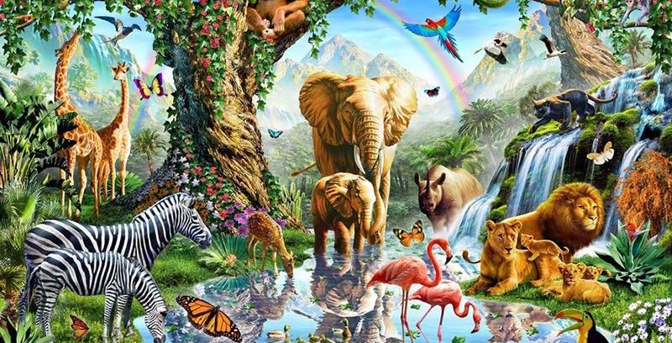
Notes:
The first words that humanity hears about itself come from God, and they are words of blessing and responsibility: ‘God said to them: Be fruitful and increase in number; fill the earth and subdue it. Rule over the fish in the sea and the birds in the sky and over every living creature that moves on the ground.’ (Genesis 1:28)
A little further on, Genesis 2:25 provides detail about the physical state of the first representatives of humanity: they were ‘naked’ – *arumim* – and were not ashamed!
‘And they were both naked, the man and his wife, and were not ashamed’ (literal translation). Immediately following, Genesis 3:1 mentions the ‘nakedness’ or ‘cunning’ – *arum* – of the serpent!

Slide 32
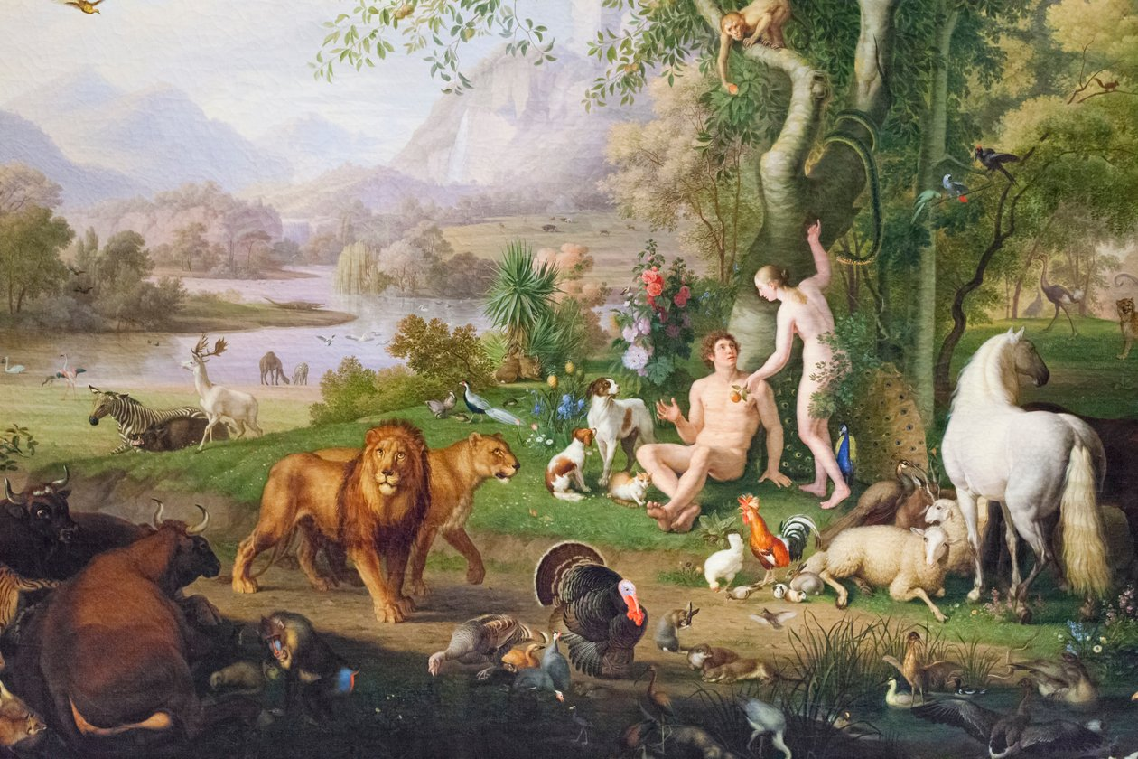
Notes:
And the serpent was *aroum* among all the living creatures of the field that Yahweh Elohim had made. Notice the connection between the ‘naked’ man, without shame or embarrassment, and the ‘naked’ serpent, without any moral or ethical connotation. It is simply stated that his nakedness is unique among all the animals of the field. Most translations have rendered the nakedness of the serpent as ‘cunning.’ The serpent, too, is not ashamed of what he is, whether it is through cunning, malice, deceit, hypocrisy, or pretense... Is this a clarification or a warning for the reader? The continuation of the story provides the answer...
The way the text is written suggests that humans and animals lived in a harmonious balance, without fear and without shame, in peaceful coexistence, and that creation functioned in optimal conditions. The problem arises later regarding the meaning given to God’s word, which disrupts this situation."

Slide 33
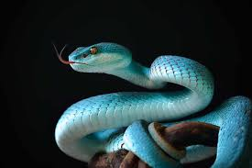
Genesis 3
Now the serpent was more cunning than any of the wild animals the Lord God had made. He said to the woman, ‘Did God really say, You must not eat from any tree in the garden?’ The woman said to the serpent, ‘We may eat fruit from the trees in the garden, but God did say, You must not eat fruit from the tree that is in the middle of the garden, and you must not touch it, or you will die.’ ‘You will not certainly die,’ the serpent said to the woman. ‘For God knows that when you eat of it your eyes will be opened, and you will be like gods, knowing good and evil.

Slide 34
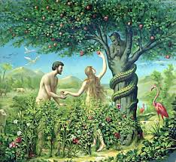
When the woman saw that the fruit of the tree was good for food and pleasing to the eye, and also desirable for gaining wisdom, she took some and ate it. She also gave some to her husband, who was with her, and he ate it.

Slide 35
What is the difference between temptation and sin?
Feminine noun
1.1
Religion
Impulse that leads to sin, to evil. .
To succumb to temptation. .
2.
What incites (an action) by arousing desire
The temptation of travel; to embark on a journey.

Slide 36
SIN
Masculine noun
1.1
RELIGION
Conscious act by which one does what is forbidden by divine law.
To confess one’s sins.
2.
SIN
The state in which a person finds themselves after committing a sin.

Slide 37
To make it simple...
Temptation is generally associated with the notion of sin
Temptation is not sin
Temptation is akin to a personal/intimate test
Temptation appeals to our conscience

