Slide 1

A New Birth Certificate
#5 IMPACT IOUC
Notes:
I’m not sure if you felt the same way I did when you had to declare the birth of your child. Each time I went to city hall to register the birth of our three children, I felt a joy in writing their names next to my family name. Each of these little beings was unique, and mentioning their names created a bond that was both different and unique. A new life, a new story with a unique life perspective…

Slide 2

Notes:
Let me tell you tonight (or wherever you are if you’re connected) a beautiful lesson that comes from the Bible: "You are unique in God’s eyes." Creation makes you unique, and so does redemption. To be unique in this way, you must accept being born from above—or, if you prefer another expression, to be born again! (Before going further, let’s pray to ask God to help us understand His Word of life, truth, and hope.)

Slide 3

Notes:
Did you know that there are more and more clinics and plastic surgery facilities because people who have the means and desire decide to change certain parts of their bodies, get hair transplants, and so on? The desire to change physical appearance is often tempting, but not everyone does it, for various reasons, mainly financial, as it has a cost, doesn’t it? Tonight’s topic also involves the concept of change.

Slide 4
John 3
But there was a Pharisee named Nicodemus, a leader of the Jews. ₂ He came to Jesus at night and said, “Rabbi, we know that you are a teacher who has come from God, for no one could perform the signs you are doing if God were not with him. ₃Jesus replied, “Very truly I tell you, no one can see the kingdom of God unless they are born again.
₄Nicodemus asked, “How can someone be born when they are old? Surely they cannot enter a second time into their mother’s womb to be born!”
Notes:
Not easy to understand, is it, considering Nicodemus’ reaction? This new birth, synonymous with regeneration, represents a process that takes the believer from death to life, from nothingness to new existence. Before this process, man remains captive to sin, a state akin to death, to nothingness (Ephesians 2:1). He needs to come (or return) to life. The grip of the flesh prevents man from having a healthy and holy relationship with God. Hence, the necessity of new birth becomes evident. Biblical teaching emphasizes becoming a new creation.

Slide 5
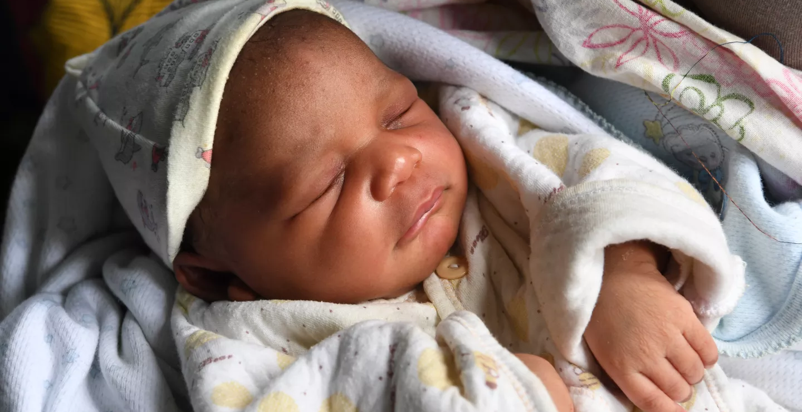
Notes:
This experience is only possible in Jesus Christ. He is ready to inspire our faith, to revive it if necessary, to make us aware that the true meaning of life is found with God, and that only with Him and in Him can we truly grow. If you were asked to choose to be reborn, what choices would you make regarding the country, the family, the color of your skin, your eyes, the texture of your hair, and other considerations? Don’t smile; I’m serious. But I also know your imagination is fertile, like that of this Pharisee leader who came to see Jesus. Excuse me for interrupting your dream... Let’s get back to tonight’s topic.

Slide 6
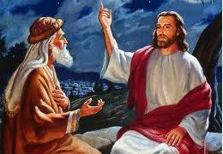
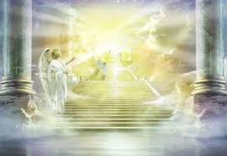
Notes:
Jesus wants to convince Nicodemus of the need to see beyond simple miracles. The theological criticism Jesus directs at Nicodemus is about how this teacher in Israel understood the signs of vocation. He associates miracles with true apostleship. If Jesus performs miracles, it’s because He has come from God. His focus is on the visible, and his reading is superficial. He does not yet know how to read between the lines, to understand at a deeper level.

Slide 7
Notes:
Jesus does not call Nicodemus small-minded, and in correcting him, He neither condescends nor is severe with this Pharisee leader. He invites him to go beyond what he sees, to distinguish between the essential and the relative, between priorities and secondary things. Nicodemus does not take offense; his self-confidence and self-esteem are likely high enough. He wants to engage in a debate, but he still has more to learn from Jesus. No one would argue the importance and interest of miracles, those signs of divine power that accompany Jesus’ ministry.

Slide 8

2 Corinthians 5
₁₇Therefore, if anyone is in Christ, the new creation has come: The old has gone, the new is here! 18 All this is from God, who reconciled us to himself through Christ and gave us the ministry of reconciliation.
Notes:
New birth, synonymous with regeneration, represents the process that takes the believer from death to life, from nothingness to new existence. Before this process, man remains captive to sin, a state akin to death, to nothingness (Ephesians 2:1). He needs to come (or return) to life. The grip of the flesh prevents man from having a healthy and holy relationship with God. Hence, the necessity of new birth becomes evident. The Bible emphasizes becoming a new creation (Galatians 6:15; 2 Corinthians 5:17). This experience is only possible in Jesus Christ. He is ready to inspire our faith, to revive it if necessary, to make us aware that the true meaning of life is found with God, and that only with Him and in Him can we truly grow.

Slide 9

Seeing with the Heart
Notes:
In the book The Little Prince by Saint-Exupéry, we remember these words that have marked generations: “One sees clearly only with the heart. What is essential is invisible to the eye.” Follow, then, the conversation Jesus had with Nicodemus, during which two major points are highlighted. First, the new birth allows one to see the kingdom of heaven, and second, when it is experienced in the water of baptism and under the holy influence of the Spirit, it allows one to enter the kingdom of God. The Christian has never “arrived” in this experience. The journey with Christ involves self-denial for a new life in Jesus. This is a fundamental aspect of the sanctification process. Step into the immediate environment of this story. Nicodemus approaches Jesus, honoring Him with a compliment: “Rabbi, we know that you are a teacher who has come from God, for no one could perform the signs you are doing if God were not with him.” (John 3:2)

Slide 10
« Jesus replied, ‘Very truly I tell you, no one can see the kingdom of God unless they are born again. » (John 3:3)
Notes:
Nicodemus sees Jesus only as a man sent from God but does not realize that it is God Himself, made human, who is speaking to him. He does not know that more than a miracle, it is the visible image of the invisible God standing before him. John tells us that Jesus corrects Nicodemus’ perception:
« Jesus replied, ‘Very truly I tell you, no one can see the kingdom of God unless they are born again.’ » (John 3:3)

Slide 11
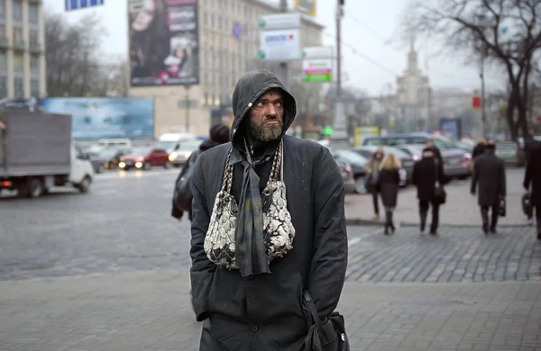
Born Again!
Notes:
There is a story about a preacher speaking to a group of people in Hyde Park, London. He was publicly confronted by an atheist who had come with bad intentions. The atheist challenged the preacher by saying:
“What can your speech do about everyday problems? People need to stop believing, and then we’ll have more freedom. Look at this man,” he said, pointing to a drunkard in the crowd. “He’s wearing old, torn clothes, and he’s dirty. With a bit of money, I can put new clothes on this man. Since he’s been here, your Christian talk hasn’t changed his life, but I can give him new clothes.”

Slide 12
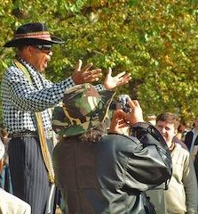
Notes:
The preacher calmly replied:
“Listen, I don’t doubt your resources. I think you could indeed put new clothes on this man, but Jesus Christ, the Savior, is able to put a new man in those same old clothes. Jesus can transform him!”

Slide 13
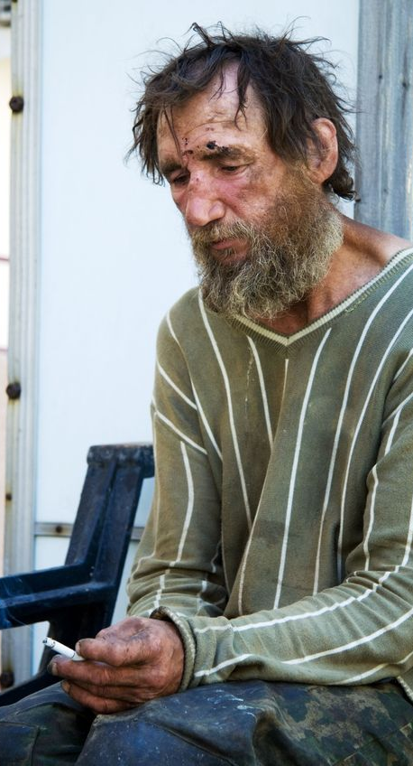


Notes:
The Bible announces that Jesus can transform the heart of any man, any woman, regardless of their social or professional background. Material resources allow for external changes, but inner change cannot be bought or sold. It comes from the cross, from God’s love for each of us.
What our society needs most is not new resources, new fashions, new clothes, or new beliefs or religious or philosophical practices. Our time needs new men and women, transformed by the power of divine grace.

Slide 14
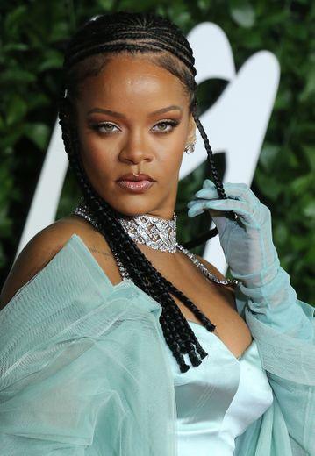


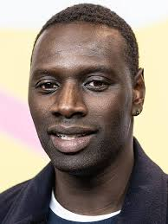

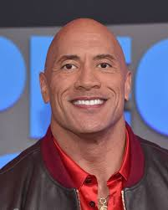
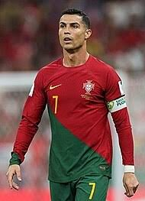
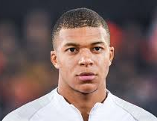

Notes:
The celebrities who fill our screens, win Oscars, trophies, and other awards—if these people are not born again…

Slide 15
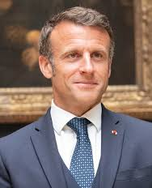
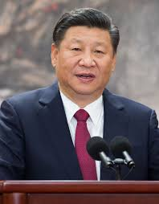
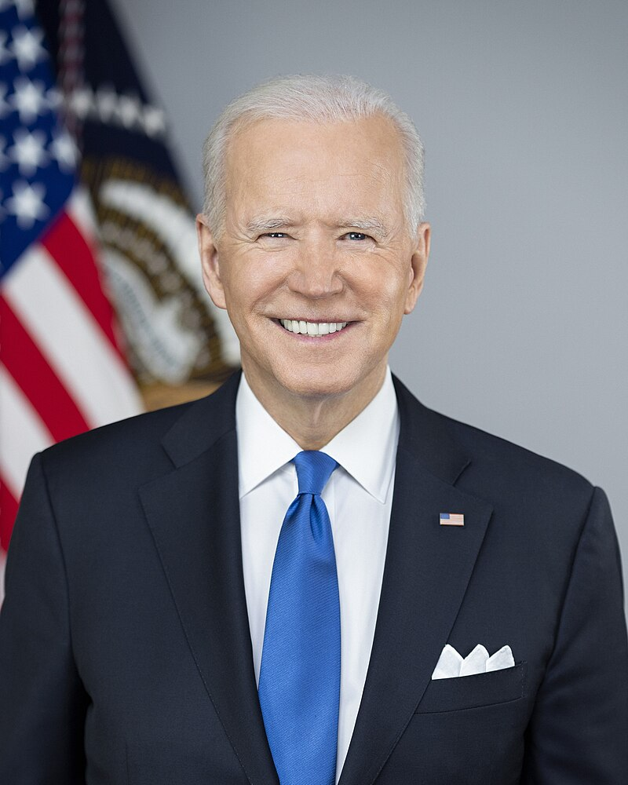
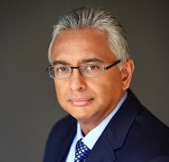
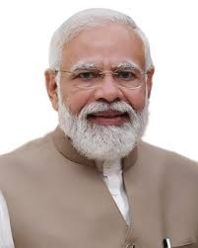
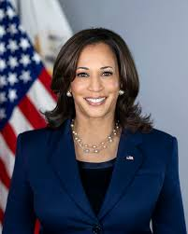
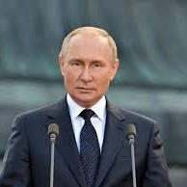
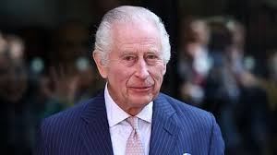
Notes:
The world leaders, those who decide our social and economic future… they also need to be born again if they want to SEE the kingdom of God.

Slide 16

Sanctification is an aspect of every transformed life. It is the visible evidence of a Christian’s growth in God’s love. Reforming ourselves is, therefore, a work of patience. God knows our weaknesses and flaws, and all He wants to do is help us correct ourselves so that the Gospel truly finds a place in our hearts and its effects around us.
Notes:
Change becomes visible when, in humility and wisdom, the believer learns to be guided by the Spirit of God. Jesus the Savior truly becomes the Lord of one’s life when the believer renounces what previously made their life incompatible with God’s will. When Jesus is present in our lives, it is felt in our language, our actions, and our relationships. A true transformation takes place because accepting Jesus in our lives necessarily brings about changes.
Do you think this concerns you today? Accepting Christ means obeying His Word and applying His teachings in our lives. “Those who love me,” says Christ, “are those who keep my commandments.” (John 15:14) This process is called sanctification, which confirms a real and daily relationship with the Lord.

Slide 17
The other aspect intimately linked to it is called justification. The one who is washed, purified by God, becomes a new creature who wants to glorify God, who exalts the Savior. There is no justification without sanctification, this relationship of holiness and growth.
Notes:
Sanctification is an aspect of every transformed life. It is the visible evidence of a Christian’s growth in God’s love. Reforming ourselves is, therefore, a work of patience. God knows our weaknesses and flaws, and all He wants to do is help us correct ourselves so that the Gospel truly finds a place in our hearts and its effects around us.
The other aspect intimately linked to it is called justification. The one who is washed, purified by God, becomes a new creature who wants to glorify God, who exalts the Savior. There is no justification without sanctification, this relationship of holiness and growth. The justified believer seeks to adhere to Jesus, and therefore to His body, which is the Church. There, he finds numerous learning opportunities, as well as real possibilities for progress, relationships, and witnessing to the glory of God.

Slide 18
Our good works will not help us enter the kingdom of God (what we like to call paradise) more easily or quickly.
Notes:
Our good works will not help us enter the kingdom of God (what we like to call paradise) more easily or quickly. That doesn’t mean they have nothing to do with our spiritual experience. When considered carefully, they reflect God’s action in our lives, His transforming power. Good works say, among other things, that salvation is real, that Jesus truly changes a life. They confirm our salvation.
If works don’t save, they don’t condemn either. They are not counted for salvation, as they are neither the primary nor the final condition. Works of holiness are not a condition of salvation but are its consequence. Without works, faith is just theory. Without works, faith is passive, and if it doesn’t express itself through concrete actions that reflect the relationship between the believer and the Lord, that faith is dead (James 2:14-20).

Slide 19
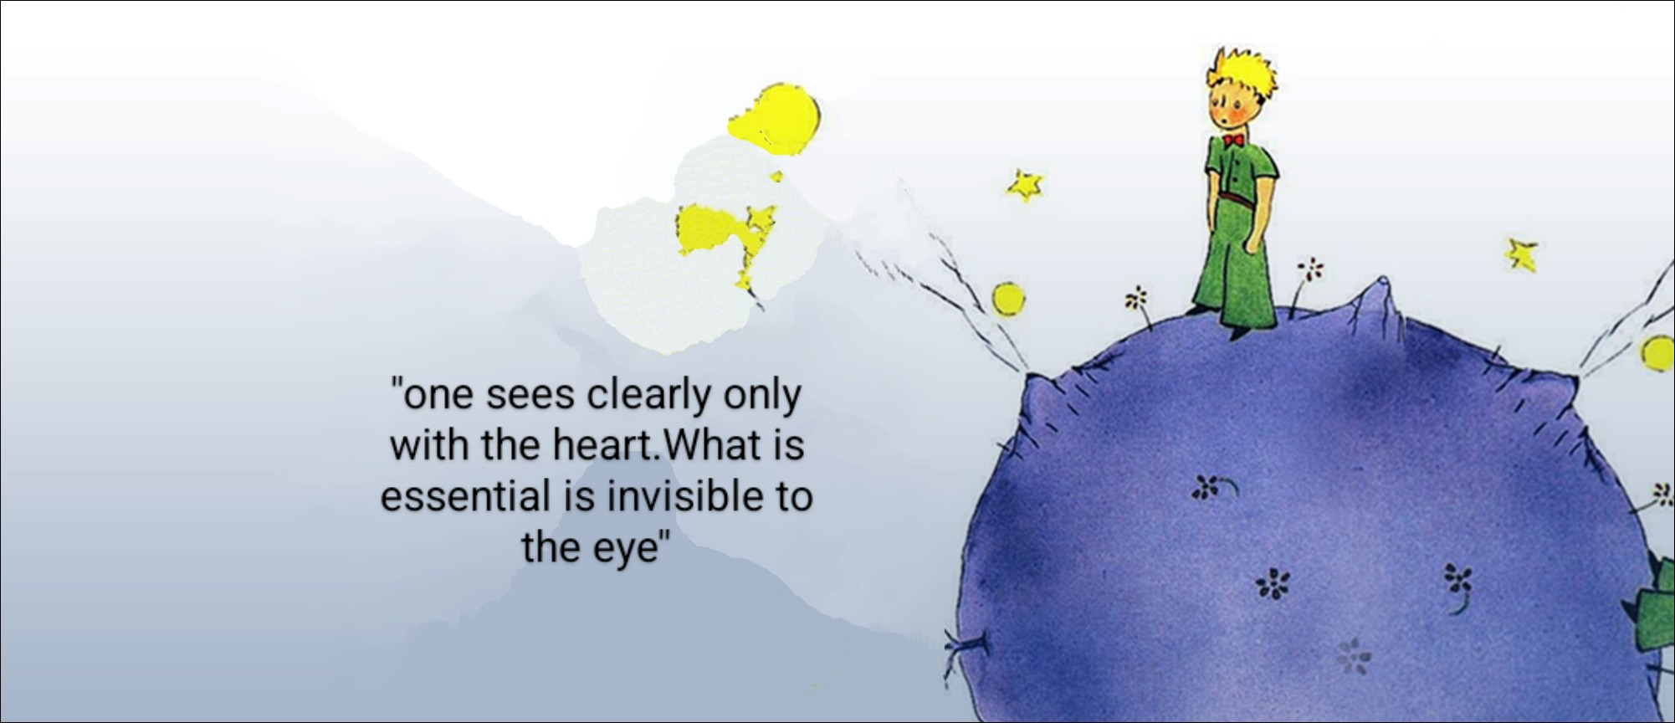
Notes:
You may be looking for answers to clear questions, but it’s also possible that the Lord goes ahead of you, revealing the shadows in your spiritual journey. To experience this, you need to embark on a journey with Jesus…
God’s love helps the believer heal from painful memories. It helps them overcome emotional wounds, relational or emotional disappointments. God’s love helps the believer rebuild themselves in view of the kingdom. From the cross, Jesus truly draws men and women to Him. Don’t miss the opportunity to look beyond the visual and to see with the heart the blessings of God or the way He responds to your prayers and needs.

Slide 20
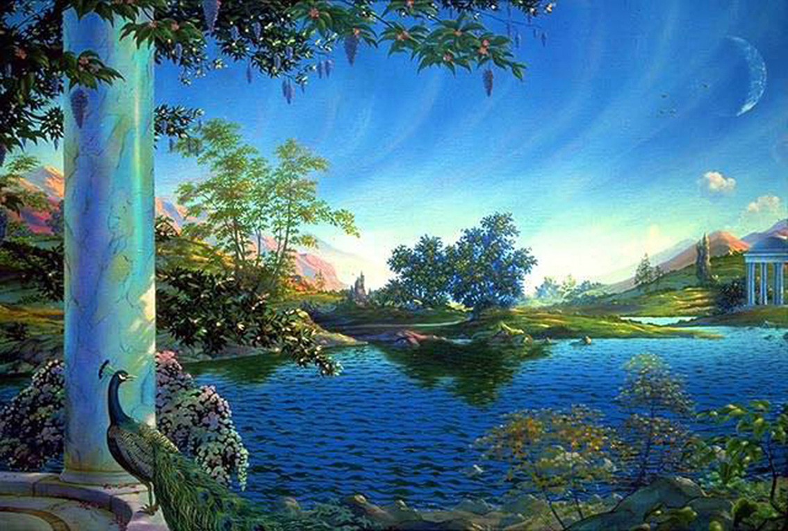
Born of Water and Spirit!
Jesus continues His conversation with this religious leader who doesn’t seem to fully grasp what Jesus wants to convey to him. “Jesus answered, ‘Very truly I tell you, no one can enter the kingdom of God unless they are born of water and the Spirit.. » (John 3:5)
Notes:
Notice, however, how Jesus proceeds and helps Nicodemus progress in his reasoning. He moves from the verb see to the verb enter. Watching miracles without seeing the kingdom of heaven (also sometimes called the kingdom of God).
Imagine someone spending their time going back and forth in front of stores, thinking that what they see is very interesting, that they could get some good deals, but they stay outside looking through the windows. The good deal will only begin if they take the time to enter. Too often, we may resemble Nicodemus. Believing that we know something about God, His kingdom, His will, yet missing the essential. Too often, people have spoken about God, written, preached, commented, but haven’t truly taken the step to fully enter the kingdom of God.

Slide 21
Notes:
The new birth (which inevitably comes from divine action) enables one to see the kingdom of heaven. Secondly, when it is experienced through the water of baptism and under the holy influence of the Spirit, it allows entry into the kingdom of God. The Christian is never "arrived" in this experience. The journey with Christ involves self-denial for a new life in Jesus. This is one of the fundamental aspects of the process the Bible calls sanctification. Notice that Jesus wants to advance Nicodemus' reasoning in the perspective of God’s kingdom, and the two major elements He emphasizes in this second truth are the following:
Being born in water;
Being born in/by the Spirit.

Slide 22
Notes:
On this subject, observe that the path with Jesus necessarily passes through the waters of baptism, especially when the opportunity arises. Jesus Himself gave a clear indication: "Whoever believes and is baptized will be saved." (Mark 16:16) Jesus specifically says “whoever believes,” meaning the person must be able to do so themselves. No one can believe on your behalf, not even those who love you the most, whether your parents, spouse, children, or friends. Only from a personal faith expressed at a reasonable age (capable of reasoning), a personal and intimate decision, as the fruit of conviction, should each individual take their baptism. Remember the Ethiopian eunuch who asked to be baptized once he understood who the Messiah was and what it meant in his life (Acts 8:26-39). Returning to the first element of Jesus' second lesson to this learned man, we are confronted with the question of baptism because it is the only concrete and explicit means that evokes water in the Christian experience. If you want to become a disciple of Jesus, the experience of baptism will be one of the most beautiful practical decisions you’ll ever make...

Slide 23
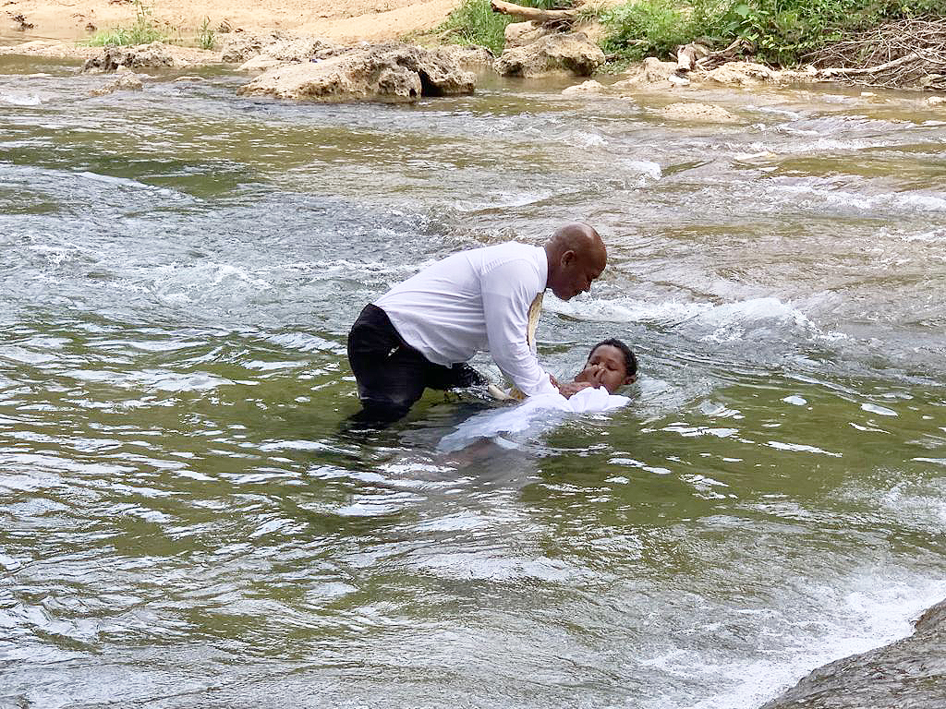
The term “baptize” comes from the Greek baptizo, which means several things:
to dip repeatedly, to immerse, to submerge (a sinking ship)
to cleanse by dipping or submerging, to wash, to make pure with water, to wash oneself, to bathe
to cover (to submerge)...
Notes:
For those of you passionate about words and their origins, know that the term “baptize” comes from the Greek baptizo and has several meanings:
to dip repeatedly, to immerse, to submerge (a sinking ship)
to cleanse by dipping or submerging, to wash, to make pure with water, to wash oneself, to bathe
to cover (to submerge)…
Being born of water undoubtedly leads the believer to experience baptism, as John the Baptist did. It is said that John baptized in the Jordan River (Matthew 3:6) and, according to the Gospel of John, specifically at Aenon because there was plenty of water there.

Slide 24
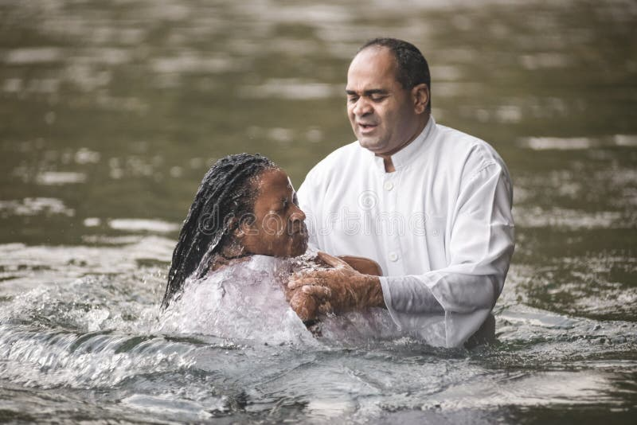
« "John was also baptizing at Aenon near Salim, because there was plenty of water there, and people were coming to be baptized." (John 3:23). »
Notes:
Let’s be practical and reason about the meaning of the verb baptize and the mode of baptism. Understand that if it were not to immerse (submerge, cover with water…) people in the river, John could have stayed in the village center or even done all this in the city of Jerusalem.
Baptism takes on its meaning already with Jesus, who asks John to baptize Him to fulfill all righteousness… (Click and read the biblical text)

Slide 25
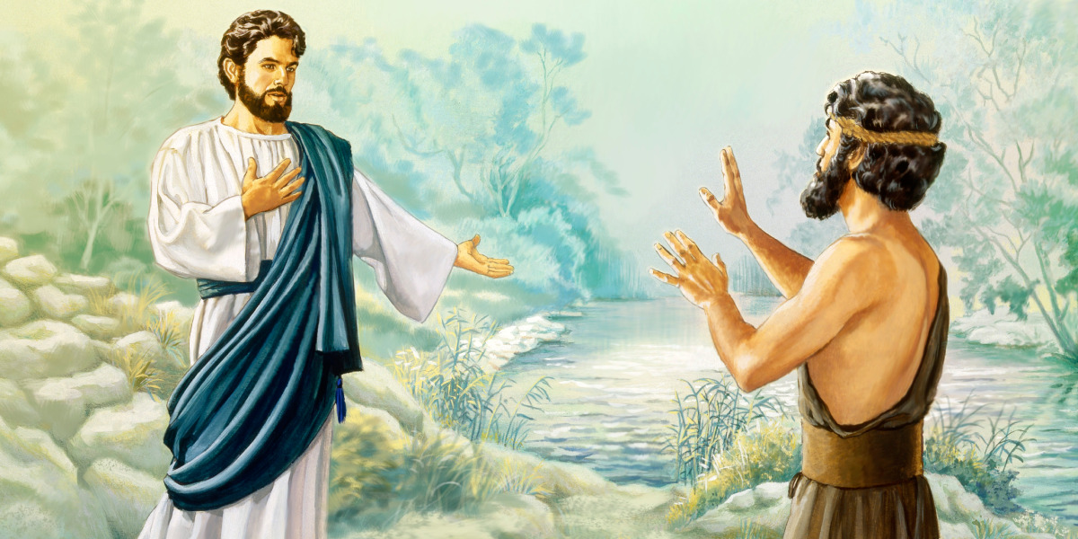
₁₃Then Jesus came from Galilee to the Jordan to be baptized by John. ₁₄ But John tried to deter him, saying, “I need to be baptized by you, and do you come to me?” ₁₅ Jesus replied, “Let it be so now; it is proper for us to do this to fulfill all righteousness.” Then John consented. ₁₆ As soon as Jesus was baptized, he went up out of the water. At that moment heaven was opened, and he saw the Spirit of God descending like a dove and alighting on him. ₁₇ And a voice from heaven said, “This is my Son, whom I love; with him I am well pleased.” (Matthew 3)
Notes:
Jesus Himself encouraged His disciples to baptize, and later, in the missionary order (Matthew 28:19), He included baptism as a necessary, complementary element in the testimony of everyone who believes in Him.

Slide 26
The second aspect of this new life is the birth in, by, or of the Spirit.
Notes:
The second aspect of this new life is the birth in, by, or of the Spirit, meaning the Holy Spirit. Jesus clarifies this to Nicodemus, who, as a learned man, a scholar, and teacher of his time, did not fully grasp what he was hearing.

Slide 27
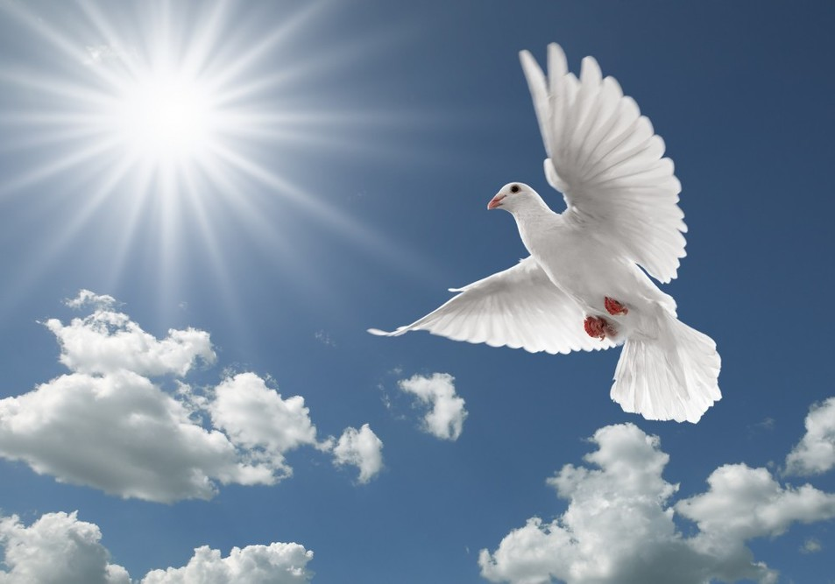
« Flesh gives birth to flesh, but the Spirit gives birth to spirit. 7 You should not be surprised at my saying, ‘You must be born again.’ 8 The wind blows wherever it pleases. You hear its sound, but you cannot tell where it comes from or where it is going. So it is with everyone born of the Spirit. » (John 3)
Notes:
Jesus uses the image of the wind, whose effects are felt and visible, even if we cannot say where it comes from, its height, width, or color… When someone accepts this new birth, its effects will be evident in them, even if they cannot fully define such an experience.

Slide 28

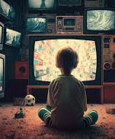
Notes:
What are you looking for in everyday life? What are you seeking? Spectacular signs from God to prove He exists? Or can you accept that even if there are no spectacular signs, you will still believe that God is alive, that He is present and active in your life?
The encounter with Nicodemus becomes an opportunity for this scholar, this university professor of his time, to be born again. The New Testament records his conversion, and it’s good news for everyone. So, how many more Nicodemuses do we need to understand that God wants to give us a new birth certificate in Jesus? God wants to be our Father and wants to make us His children, His sons and daughters.

Slide 29

Notes:
What are our interests? How do we organize our family life? If someone has experienced setbacks, relational, professional, or financial failures, what motivates you today?

Slide 30
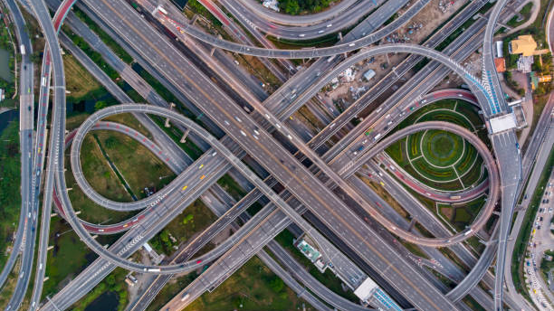
Notes:
Which path to take to enter the kingdom of God? The shortest one? The flattest? The most comfortable? The least demanding? Which path? The one you already know? A path shaped by education, traditions, cultural heritage?
Jesus presents Himself as the new path for a new beginning…

Slide 31

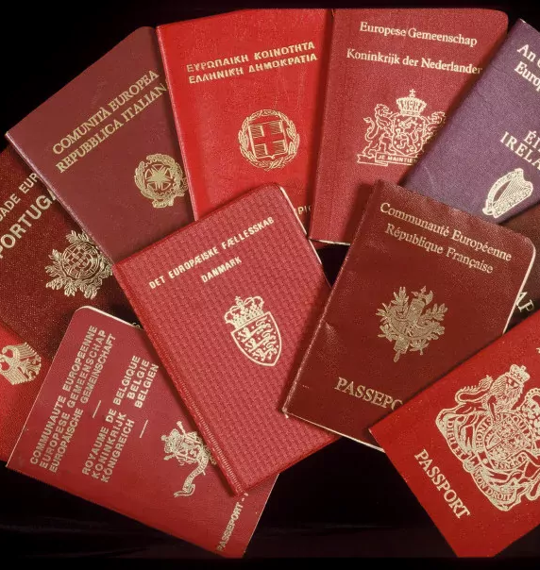
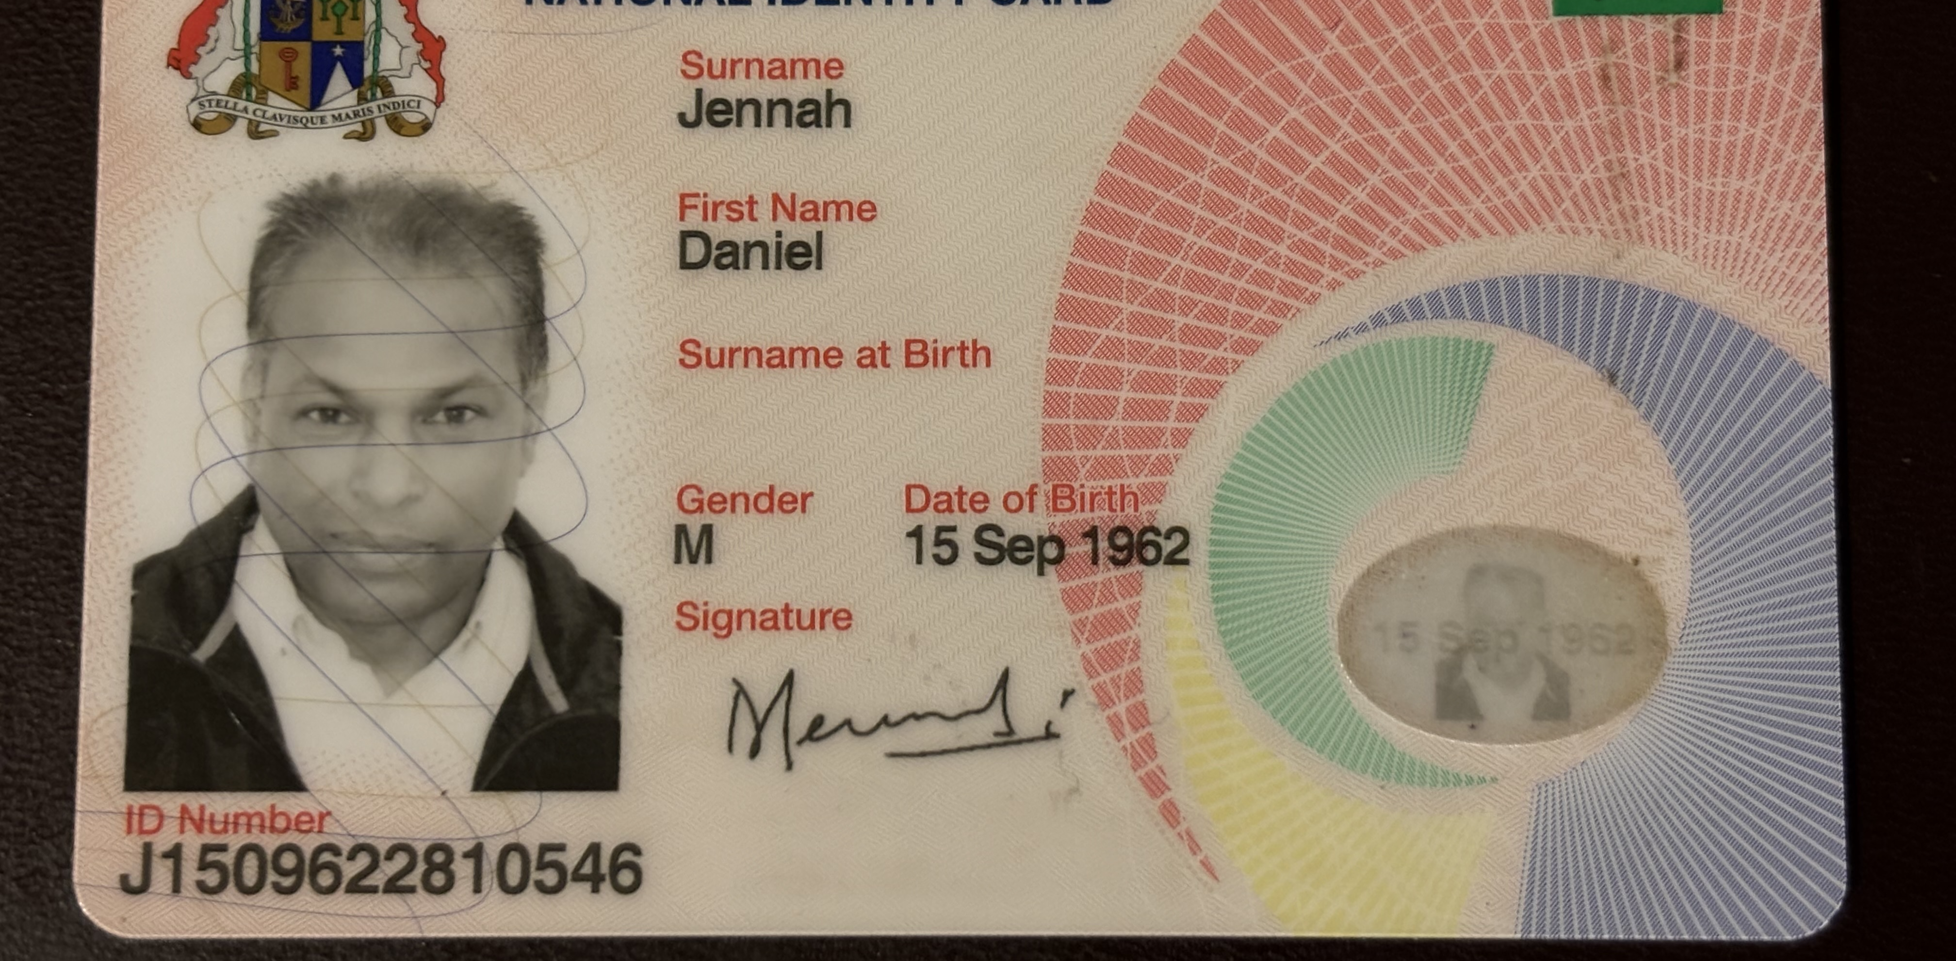
Notes:
When we go through administrative processes...
following the loss of our identity papers or passport, do we use the opportunity to change our nationality? Of course not! But when we encounter Jesus, our life changes direction, and we find a new spiritual identity through this change by being born of water and the Spirit.

Slide 32
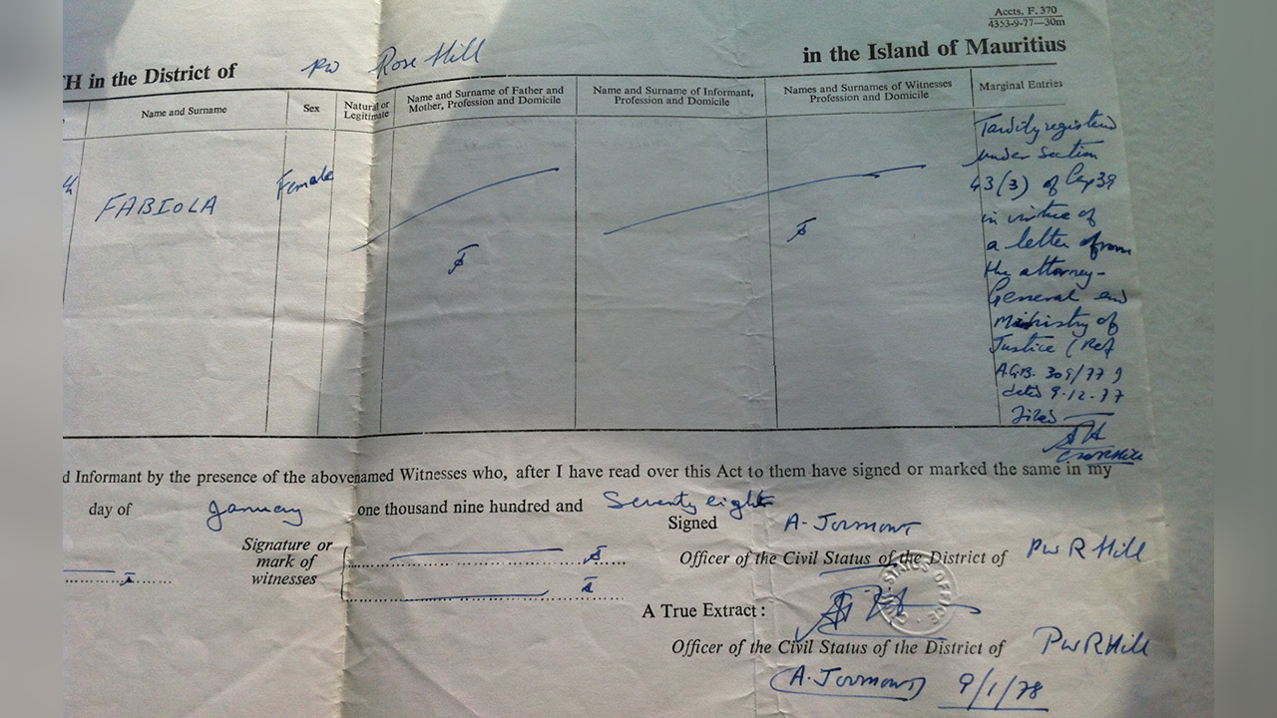
IF SOMEONE IS NOT BORN FROM ABOVE…
IF SOMEONE IS NOT BORN OF WATER AND THE SPIRIT
Notes:
Remember what is essential tonight, the essential that is seen with the heart, the essential that involves a true change of mindset and gives meaning to our lives. The kingdom of heaven awaits at the end of this experience. Jesus allows us to break free from the pessimistic human cycle: to be born, live, and die. He invites us to add the word hope to our life’s journey.

Slide 33
Do you believe that God loves you, even if nothing spectacular happened to you this week?
Have you experienced baptism by immersion? If not, would you consider it in your heart tonight?
God loves you in Jesus: do you accept Jesus as the Savior and Lord of your life?
Notes:
If we accept Him, we will immediately begin our journey of life with Jesus. He will surely lead us to the Father, for it is through His Only Son that God has brought His love into our hearts…
Before concluding, allow me to ask you three simple questions:

Slide 34
Seven words for eternity:
God wants to see you in His kingdom!
Notes:
I am happy to have shared this message with you tonight. I am even happier to know that Jesus is speaking to you, just as He did to Nicodemus, and His invitation to a new birth still resonates this October 2025, here, on this beautiful island. Think about it, because it’s for you and me that He came to share the will of the Heavenly Father. Remember these seven words: God wants to see you in His kingdom. Don’t get distracted, and at least take time to reflect on the answer you will give to the God who loves you. What you decide today could have eternal consequences…
If you can see this kingdom spiritually tonight, take the step you need to enter it. Entrust your life to Jesus, for He is the one who leads to the Heavenly Father who opens the way for you.
I wish you a good evening and a safe journey with Jesus!

Slide 35
#5IMPACT IOUC 2025

