Slide 1
#6 Seeking the Kingdom
Conférences bibliques

Slide 2
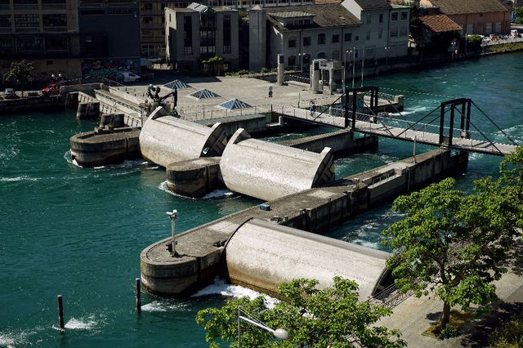
Notes:
In early October 2023, French President Emmanuel Macron was on a two-day state visit to Switzerland, with an unusual negotiation on his agenda: the head of state was officially asking to increase the flow of the Rhône River, whose "tap" is located in Switzerland and controlled by the Seujet dam in the heart of Geneva.

Slide 3
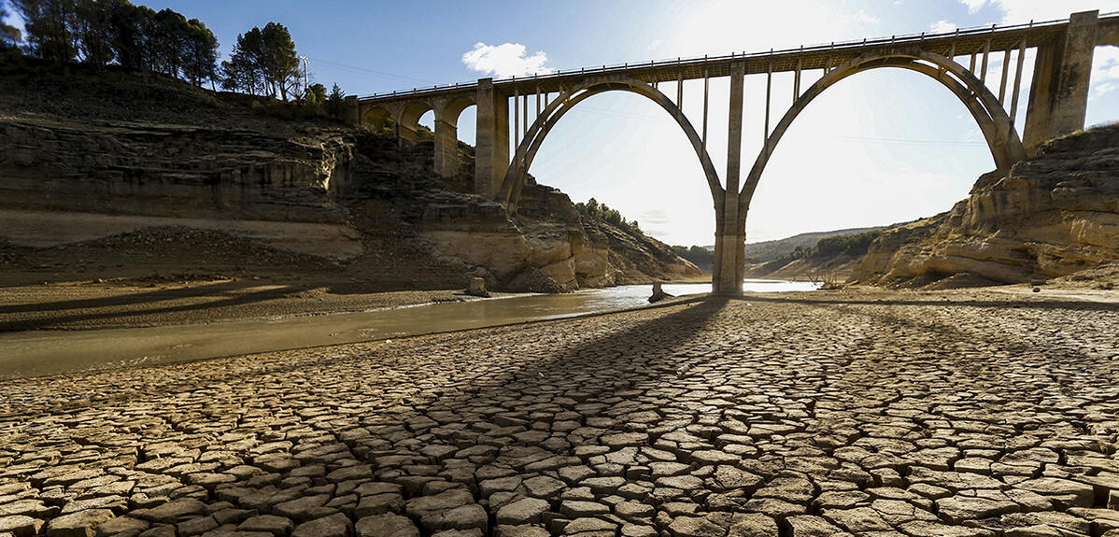
Notes:
Water is life! Without water, there is no hope for life, and many countries with shared borders may either clash or need to agree for their populations to survive.
And this is where the solemn, clear, and precise invitation of Jesus resonates. It’s an invitation we find in the Sermon on the Mount, where He urges His listeners, especially those who want to be His disciples, to "seek first the kingdom of God and His righteousness, and all these things will be added unto you." (Matthew 6:33). This search, ladies and gentlemen, should not primarily be a material pursuit, but rather a response to humanity’s deepest need. (I invite you to pray before we continue our reflection.)

Slide 4
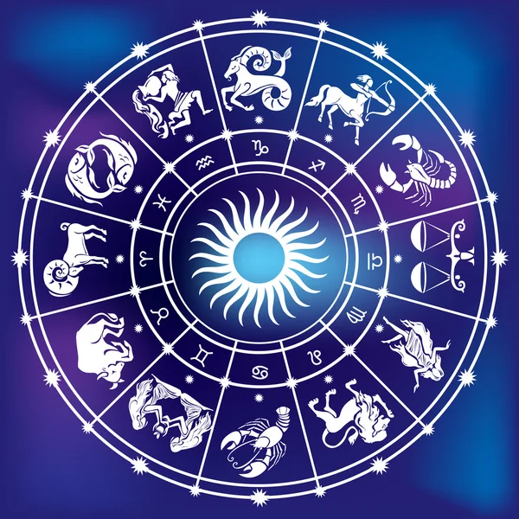
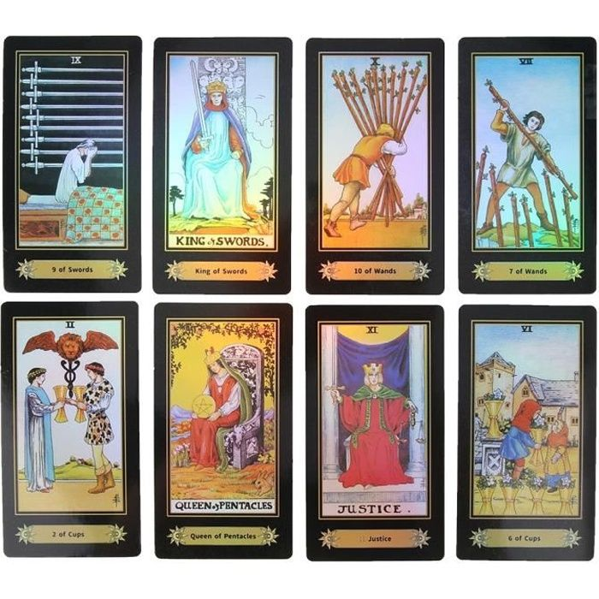
How long will this planet keep turning like this?
Notes:
In other words, what is the future of the world? Do you think it should be sought in horoscopes, crystal balls, or tarot cards?

Slide 5
How can we know the future of our world?
Notes:
On Google or Wikipedia, Facebook, and other search engines? Should we ask Artificial Intelligence to tell us about an interesting future, a dream future? Ladies and gentlemen, I invite you to listen to what the Bible, the Word of God, wants to say to you and me tonight.

Slide 6
« Seek first the kingdom of God and His righteousness, and all these things will be added unto you.»
(Matthew 6:33)
Notes:
Not just for us gathered here or connected, but for our loved ones, our families, our friends, for the whole world. Read this beautiful invitation with me: "Seek first the kingdom of God and His righteousness, and all these things will be added unto you." (Matthew 6:33).

Slide 7
« Seek first the kingdom of God and His righteousness, and all these things will be added unto you.»
(Matthew 6:33)
Notes:
Look closely at this text and memorize it.
It will be helpful in the decisive moments of your life. Jesus instructs His listeners—and us here in 2025—on humanity’s true needs. He speaks of existential needs like food, clothing, and other daily necessities, but He quickly draws attention to the priority pursuit: the kingdom of God and His righteousness!
And tonight, I would like to add questions that concern all of us, you and me. What is this kingdom? Where should we set our sights? Prayer or action? Meditation or agitation? Spiritual transformation or social reform? In other words, to put it simply: what difference would prioritizing the search for the kingdom of God make in my life? This kingdom does not come randomly or accidentally. It comes according to God's plan for humanity, impacted by evil and the consequences of sin—a plan that God has communicated to His prophets.
And tonight, I would like to add questions that concern all of us, you and me. What is this kingdom? Where should we set our sights? Prayer or action? Meditation or agitation? Spiritual transformation or social reform? In other words, to put it simply: what difference would prioritizing the search for the kingdom of God make in my life?

Slide 8
« Seek first the kingdom of God and His righteousness, and all these things will be added unto you.»
(Matthew 6:33)

Slide 9
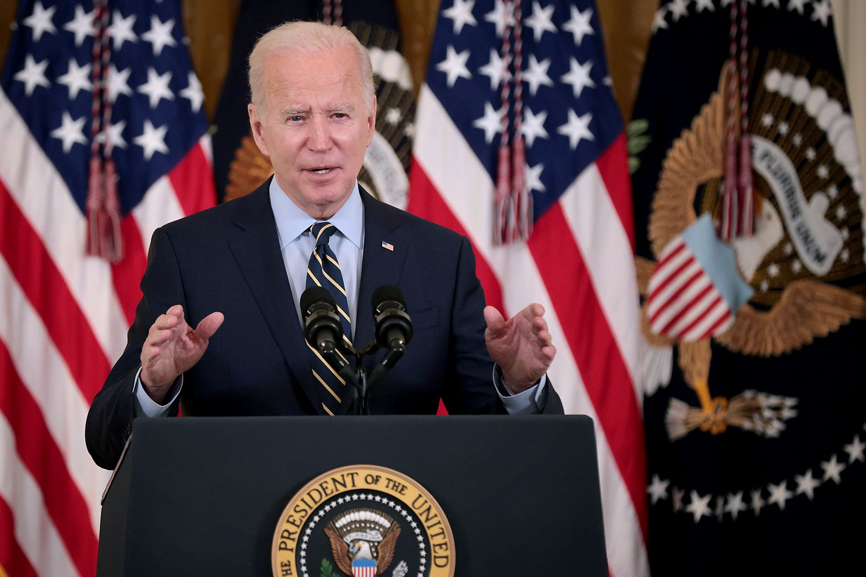
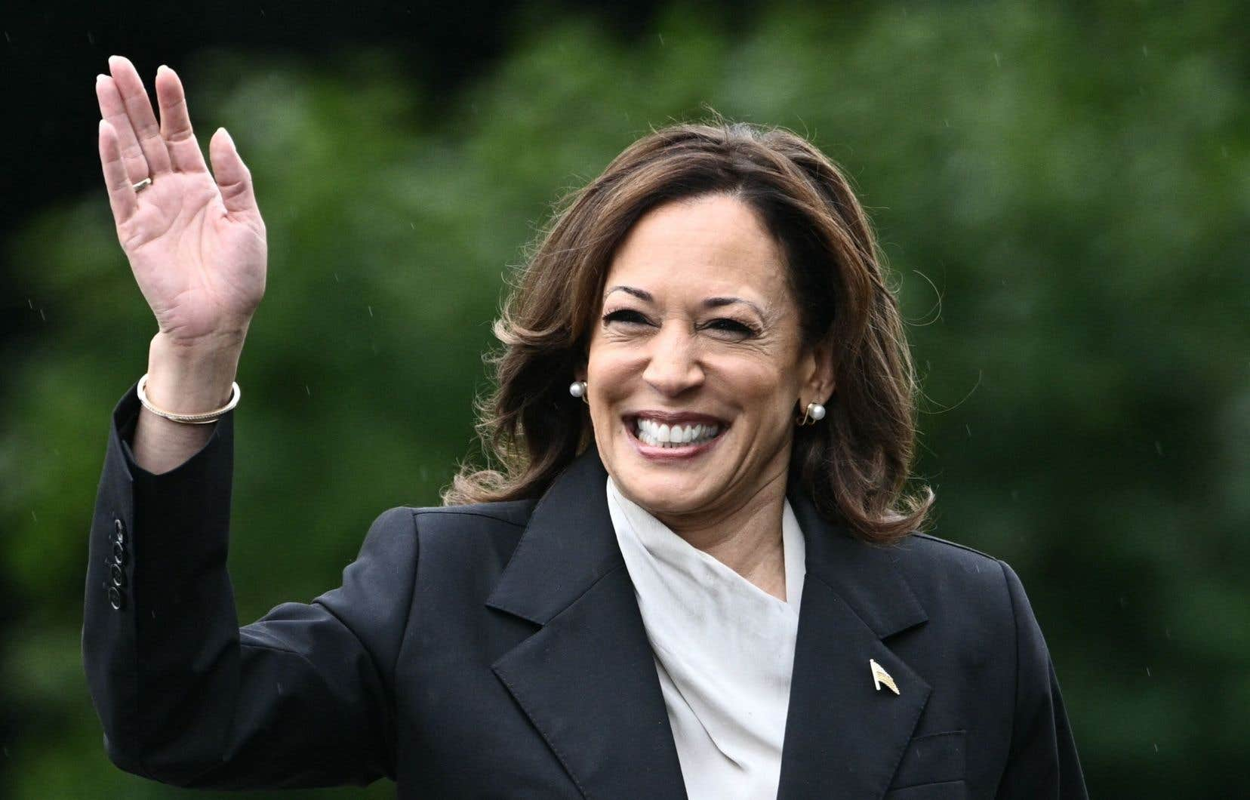
A Prophetic Picture
Notes:
Many of you may remember that last year, on Sunday, July 21st to be exact, the sitting American president, Joe Biden, announced that he would not seek re-election in the presidential race scheduled for November of that year. A shocking announcement made just four months before the election, following weeks of questioning his physical and mental fitness. The Democratic Party, aided by public opinion or certain celebrities, nominated Vice President Kamala Harris to carry the Democratic torch and defeat Donald Trump. And you know the rest…

Slide 10
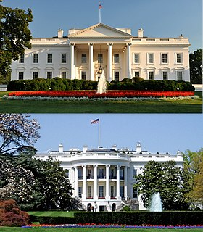
Notes:
Power attracts, but power also brings responsibility. Whatever our opinion may be, we must recognize the way some nations have built themselves into kingdoms or democracies. There are still dictatorships, authoritarian crises, and injustices in our world, and this doesn’t seem to improve over time as humanity becomes increasingly selfish and unconcerned with morality.
God wants to speak to us again, just as He spoke to people, even the mighty, in ancient times. More than 2,500 years ago, God took the time to speak to a powerful king to reveal the future of the world. When you hear this unique story tonight, you’ll understand more deeply why Jesus calls us to seek first the kingdom of God.

Slide 11
« But seek first the kingdom of God and His righteousness, and all these things will be added to you.(Matthew 6:33) »
Notes:
This is the solemn, clear, and precise invitation of Jesus that resonates here. An invitation we discover in the Sermon on the Mount, where He urges His listeners—and especially those who wish to become His disciples—to “seek first the kingdom of God and His righteousness, and all these things will be added to you.” (Matthew 6:33). This pursuit, ladies and gentlemen, should not primarily be a material pursuit, but rather a response to the deepest need of humanity.

Slide 12
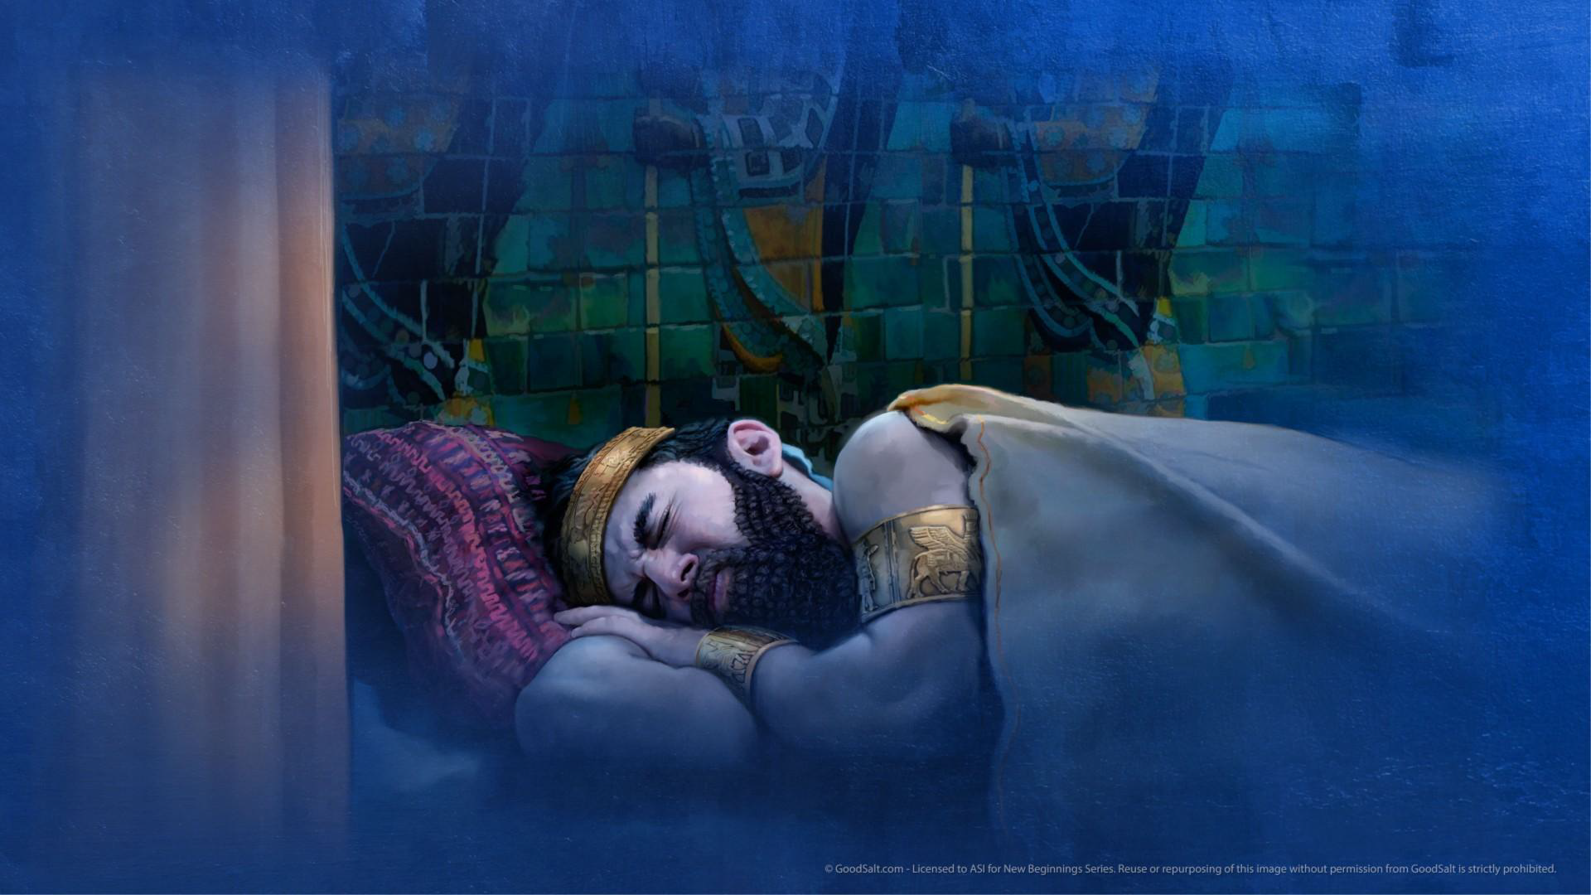
Notes:
The Bible tells the story of a king who had a dream and forgot its content. In the book of the prophet Daniel, in chapter 2, there is mention of a dream that King Nebuchadnezzar (or Nebuchadrezzar, as some may have read in various books or versions of the Bible) had during the night. He forgot what he dreamed, and Daniel, a young man inspired by God, reveals his dream to him. Here’s what he saw:

Slide 13
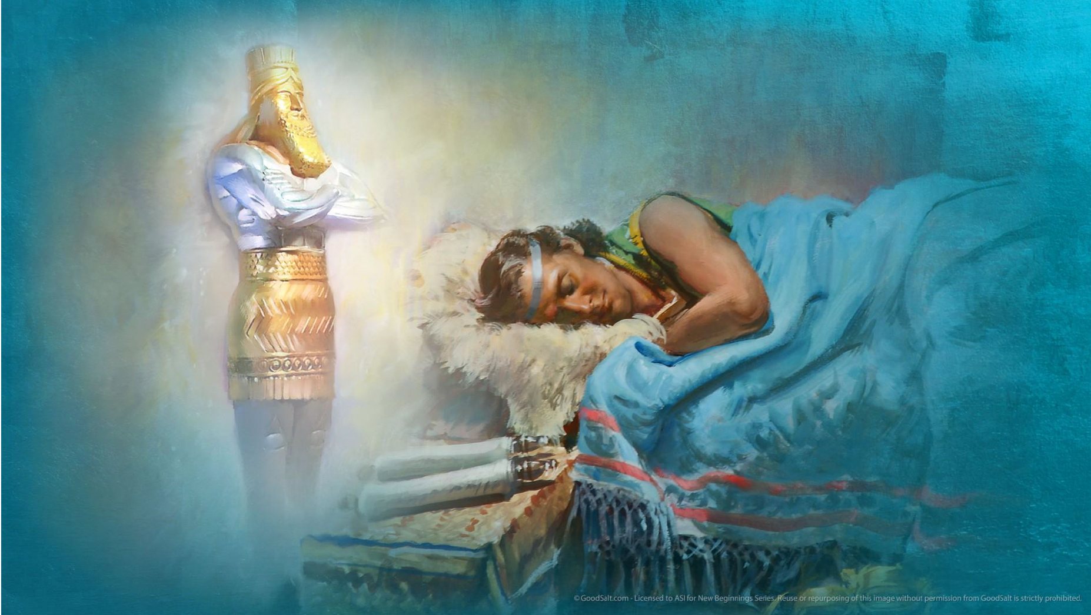
Notes:
The king does not realize that he has seen the future of the world in his dream…

Slide 14
Notes:
Then the prophet reveals to him the truth that comes from above…

Slide 15
Notes:
This truth is not the prophet's work but is revealed by the God of heaven…

Slide 16
Daniel responded before the king: “The mystery that the king demands is not something that the wise men, enchanters, magicians, or astrologers can reveal to the king; but there is a God in heaven who reveals mysteries, and He has made known to King Nebuchadnezzar what will happen in the latter days. Here is your dream, the visions that you had upon your bed.” (Daniel 2:27,28)
Notes:
(Read the biblical text) The king is troubled by two things: his lack of memory of the dream and the unusual nature of the image that the prophet describes to him.

Slide 17
Notes:
A statue composed of various metals, including an unusual alloy:
Head of gold
Chest and arms of silver
Belly and thighs of bronze
Legs of iron
Feet and toes partly of iron and partly of clay

Slide 18
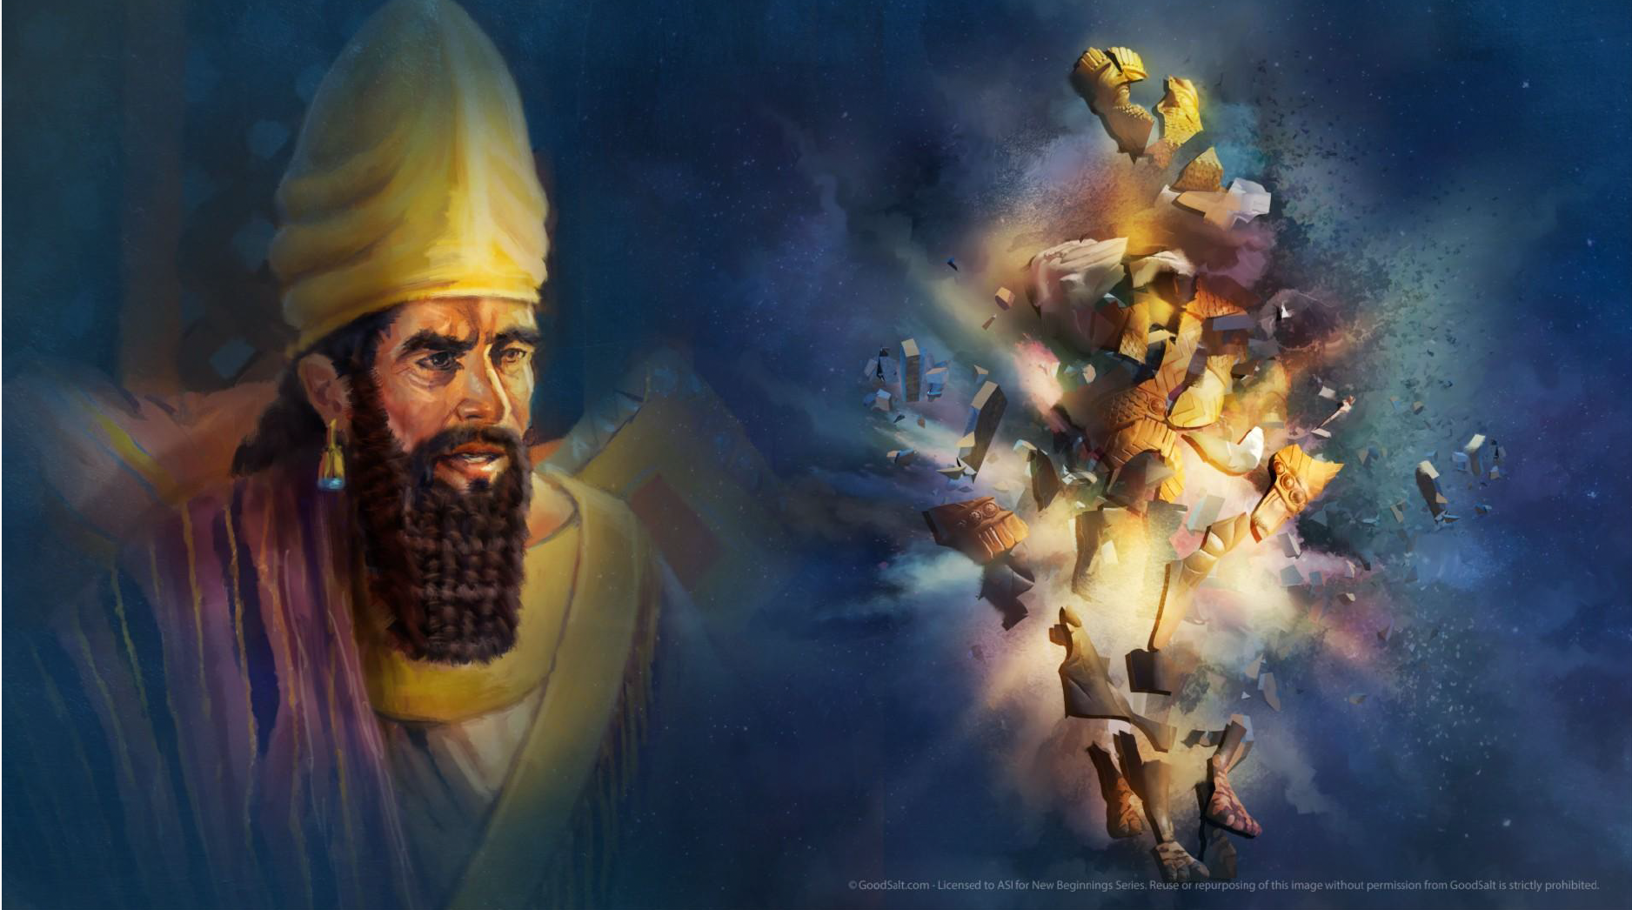

Slide 19
Notes:
Suddenly, a stone came and struck the statue, shattering it to pieces…

Slide 20
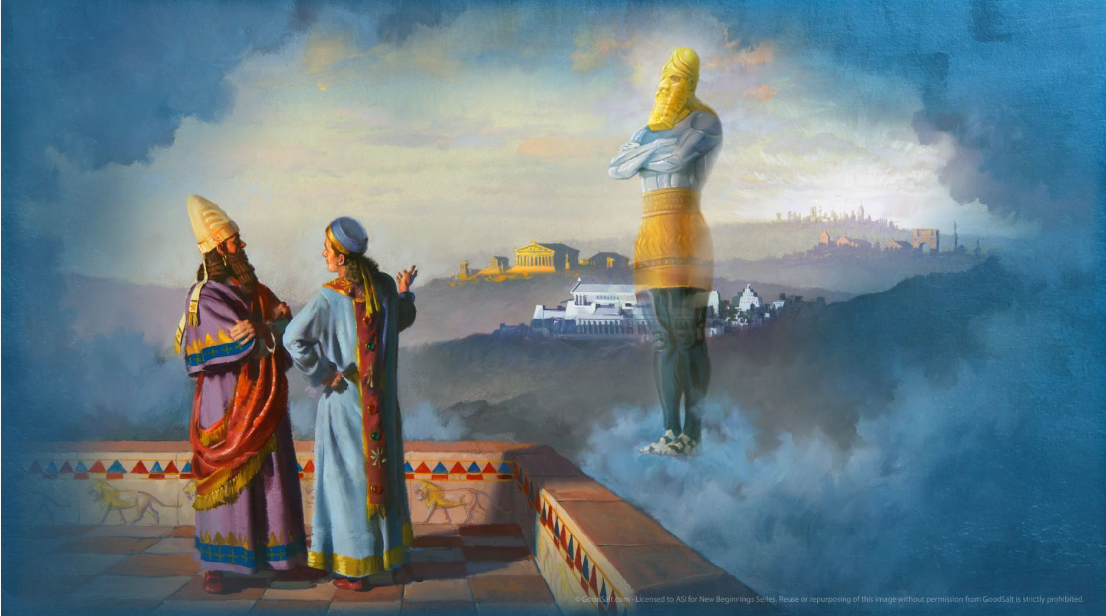
Head of gold
Chest and arms of silver
Belly and thighs of bronze
Legs of iron
Feet and toes partly of iron and partly of clay
Notes:
The prophet tells the king that he has seen a composite, hybrid statue:
Head of gold
Chest and arms of silver
Belly and thighs of bronze
Legs of iron
Feet and toes
According to the revealed interpretation, Daniel explained the meaning of the vision:

Slide 21
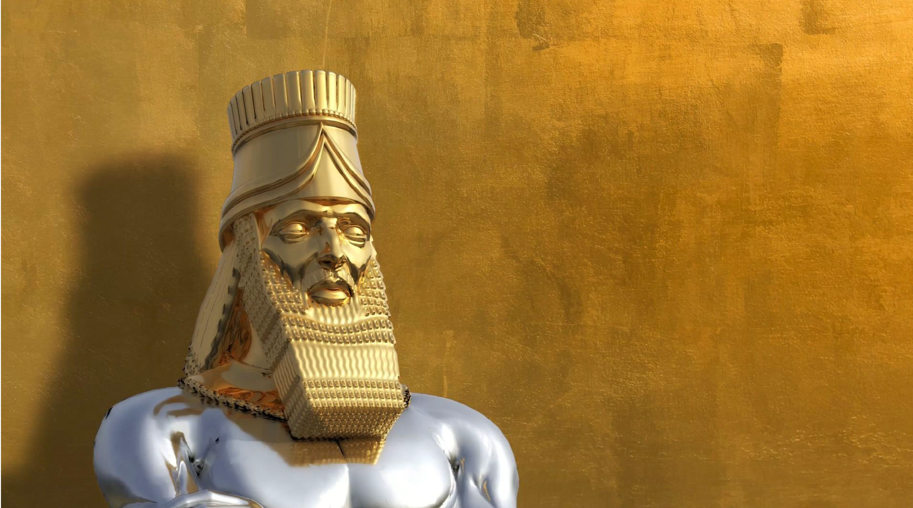
"You are the head of gold" - the kingdom of Babylon is represented by the king of metals: gold!
Notes:
Daniel begins with the king of Babylon to show the contemporaneity of the revelation and its immediate application. The revelation occurs live, without needing to consult old manuscripts to understand its interpretation. God reveals and provides the explanation through the prophetic voice...

Slide 22
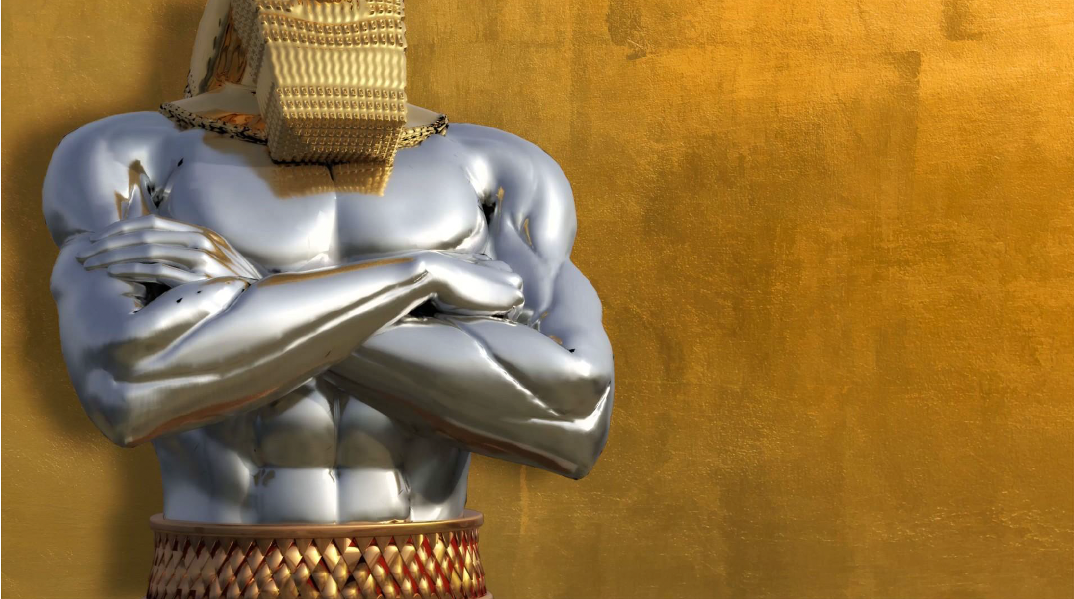
His chest and arms were of silver" (Daniel 2:32)
History tells us that after the Babylonian empire, the Medes and Persians dominated the world (silver).
Another kingdom will arise after you, inferior to yours." (Daniel 2:39a)
Notes:
After Babylon comes another kingdom... represented by silver. Lesser than gold but still significant. A second empire. History tells us that after the Babylonian Empire, it was the Medes and the Persians who would dominate the world (silver).

Slide 23
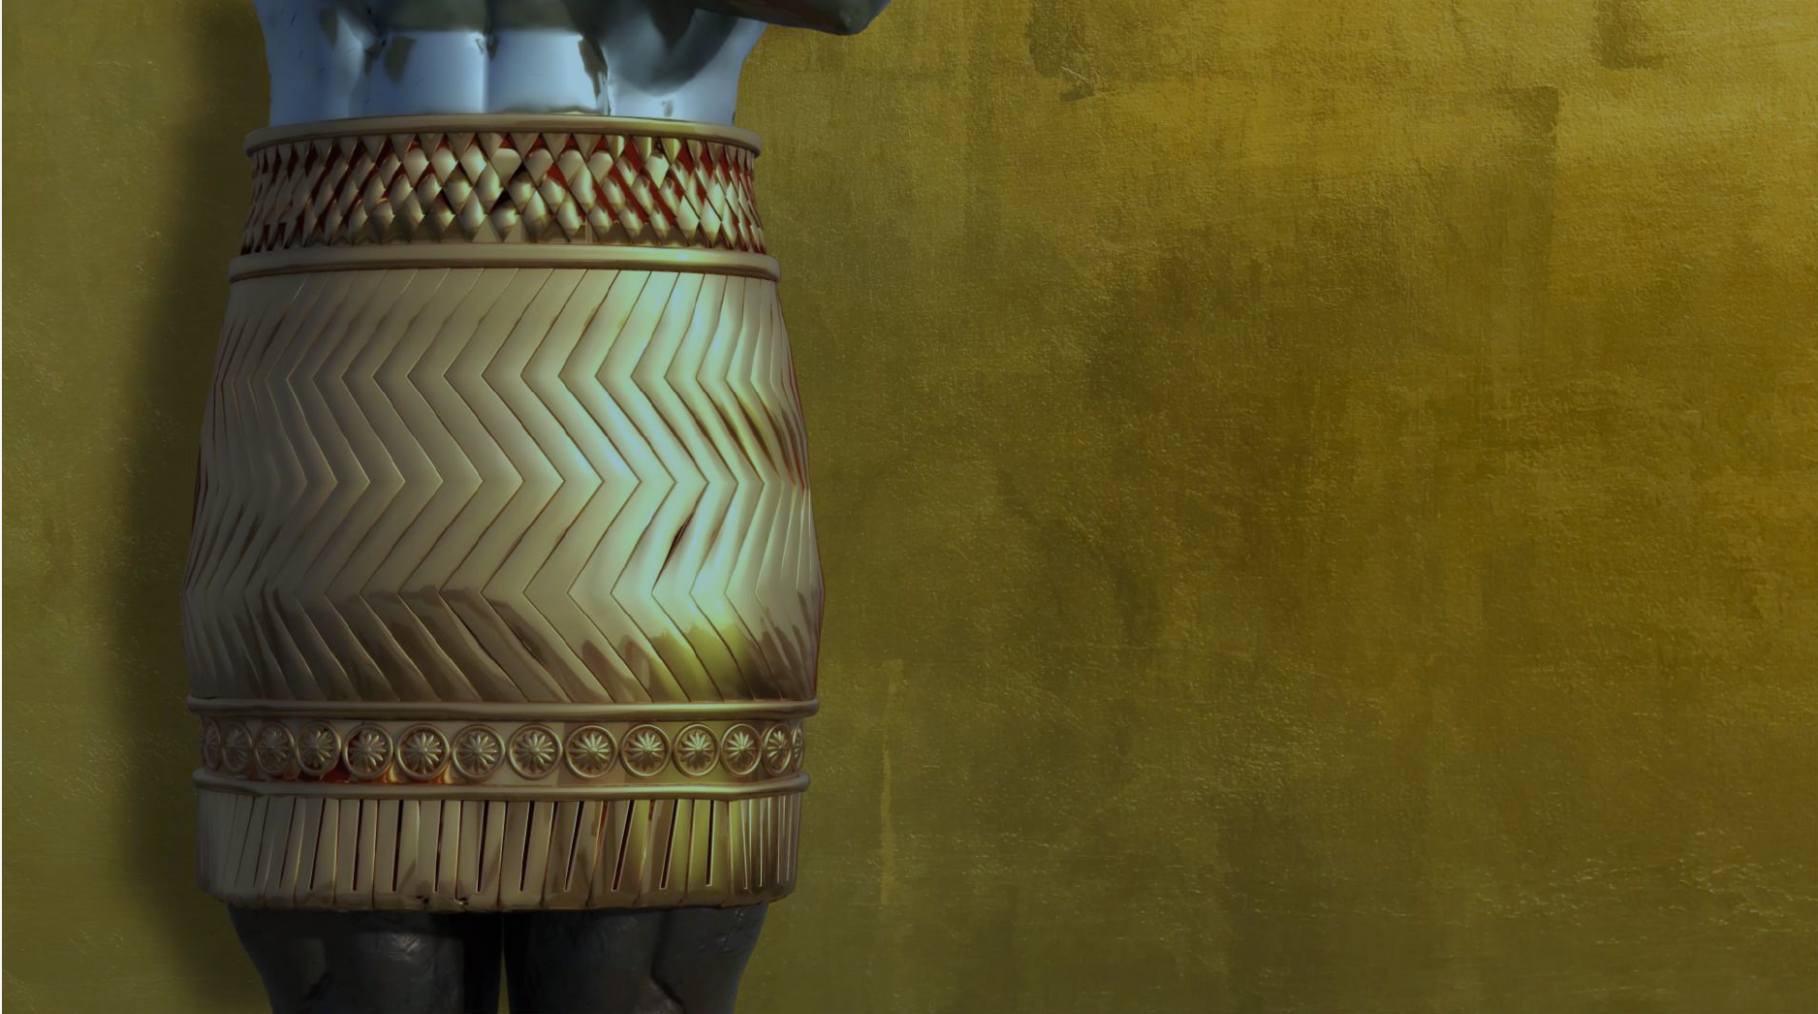
hen a third kingdom, which will be of bronze, and will rule over all the earth." (Daniel 2:39b)
History confirms that after the Medes and Persians, the Greeks, with Alexander the Great as their most prominent figure, would indeed dominate the world—from Europe to the edges of India.…
Notes:
Then a third kingdom, which will be of bronze, and will rule over all the earth." (Daniel 2:39b) History confirms that after the Medes and Persians, the Greeks, with Alexander the Great as their most prominent figure, would indeed dominate the world—from Europe to the edges of India.…

Slide 24
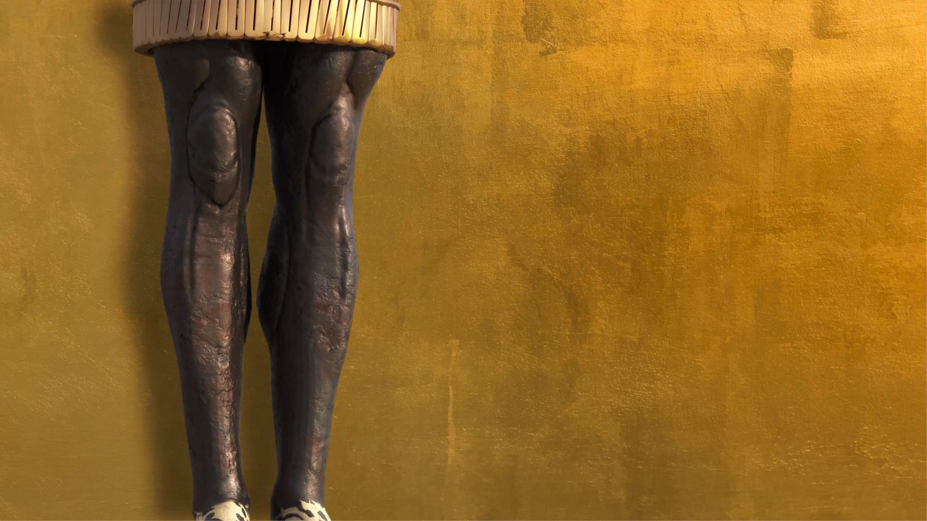
« There will be a fourth kingdom, as strong as iron; just as iron crushes and shatters everything, it will crush and break everything, like iron that breaks all." (Daniel 2:40)»
What other kingdom embodies iron, if not Rome (or the Roman Empire) — hard as iron, ruthless, efficient, and irresistible?
Notes:
There will be a fourth kingdom, as strong as iron; just as iron crushes and shatters everything, it will crush and break everything, like iron that breaks all." (Daniel 2:40)
What other kingdom embodies iron, if not Rome (or the Roman Empire) — hard as iron, ruthless, efficient, and irresistible?

Slide 25
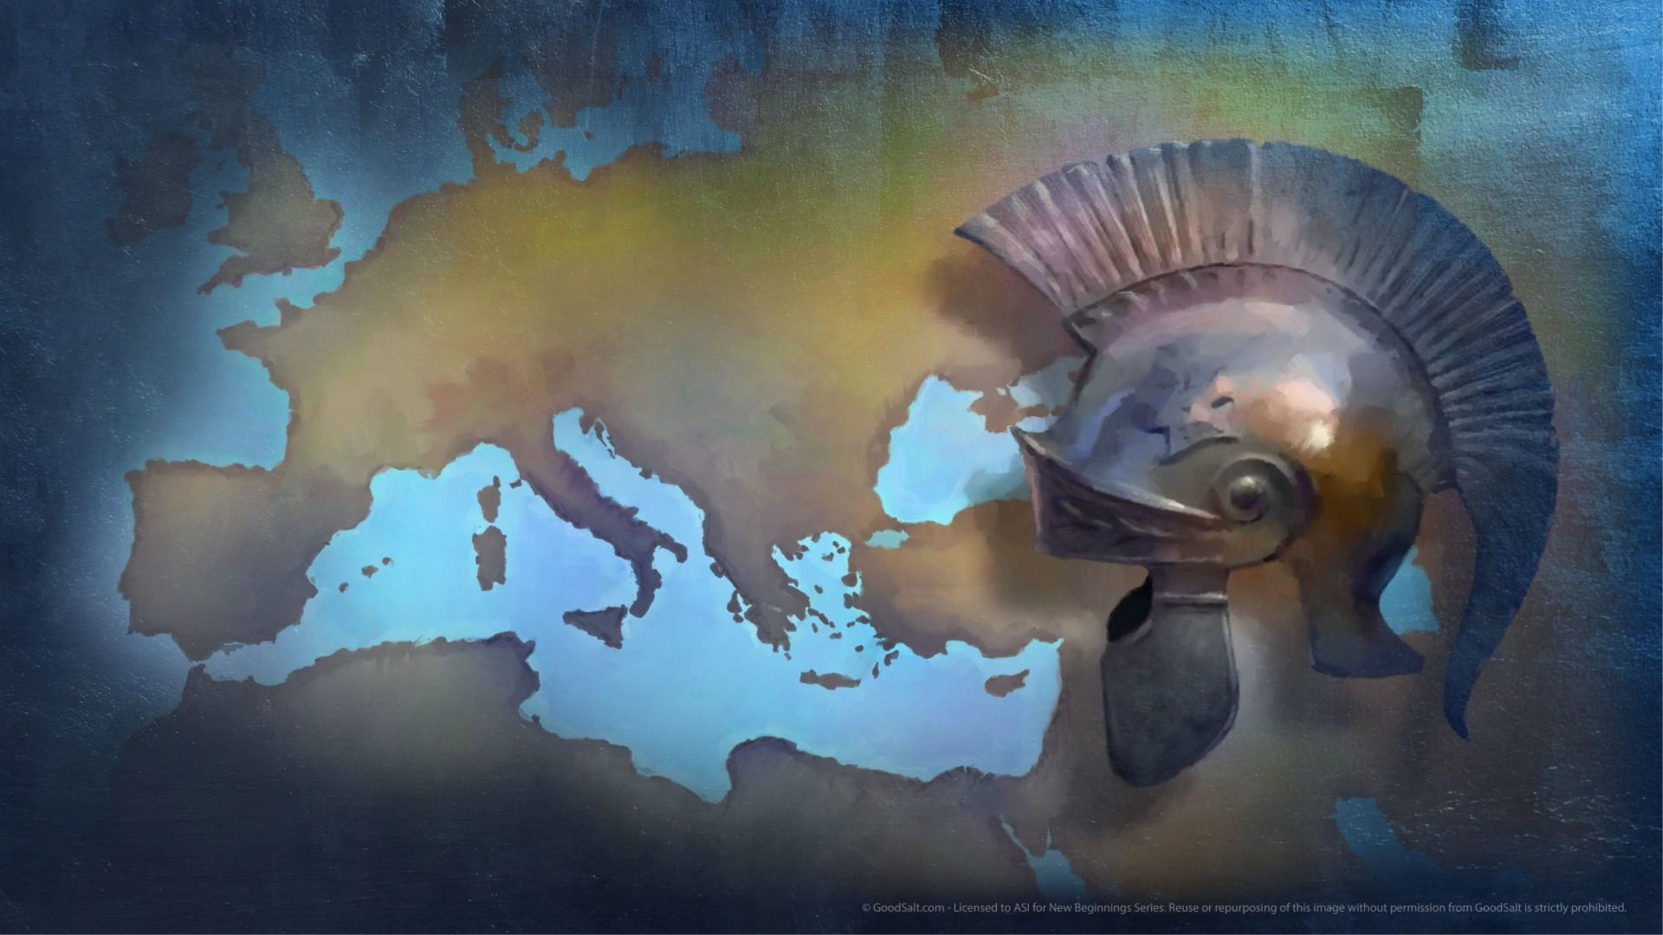
Notes:
The Roman Empire would be built with even more power, a stronger will for conquest and domination.

Slide 26
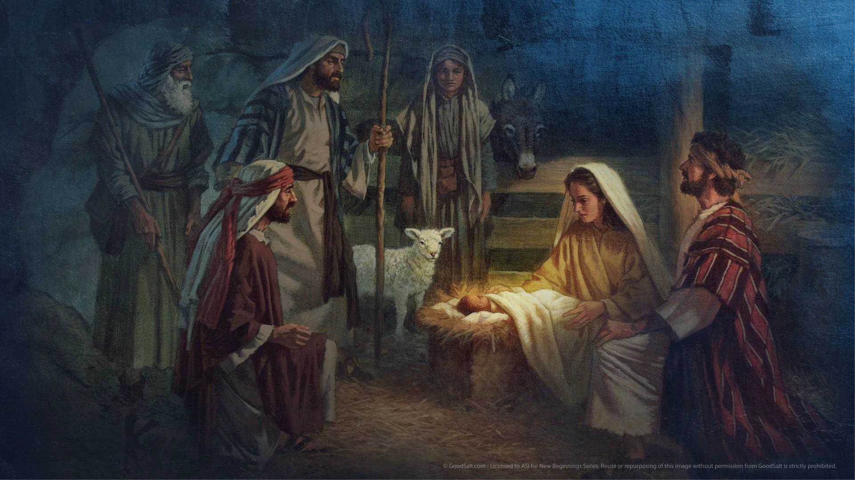
Notes:
And quite spectacularly, Jesus would be born under the Roman Empire, in an occupied Palestine; in His wisdom, God chose to have His beloved Son born under the authority of an empire so that the Good News of the coming of His kingdom would resonate even more strongly throughout the world. It is interesting to note that the prophet had the privilege of contemplating history, including the two comings of Jesus. No detail of the first coming is given, but the final phase of history is already announced.

Slide 28
« And as you saw the feet and toes, partly of potter’s clay and partly of iron, this kingdom will be divided; but there will be in it some of the strength of iron, because you saw iron mixed with clay. And as the toes of the feet were partly of iron and partly of clay, this kingdom will be partly strong and partly brittle." (Daniel 2:41-42)
Notes:
Daniel did not announce a fifth universal kingdom, but rather the breakup of the fourth kingdom — the Roman Empire. Indeed, it weakened from within and was eventually conquered by barbarian tribes.

Slide 29
« You saw the iron mixed with clay because they will mix through human alliances; but they will not hold together, just as iron does not mix with clay." (Daniel 2:43)
Notes:
Like the toes of the statue, these tribes were ten in number. Seven of them became the origins of seven European nations, while the other three disappeared, merging into populations where they settled or blended with others through alliances. Like the toes of the statue, these tribes were ten in number. Seven of them became the origins of seven European nations, while the other three disappeared, merging into populations where they settled or blended with others through alliances. These tribes formed Europe:

Slide 30
From the Roman Empire to Europe
The Saxons, the origin of the English nation.
The Franks, the origin of the French nation.
The Alemanni, the origin of the German nation.
The Visigoths, the origin of the Spanish nation.
The Suebi, the origin of the Portuguese nation.
The Lombards, the origin of the Italian nation.
The Burgundians, the origin of the Swiss nation.
The Heruli, now extinct.
The Vandals, now extinct.
The Ostrogoths, now extinct.
Notes:
This number can be understood literally, in a quantitative sense. However, remember that the number 10 (represented in Hebrew by the letter yod, the smallest letter of the alphabet—equivalent to the Greek iota) symbolizes the minimum that can signify much. Whether the Roman Empire was fragmented and reconstituted into about ten nations (or more), the question remains open. What is clear here is the continuity and replacement of the Roman Empire by the nations that gradually formed Europe.

Slide 31
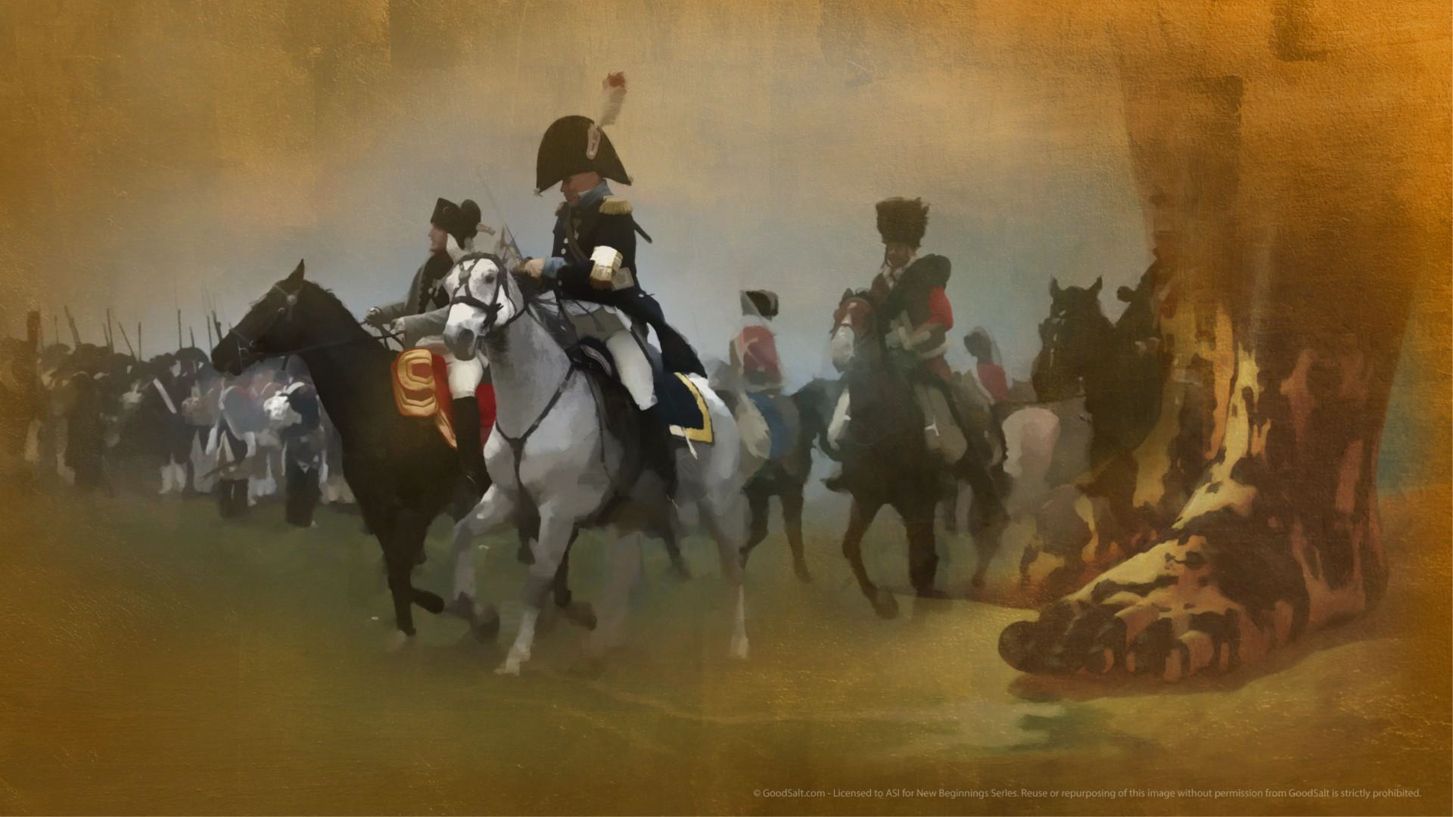
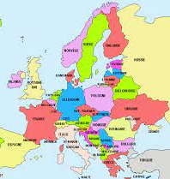
Notes:
The Development of Modern Europe
In the 20th century, Europe began with six founding nations (France, the Federal Republic of Germany, Italy, Luxembourg, Belgium, and the Netherlands). In less than a century, it expanded to 12 member states, then 25, and eventually 28. Later, the United Kingdom distanced itself through Brexit.
The war in Ukraine has demonstrated Europe's unity in implementing economic sanctions and military aid, though consensus on issues like deploying troops to the battlefield remains elusive. Agreement and disagreement are part of Europe’s internal dynamics, sustaining its organization. Many projects have reshaped the cultural, religious, social, technical, and financial landscape of Europe.

Slide 32
Notes:
Unity remains difficult to achieve between secular liberals and religious liberals. Western Europe, increasingly entrenched in an intolerant secularism, faces the demands of Eastern European nations that assert a nationalism rooted in a strict interpretation of Christianity. Consider countries like Poland, Hungary, and Austria.
Since the papacy of John Paul II, the first Polish pope, there has been a resurgence of Catholic influence. His leadership contributed to the fall of communism and the collapse of the Iron Curtain between Eastern and Western Europe. As a result, everything became possible, and each nation sought to find its place in a constantly evolving Europe.
Biblical prophecy had already foretold the fragility of relations among “these kings” and their alliances. While they exist, they remain intrinsically weak, as depicted in the image of "iron mixed with clay." The future had already been revealed…

Slide 33
Notes:
Daniel prophesied that despite all efforts, European nations would not unite to form a fifth empire. Throughout history, leaders like Charlemagne, Charles V, Louis XIV, Napoleon, Wilhelm II, and Hitler attempted to unify Europe under a single ruler, but all failed.
French President François Mitterrand (1981-1995) spoke of a Europe stretching “from the Atlantic to the Urals.” Since the expansion to 28 members and the Brexit, efforts have continued to position the European Union as a global power comparable to the United States. However, unlike the USA, which has a single language and currency, Europe’s linguistic and monetary diversity often hinders its progress and growth. Furthermore, differences in political cultures result in one step forward and two steps back. Yet Europe persists and raises its voice when necessary.

Slide 34
Notes:
Europe is both strong and weak. Consider the aftermath of Brexit. Everyone appears to be making efforts to facilitate the “divorce,” but no one wants to do it amicably. Internal crises in the UK should not disrupt or slow down European integration. Whether the withdrawal is orderly or not, the implications—economic, tourist, monetary, free movement, pensions, etc.—are significant. Ultimately, everyone seems more concerned about their own interests than those of their neighbors.
European leaders know that sooner or later, the risk of implosion could threaten the EU's unity.

Slide 35
Notes:
In past centuries, ruling families maintained Europe’s unity and peace through intermarriage, creating political, administrative, and military stability. However, things have changed since European nations built democratic frameworks, facilitating harmony through institutions like the European Commission in Brussels and the European Parliament in Strasbourg.
Despite these efforts, history remembers that both World Wars originated in Europe and were primarily fought on the continent. Strong yet fragile? Prophecy had already written this history…

Slide 36
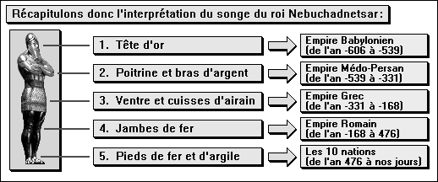
Notes:
Through the prophet Daniel, God revealed to the king the history of nations until the end of the world. (Refer to the slide chart for details)

Slide 37
Notes:
God provides a revelation through a dream and a statue to paint a picture of civilizations from Babylon to the end of this current history. By revealing the future, God not only unveils His plans to Daniel but also to Nebuchadnezzar, the conqueror who would ultimately be conquered by one greater and stronger than himself. Nebuchadnezzar is confronted with his personal story, placed at the heart of History—and, most importantly, with the true meaning of the history of our planet.

Slide 38
Turning a Stone into a Mountain
Notes:
This expression takes on profound significance, directing the biblical reader toward a teleological dimension of history.

Slide 39
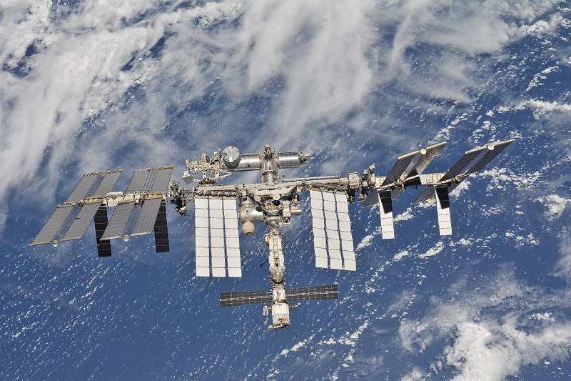
La Station Spatiale Internationale (SSI/ISS)
Notes:
Did you know that the International Space Station (ISS) is positioned in orbit approximately 400 km above Earth? It orbits our planet continuously at a constant speed of 28,000 km/h, unhindered by atmospheric resistance. Its purpose is to observe the state of our planet.
From above, Earth can appear both beautiful and degraded. Areas impacted by the melting of eternal snow or polar glaciers do not inspire confidence. Yet, even at this speed and with such a breathtaking view, no astronaut has ever suggested that we look higher for the future of our planet. Admiring the heavens without seeking God, being concerned about the Earth without acknowledging its Creator—this is the harsh truth about humanity since the Tower of Babel.
However, the Word of God spans the centuries and transcends humanity's greatest scientific achievements because it provides assurance about the future.

Slide 40
"While you were watching, a rock was cut out, but not by human hands. It struck the statue on its feet of iron and clay and smashed them." (Daniel 2:34)
Notes:
A rock shatters the fictional monument. A celestial rock breaks the statue of earthly history. This narrative does not lead us to a grim conclusion about the story of our planet. Heaven takes responsibility for this history, but the prophetic book tells us that the key to human history rests in the hands of the One who reigns in the heavens.
Only God can tell the story of the world’s future. The image is beautiful, and the theological teaching is even more powerful.
The rock is cut out of a mountain (v. 45). This is not a meteorite striking the Earth to usher in a new geological era. Instead, the rock is cut from a greater whole, becoming itself a great mountain that fills the entire Earth (v. 35), creating a unified entity.

Slide 41
“Then the iron, the clay, the bronze, the silver and the gold were broken to pieces and became like chaff on a threshing floor in summer. The wind swept them away without leaving a trace. But the rock that struck the statue became a huge mountain and filled the whole earth.” (Daniel 2:35)
Notes:
This stone is stronger than the other metals that make up the statue. It represents divine power—unmatched and irresistible. It is neither gold, silver, bronze, nor even iron that breaks the statue.
The iron mixed with clay symbolizes the transition of history from great empires to smaller, more fragile kingdoms. As the history of nations progresses, it becomes increasingly fragile, inevitably moving toward weakness, until divine intervention occurs.
However, it is during the time of the European entities that the reign of Jesus will be established...

Slide 42
"This is the meaning of the rock cut out of a mountain, but not by human hands, that crushed the iron, the bronze, the clay, the silver, and the gold to pieces. The great God has shown the king what will take place in the future. The dream is true, and its interpretation is trustworthy." (Daniel 2:45)
Notes:
However, the explanation given to the prophet goes beyond earthly powers. His mind was marked by an event whose origin is neither human nor earthly, but extraterrestrial! A rock is cut “from the mountain, but not by human hands” and strikes the feet of the statue.
This colossus, which represents the history of nations, rests on the fragility of human history—on the limitations of world leaders, ideological politics, military, industrial, and economic wars, conquests, occupations, and other forms of earthly or spatial domination.
Human observers learn (or must learn) that the true eternal kingdom can only come from the eternal God!
Nebuchadnezzar is confronted with a prophetic truth: the God of heaven has the power to sweep away history and establish His kingdom. The future is laid bare before a shaken king:

Slide 43
Notes:
Chapter 2 provides the first historical tone to the book of Daniel. This is the first time that the history of great civilizations is told in the future tense.
Nebuchadnezzar acknowledges it: only the God of Daniel, the God of heaven—who is above gods and kings, presidents, and prime ministers—is capable of such a demonstration. He is the Revealer of the future!

Slide 44
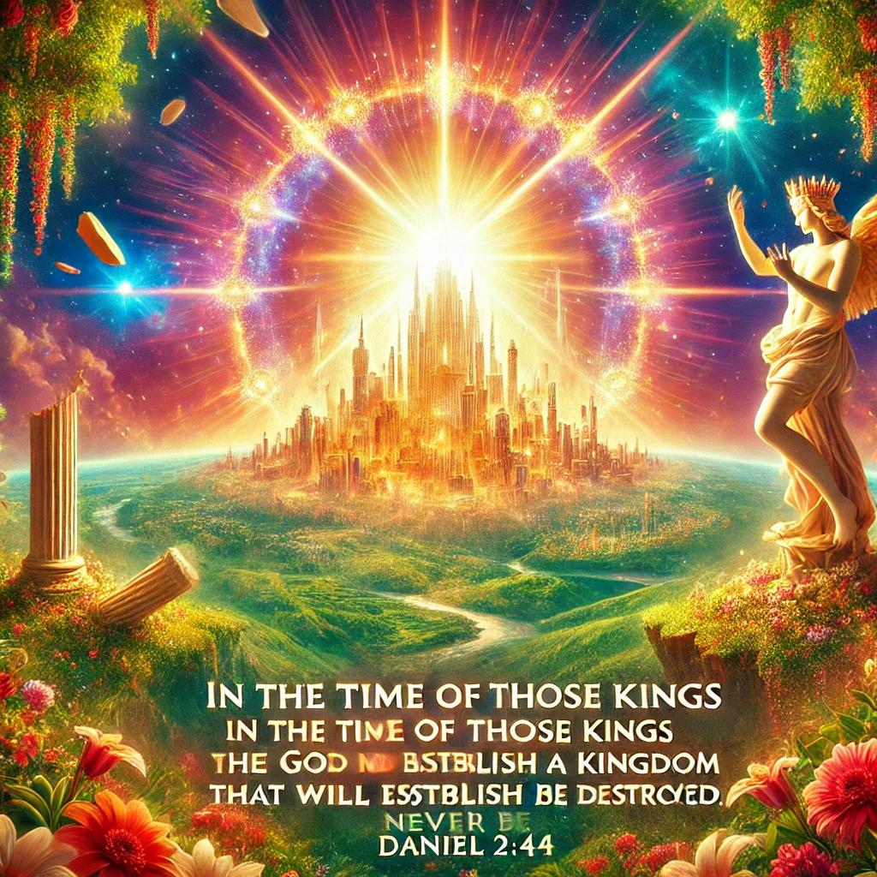
Notes:
The hybrid statue, a symbol of human mixtures and alliances—their politics, cultures, and projects—gives way to a stone, a unique and homogeneous material. What comes from the mountain symbolically comes from above, and therefore from God.
The mountain reflects the divine throne, the heights, the elevated places—sometimes inaccessible, sometimes revealed to men, especially to the prophets...

Slide 45
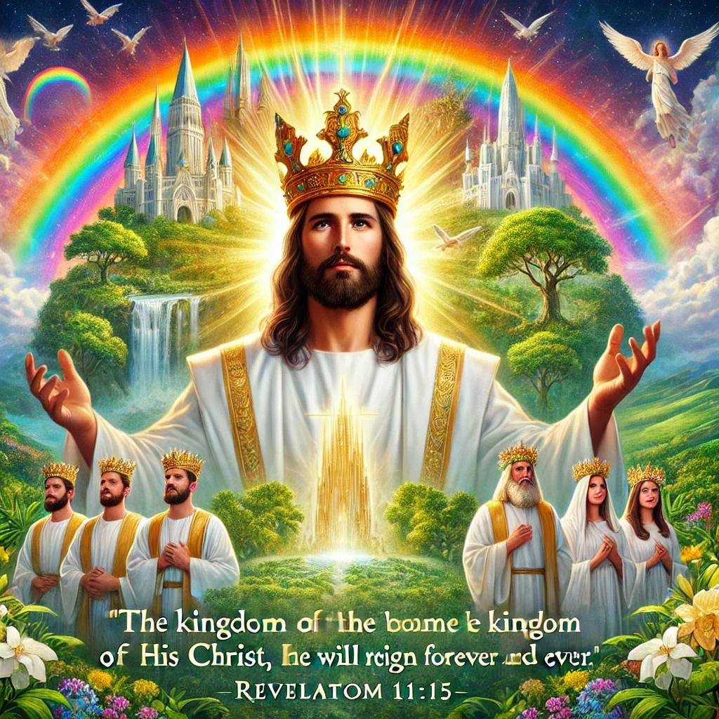

Slide 47
Notes:
This king acknowledges the power of the God who alone can reveal the future. But what about you tonight, ladies and gentlemen, and even you, the younger ones?
It is neither politicians, nor bankers, nor even environmentalists who will shape the true future of the world. The Bible clearly states that during the time of the European nations, the God of heaven will establish His kingdom.
This means that the return of Jesus will occur during the era of the nations of the European Union. We do not know how long this alliance among the peoples, heirs of the Roman Empire, will last, but we do know that it will happen during their existence.
You are not just informed—you are warned. Even more, you are receiving a clear and non-negotiable instruction.

Slide 48
Notes:
Chapter 2 sets the first historical tone in the book of Daniel. It is the first time that the history of great civilizations is told in the future tense.
Nebuchadnezzar acknowledges it: only the God of Daniel, the God of heaven—who is above gods and kings, presidents, and prime ministers—is capable of such a demonstration. He is the Revealer of the future!

Slide 49
"For as the new heavens and the new earth that I make shall remain before me, declares the Lord, so shall your offspring and your name remain. From new moon to new moon, and from Sabbath to Sabbath, all flesh shall come to worship before me, declares the Lord." (Isaiah 66:22-23)
Notes:
Listen to the words of the prophets and apostles who speak of the coming of the kingdom of God: The kingdom of God is advancing. Soon, it will fulfill what it has promised: new heavens and a new earth.
“For as the new heavens and the new earth that I make shall remain before me, declares the Lord, so shall your offspring and your name remain. From new moon to new moon, and from Sabbath to Sabbath, all flesh shall come to worship before me, declares the Lord.” (Isaiah 66:22-23)

Slide 50
"The Lord is not slow in keeping his promise, as some understand slowness. Instead, he is patient with you, not wanting anyone to perish, but everyone to come to repentance. But the day of the Lord will come like a thief. The heavens will disappear with a roar; the elements will be destroyed by fire, and the earth and everything done in it will be laid bare." (2 Peter 3:9-10)
Notes:
"The Lord is not slow in keeping his promise, as some understand slowness. Instead, he is patient with you, not wanting anyone to perish, but everyone to come to repentance. But the day of the Lord will come like a thief. The heavens will disappear with a roar; the elements will be destroyed by fire, and the earth and everything done in it will be laid bare." (2 Peter 3:9-10)

Slide 51
"According to the Lord’s word, we who are still alive, who are left until the coming of the Lord, will certainly not precede those who have fallen asleep. For the Lord himself will come down from heaven, with a loud command, with the voice of the archangel and with the trumpet call of God, and the dead in Christ will rise first." (1 Thessalonians 4:15-16)
Notes:
"Soon, when Jesus returns, He will offer resurrection to all those who have placed their faith and trust in Him."

Slide 52
Notes:
"Jesus wants to welcome you into His Father’s house. The kingdom of heaven, which Jesus invites us to seek with all our hearts, is accessible. We have nothing to pay for it—He has done it all. Are you ready to hear these words from Jesus: ‘Come, you who are blessed by my Father…’?"
The hybrid statue, a symbol of human mixtures and alliances—their politics, cultures, and projects—gives way to a stone, a unique and homogeneous material. What comes from the mountain symbolically comes from above, and therefore from God.
The mountain reflects the divine throne, the heights, the elevated places—sometimes inaccessible, sometimes revealed to humanity, especially to the prophets…

Slide 53
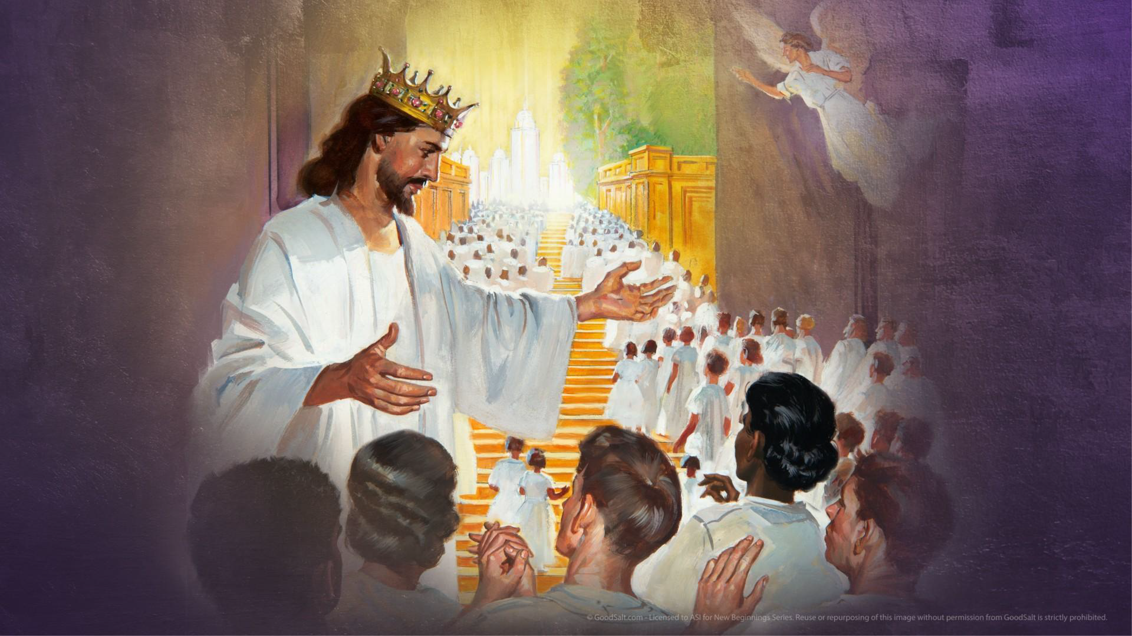
Notes:
"I have a reassuring vision of the future, even though the world is troubled and evil is growing. That is why, this evening, I invite you, based on the words of Jesus, to seek first the kingdom of God. He has already revealed the direction in which history is heading.
Before concluding tonight, I would like, in all simplicity, to invite you to consider this unique God who is capable of revealing the future of our planet. If you are convinced, listen closely to Jesus’ invitation to ‘seek first the kingdom of God and His righteousness…’.
(Let us pray to the Lord)"

Slide 54
IMPACT IOUC 2025

